Slide 1
Towards Easy Comparison of Local Businesses Using Online Reviews
Yong Wang¹, Hammad Haleem¹, Conglei Shi², Yanhong Wu³, Xun Zhao¹, Siwei Fu¹ and Huamin Qu¹
1
2
3
Notes:
Hello, everyone, welcome to my presentation. I am Yong Wang, from Prof. Huamin Qu's research group in the Hong Kong University of Science and Technology.
The title of our work is “towards …”. This is actually a collaboration work between our team, airbnb and visa research.

Slide 2
Background
Notes:
So before going to the technique details, let me first introduce the overall background and initial motivation of this work.

Slide 3
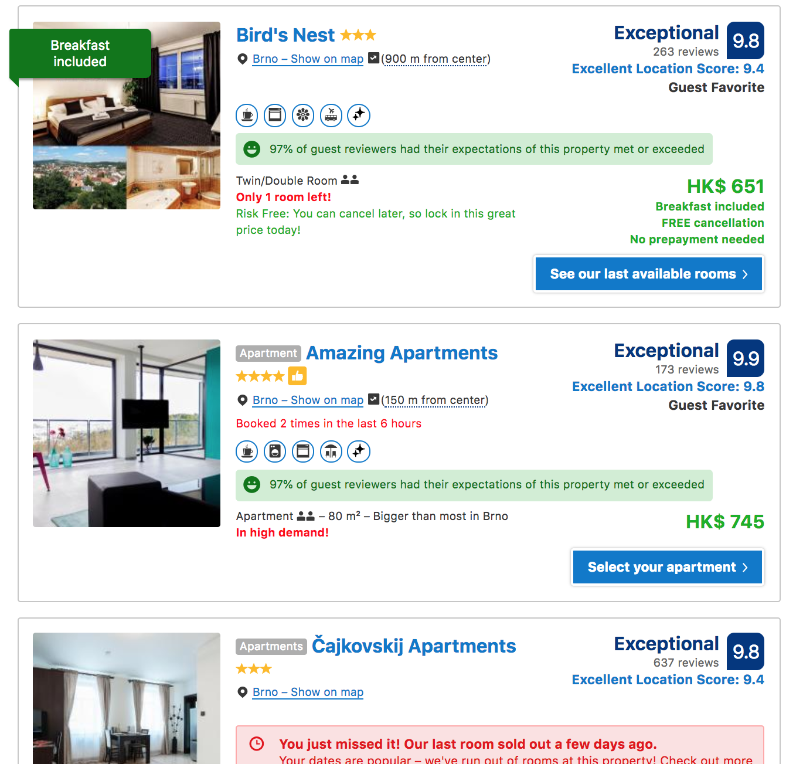
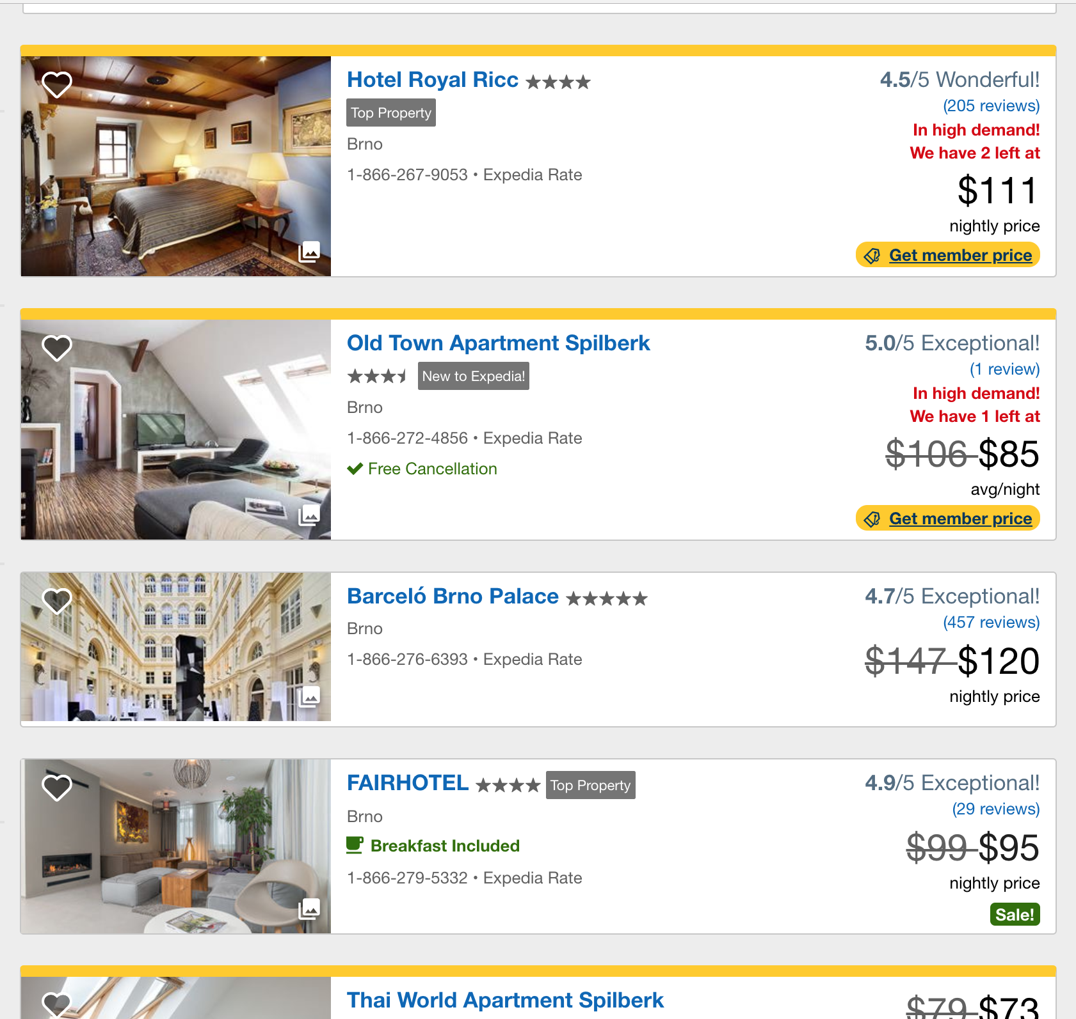
Review Platforms
Yelp
Airbnb
TripAdvisor
Various review platforms provide users with detailed customer comments about local businesses!
Notes:
As we all know, nowadays, numerous customer review platforms have been launched, for example, Yelp, TripAdvisor, Airbnb,.
All of them allow users to post reviews for the local businesses, like restaurants, shops,, hotels , so on an so forth. The reviews often consist of both a numeric rating and a text description.
=====
amazon, taobao, Alibaba

Slide 4
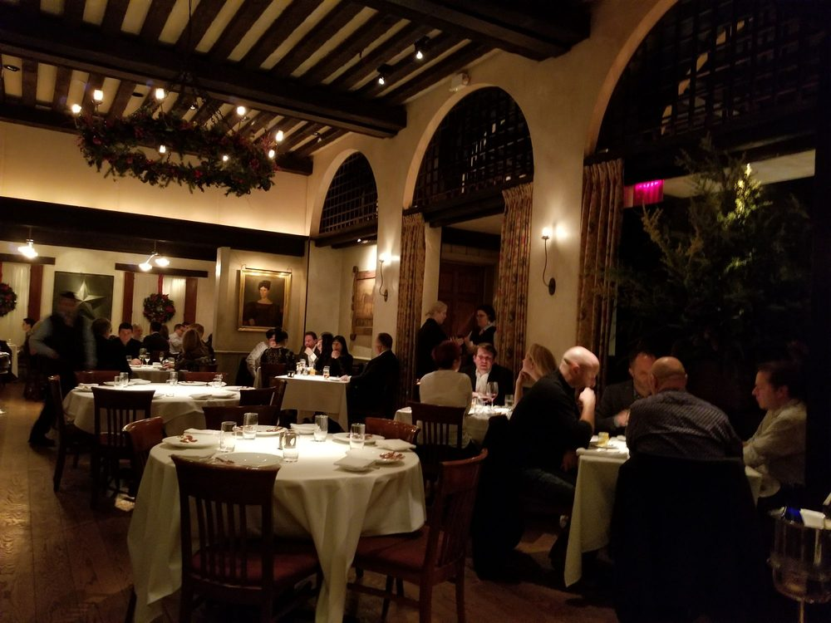
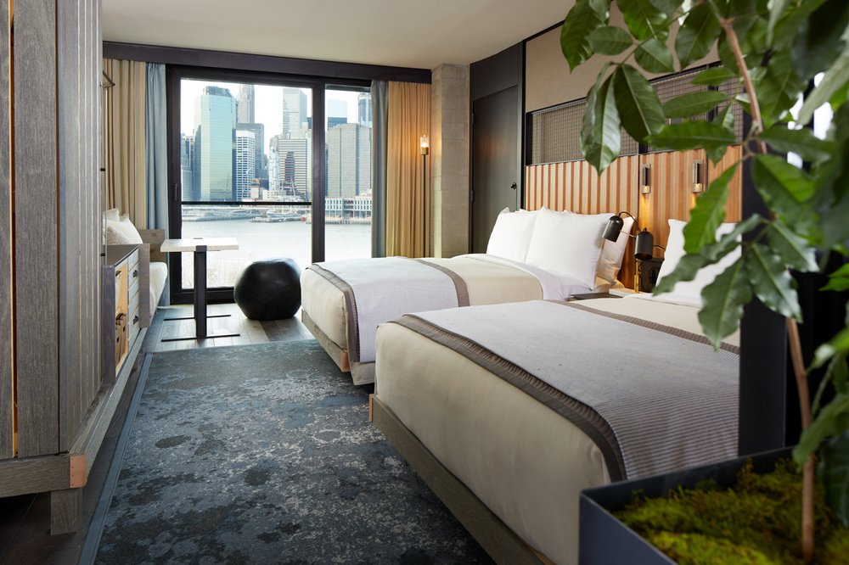
Online Reviews vs Purchase Decisions
Three-quarters of travelers have considered online reviews when planning their trips ^{[1]}
[1] Gretzel, U., & Yoo, K. H. (2008). Use and impact of online travel reviews. Information and communication technologies in tourism, 35-46.
Notes:
These online reviews have become a major resource to help customers make a good purchase decision in many application scenarios, for example, finding a good restaurant for an important celebration, choosing a professional barbershop for a stylish haircut or booking a suitable hotel for a distant trip.
Sometimes, the online reviews may even be the only resource for us to make a good purchase decision. For example, this is my first time to Europe, and I have no friends in Brno, then I can only rely the online reviews to book a hotel.
Some researchers have demonstrated that three-quarters of travelers have …

Slide 5
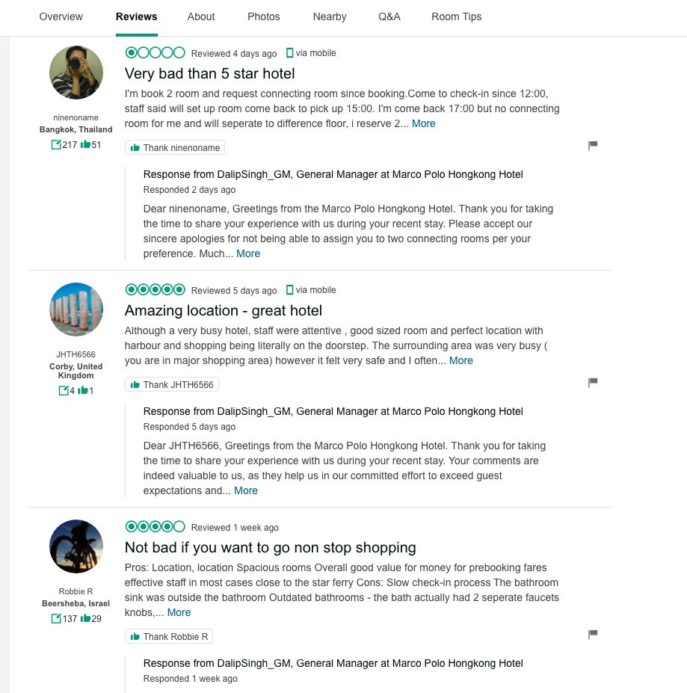
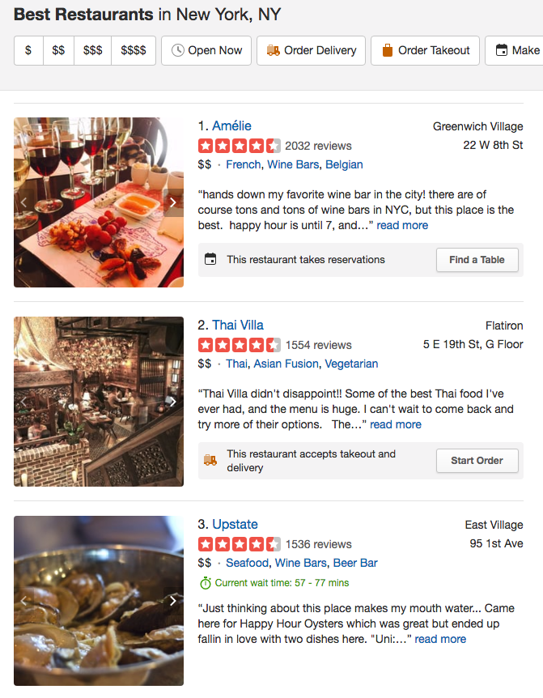
Online Reviews
Notes:
But it is actually not easy to use the existing reviews for quickly making a good purchase decision.
there are usually many potential choices that satisfies our basic requirements. Users need to compare them and find the best choice.
For each local business, there are often a large number of reviews, as we can see in the left figure, some restaurants may even have more than 1500 reviews. It is very difficult for us to read all of them.
The major content of the reviews is the text comments about a business, but it is usually time-consuming for readers to digest and extract useful information from the text reviews.
=====
They also provide numeric ratings, but numeric ratings are not able to provide more details, for example, how about two hotels with exactly the same rating?
Therefore, it is difficult for customers to quickly compare local businesses and make an optimal and fast shopping decision using those reviews.

Slide 6
Challenges
There are usually many candidates satisfying users’ requirements
The online reviews are dynamically changing
The information overload due to the large volume of review texts, different review focuses, etc.
The possible standard inconsistency across different customers
Notes:
To sum up, It is challenging to use existing online reviews to make a quick purchase decision.
Because
There are many candidates….
The online reviews are dynamic changing…
The information overload …
The possible standard inconsistency across different customers.

Slide 7
How can we achieve easy comparison of local businesses using online reviews?
Notes:
so, a natural question to ask is: How can we achieve an easy comparison of local businesses using online reviews?

Slide 8
Our Approach: E-Comp
Notes:
In this paper, we present an interactive visualization system called E-Comp to help customers conduct easy and fast comparison of local businesses.
In this paper, we mainly use the Yelp dataset, so the examples in this paper is mainly focusing on restaurant reviews. But it can be easily extended to other local business types, like hotels and stores.

Slide 9
Design Requirements
General exploration procedures:
Preliminary Comparison
Detailed Comparison
R1. Quick overview for filtering out candidates
R2: reliable comparison between businesses
R3: temporal analysis of user reviews
R4: insightful details of important features
R5: detailed review text on demand
R6: intuitive visual designs
Notes:
Before we get into the details of our approach, let’s first discuss the basic design requirements. To gain the design requirements, we conducted interview with users and also did detailed literature survey of marketing and business.
According to the result, the general exploration procedures of using online reviews to compare local businesses can be divided into two stages: preliminary comparison and detailed comparison.
In the prelimianry comparison, they will use some basic information, like location, percentage of good ratings and rpice to filter out some candidates, so a quick overview is necessary.
then they will further conduct detailed comparison by using more detailed information. They will need ….
As the target users usually have no background in information visualization, then intuitive visual designs are necessary

Slide 10
Our Approach: E-Comp
Map View: Preliminary Comparison
Notes:
Based on these requirements, we designed our visual analytic system.
First, we have a map view for preliminanry comparison. We designed compact glyphs to encode the basic information of each local business and overlay these glyphs on the map to provide a quick overview.

Slide 11
Our Approach: E-Comp
Detailed Comparison
Common Customer View
Augmented Word Cloud View
Temporal View
Notes:
we also designed three major views to support detailed comparison.
basically, we focus on the comparison between two local businesses.
We designed common customer view to compare the ratings by the common customers of both businesses.
We also introduced a temporal view to show the overall temporal trend of reviews.
An augmented word cloud view is also designed to show the adjective+noun word pair clusters and these word pair clusters are also classified into different categories to give users more insightful details. Users can interactively select the category of interest.
We also show the detailed review text on demand, which is the View F.

Slide 12
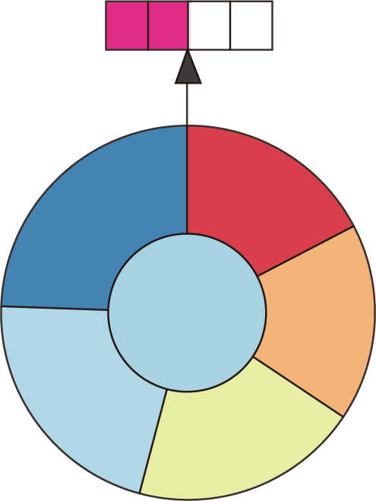
Preliminary Comparison – Glyph Design
Notes:
Let me introduce the details of the major views one by one.
For the preliminary comparison, We designed an intuitive glyph to show the basic information of each business.

Slide 13
Preliminary Comparison – Glyph Design
Price Level
Overall Rating
Review Number of Each Rating
Total Review Number
Notes:
First, the top bar encode the price level of each restaurant.
The color of the center circle encodes the overall rating levels.
The area of the outer circle (not the radius) represents the total number of reviews, reflecting the potential popularity of the businesses.
The surrounding sectors encode the percentages of each level of ratings. Sicne there are usually five ratings levels, so there are 5 sectors.
For the color scheme, we choose a diverging color scheme from red to blue instead of a sequential color scheme. Since a rating score of 3 usually represent a neutral opinion on a business, and we need to emphasize this point.

Slide 14
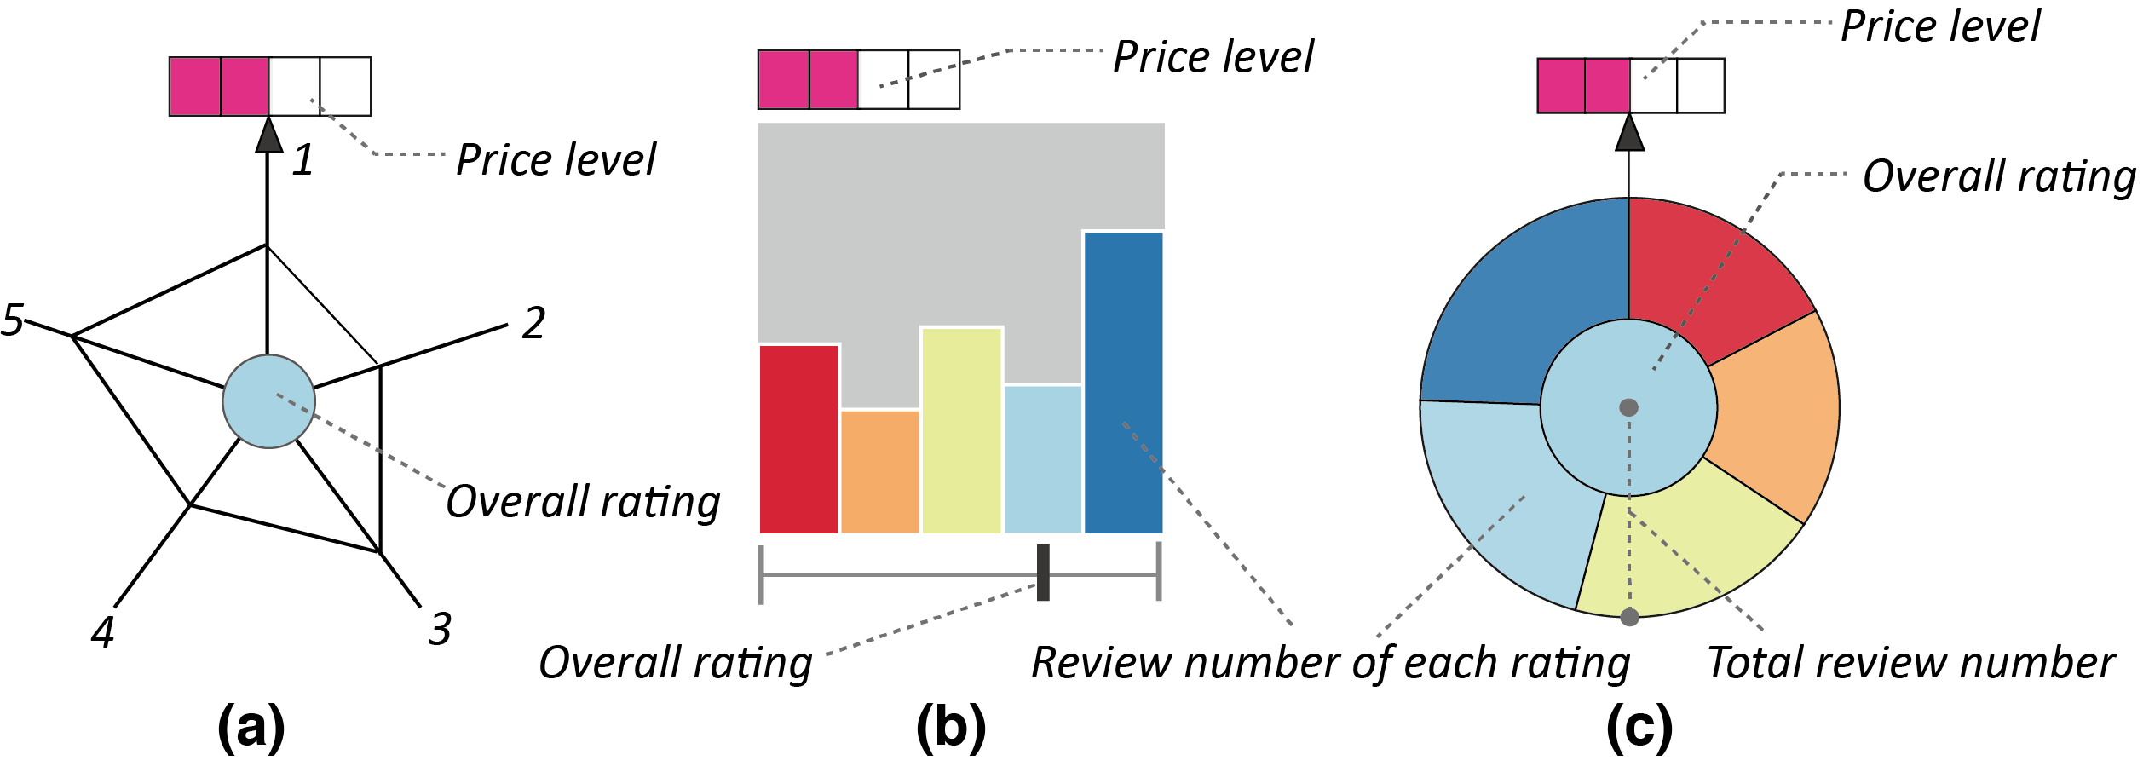
Preliminary Comparison – Glyph Design
Alternative Designs
Notes:
Before we come up with the final design, we also considered other alternative designs, like the radar-chart-based glyph and the bar-chart based glyph.
the bar-chart based glyph can show the absolute number of each ratings, but it is not able to explicitly show the percentage of each rating level, which may be more important for the candidate filtering.
The radar chart glyph has the same issue and prior studies also shows that the shape characteristics of radar chart can affect the accurate understanding of the underlying data.
therefore we finally discard them.

Slide 15
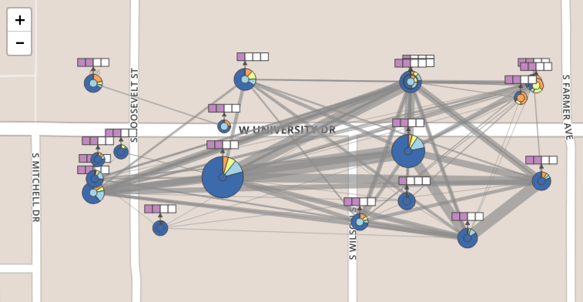
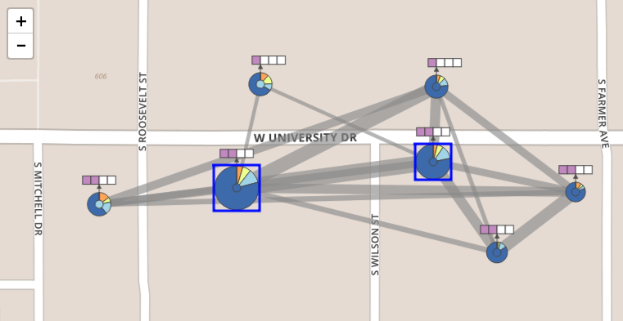
Preliminary Comparison
Interactive Filtering
The link width encodes the number of common customers
Notes:
Moreover, we add links between local businesses. The link width encodes the number of common customers, this can reflect the potential similarity of local businesses. It will be helpful for the quick filtering of candidates.
When there are too many candidates and links, visual clutter may exist. We enable users to interactively remove some candidates and links. For example, some links econding few common customers can be removed. Some glyphs with less customers will be removed.
==
bECAUSE ... few customers represent less popularity, ...

Slide 16
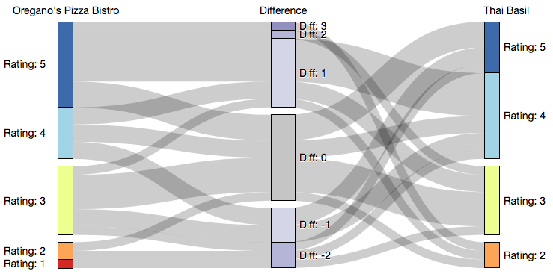
Detailed Comparison
Common customer comparison view
- The review standards by the same customers are relatively stable
Notes:
For the detailed comparison, let's first focus on the common customer comparison view.
We introduce a Sankey-diagram-based design to encode the review difference by the common customers. Why do we need this view, because different customers may have quite different rating standard, but the rating standards by the same customer are relatively stable.
In this view, The leftmost and rightmost stacked bars show the ratings by the common customers, and the middle stacked bars show the rating difference by the same person, i.e., the rating for the left restaurant subtracted by the rating for the right one.
For example, in this figure, the two restaurants have almost the same price and ratings from the overview glyph.
But from the common customer view, we can clearly see that the left restaurant gains relatively better feedback from the common customers.

Slide 17
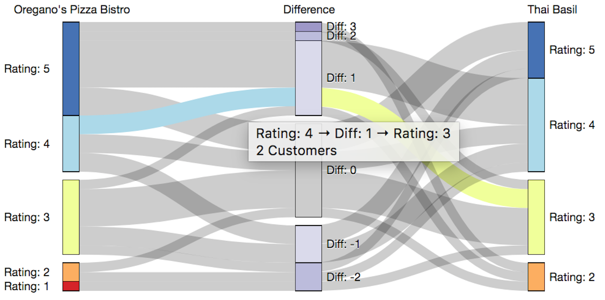
Detailed Comparison
Common customer comparison view
Interactive Exploration
Notes:
We also support interactive exploration, for example, when users hover above a link, the detailed information indicating the ratings for both sides will be shown.

Slide 18
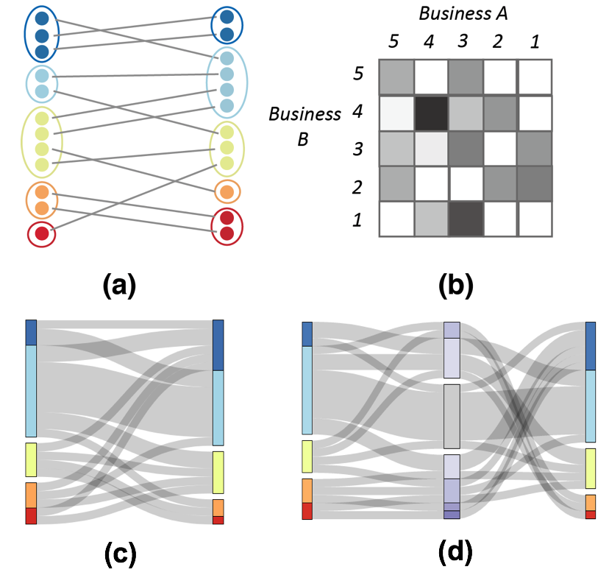
Detailed Comparison
Common customer comparison view
Alternative Designs
Notes:
We also considered several alternative designs before we finally fix it. But due to the time limit, I will skip the detailed reasons for discarding those designs.
======
---- visual clutter
Not intuitive, not space-efficient
Not explicitly show the differece.

Slide 19
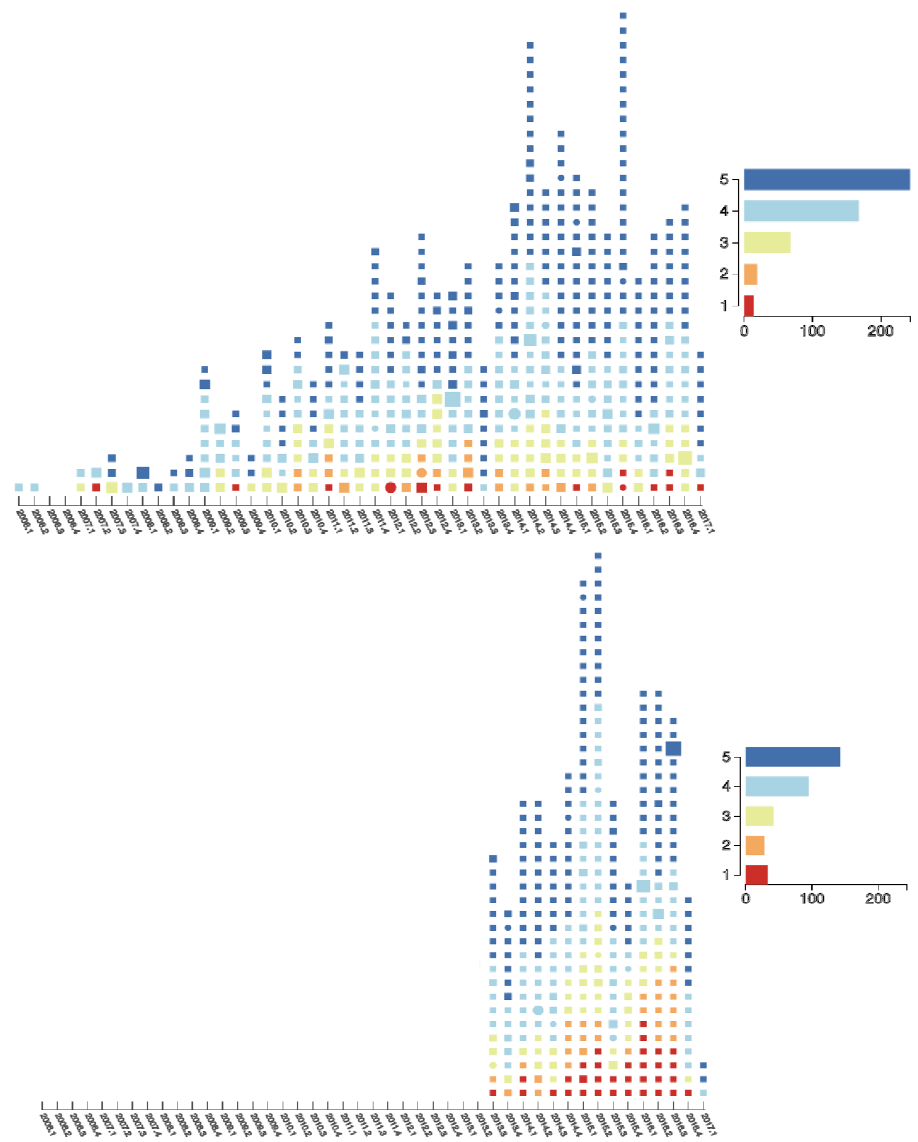
Detailed Comparison
Temporal view
- Temporal trend of reviews
Notes:
Users may be interested in the overall temporal trend of the reviews. For example, when do the local businesses begin to receive reviews? are there more and more reviews or just the opposite?
We introduce this temporal view to inform users of this kind of detailed temporal information. Where the color encoding is exactly the same with the map view,
From this figure, we can clearly see that though the bottom restaurant may have less total reviews, but it is more recently opened than the upper restaurant and it already received a lot of reviews, which meands that the bottom restaurant is at least as popular as the upper restaurant.
====
red – bad rating, and blue –good ratings.

Slide 20
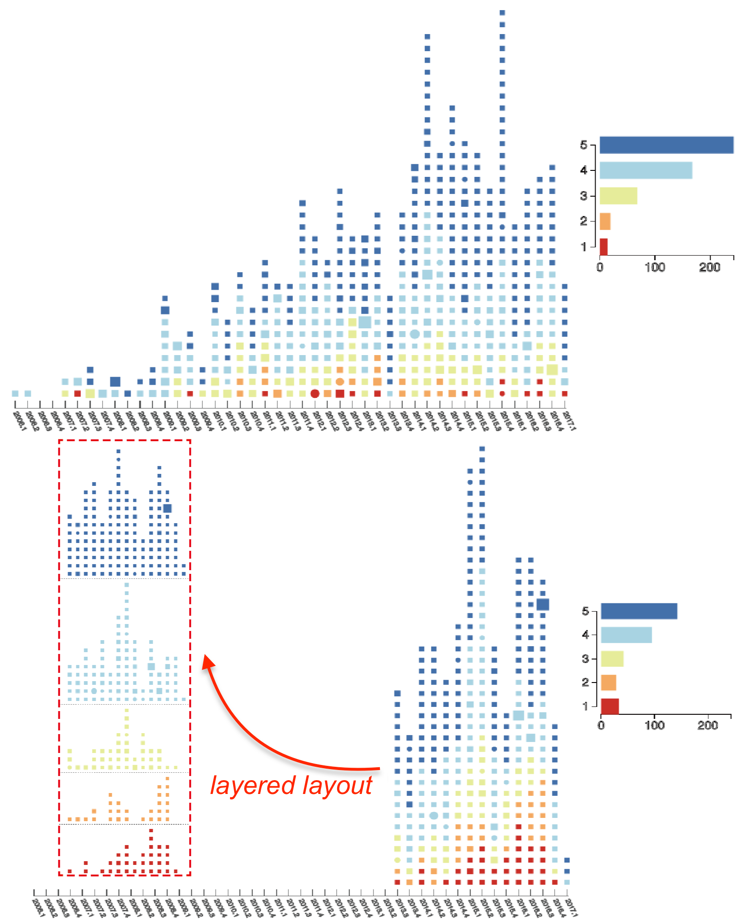
Detailed Comparison
Temporal view
- Temporal trend of reviews
Notes:
More specifically, users may also want to know what is the temporal trend of each rating level. For example, are there more and more good ratings or more and more bad ratings?
So we also support layered layout to help users check the temporal trend of each rating level.

Slide 21
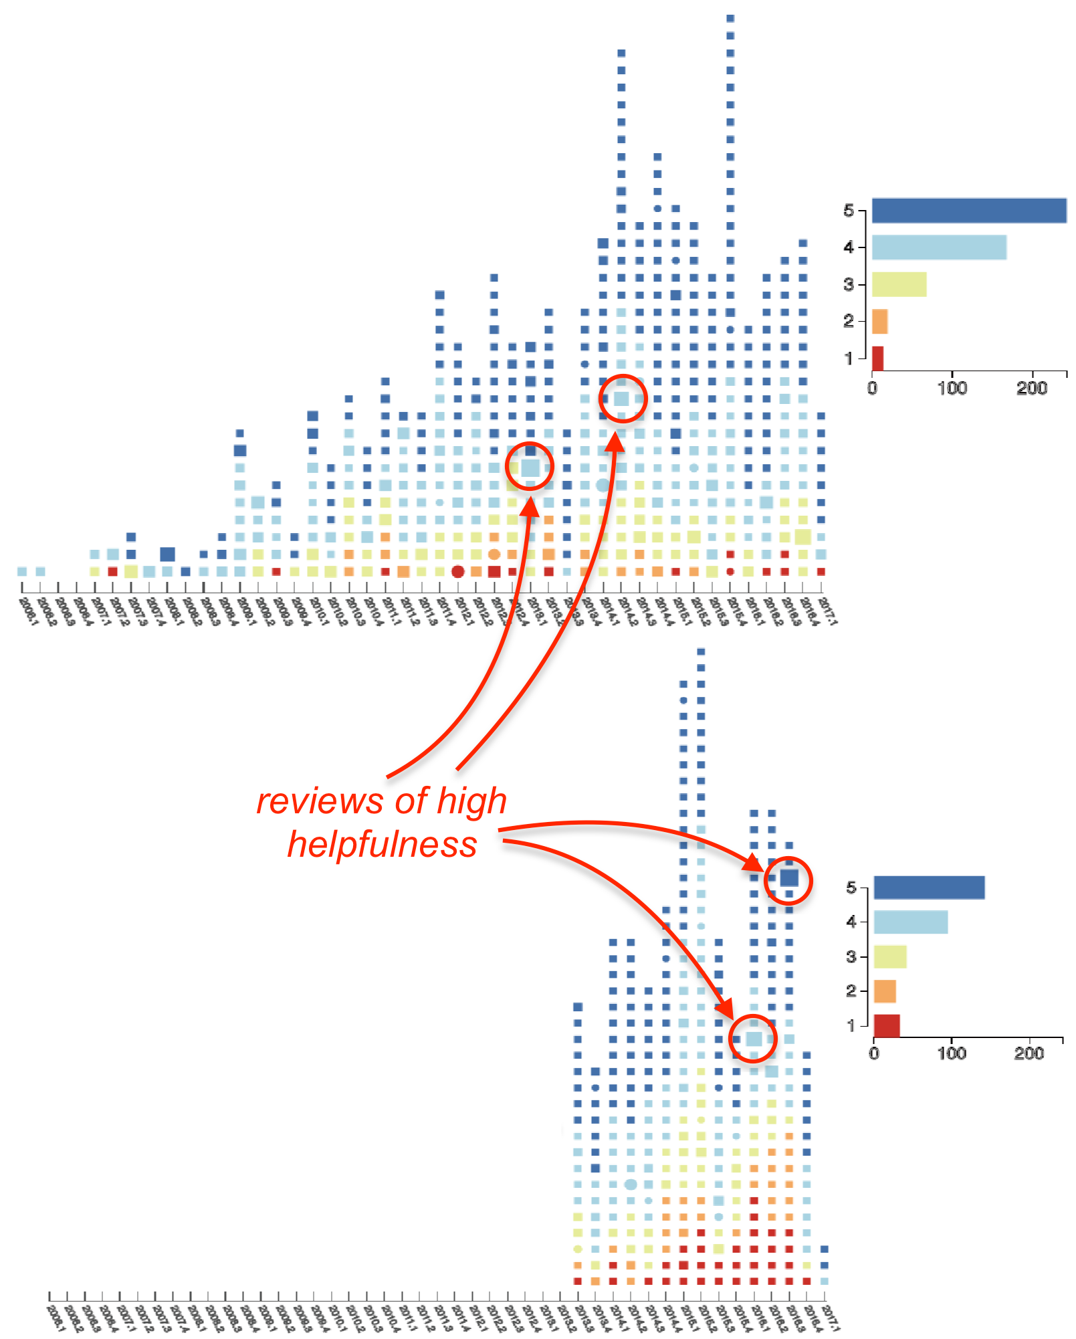
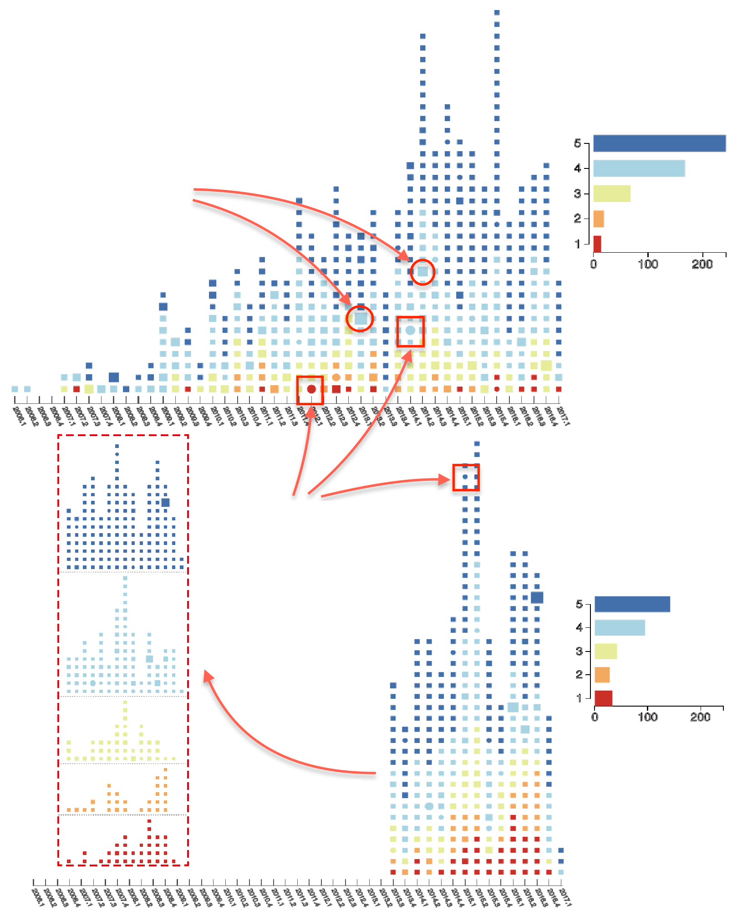
Detailed Comparison
Temporal view
- Review helpfulness
reviews of high
helpfulness
Helpfulness votes
Reviews by
Common customers
Review depth
Review extremity
Layered layout
Mudambi, S.M. and Schuff, D. What makes a helpful review? A study of customer reviews on Amazon.com. MIS Quarterly 34, 1 (2010), 185–200.
Notes:
Since there are usually a lot of reviews for each local business, it is time-consuming to check all of them. Then it would be very helpful to let users know which reviews are more helpful and contain more useful information.
According to our survey, researchers from marketing and management field have studied this helpfullness issue.
For example, it has been confirmed that review extremity, review depth (i.e., the number of words in a review comment), and helpfulness votes indicate the helpfulness of a review.
Based on this, we come up this metric for showing the overall helpfulness of each review.
Basically, R_e is …. It is shown that The extreme reviews are relatively less helpful than the reviews with a neutral rating score. So we use the rating deviation from rating 3 to delineate the helpfulness in terms of review extrimity.
R_d is the review depth, simply word counting
R_v is the helpfulness votes, which can be found in the original yelp datasets.
In the right figure, we highlight several reviews with high helpfulness, where the rectangle size encodes the helpfulness.

Slide 22
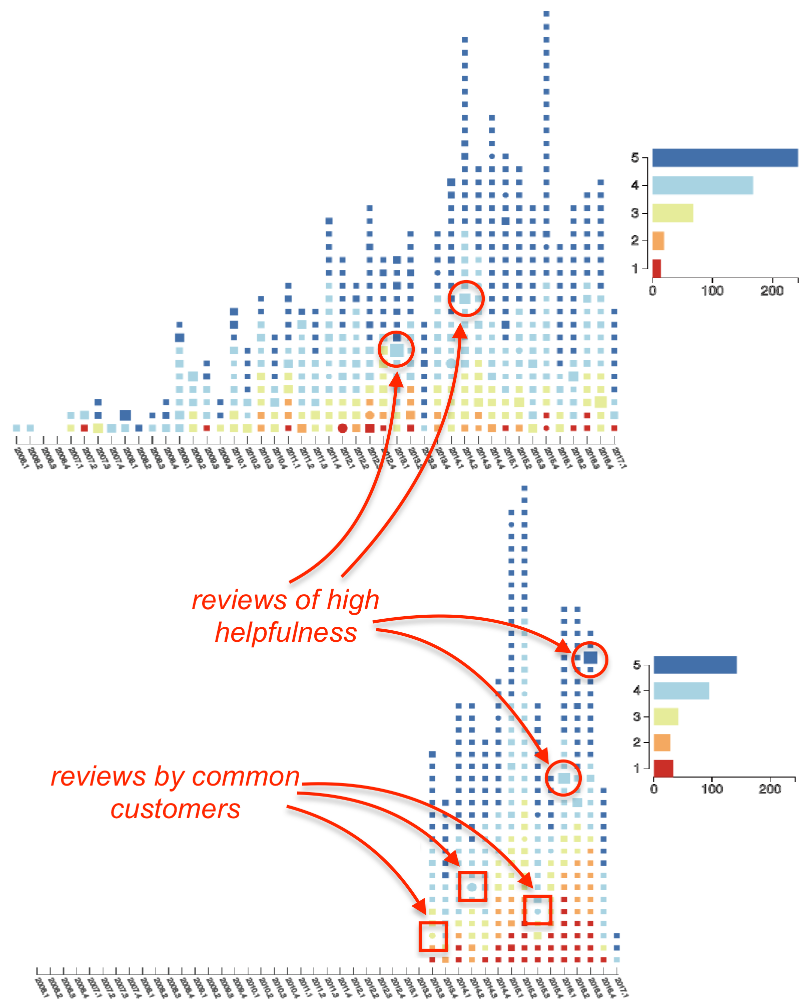
Detailed Comparison
Temporal view
- Review helpfulness
reviews of high
helpfulness
Helpfulness votes
Reviews by
Common customers
Review depth
Review extremity
Layered layout
Mudambi, S.M. and Schuff, D. What makes a helpful review? A study of customer reviews on Amazon.com. MIS Quarterly 34, 1 (2010), 185–200.
Notes:
We also highlight the reviews by the common customers of both businesses. The common customer reviews are shown as circles, with its size encoding the helpfulness as well.

Slide 23
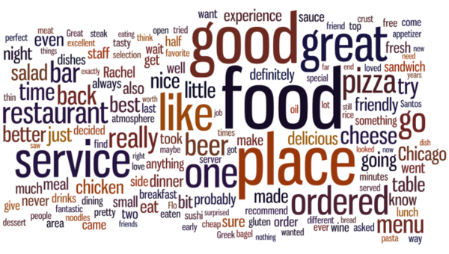
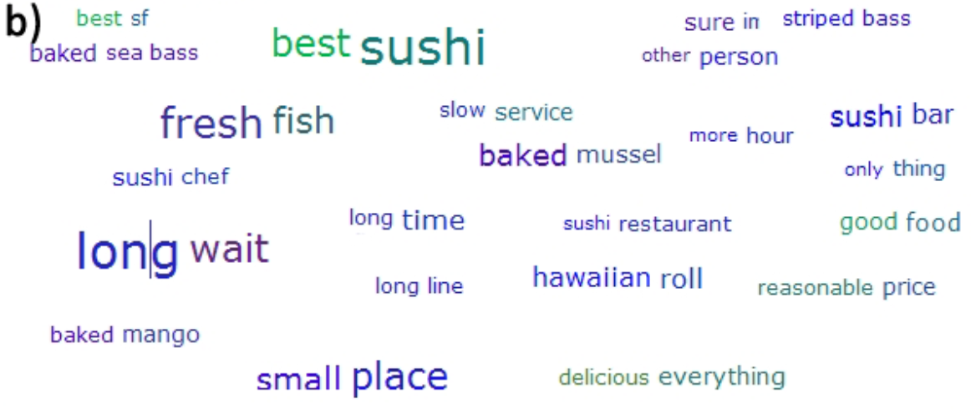
Detailed Comparison
Augmented word cloud view
What kind of place?
What is great?
How is the service?
Traditional Word Cloud
Adjective+Noun Word Pairs
http://firstmonday.org/article/view/5436/4111
Yatani, Koji, et al. "Review spotlight: a user interface for summarizing user-generated reviews using adjective-noun word pairs." CHI, 2011.
Notes:
The augmented word cloud view is the third major view for detailed comparison. It mainly shows the information from the review text.
Traditional word cloud has been widely used. But it cannot provide more detailed opinions about a local business. For example, left figure is a traditional word cloud of restaurant reviews. But you are not able to gain the detailed customer opinion. For example, …..
How is the service? ....
It is unclear.
Yatani et. al proposed showing adjective+noun word pairs. It can show more opinions in the review text, but it is not able to provide a quick overview of the important business features due to their random layout and word pair selection.
Inspired from this, we propose augmented word cloud view.

Slide 24
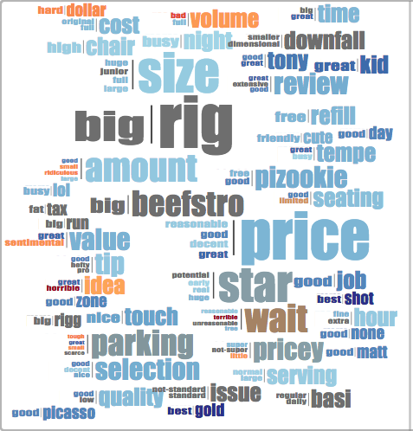
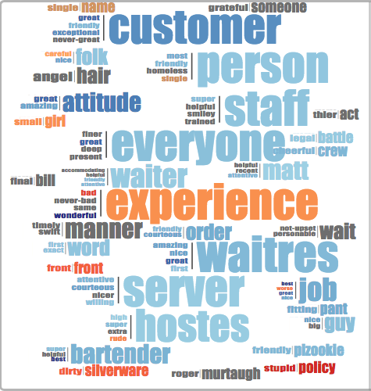
Detailed Comparison
Augmented word cloud view
Service
Price
Notes:
Basically, We also use adjective+noun word pairs, but we group the word pairs with the same noun word into a word pair cluster to provide users with a collective understanding of each object. Also, we classify the word pairs into different categories for a better comparison.
For the yelp dataset used in this paper, we classify the word pairs into four categories: food, price, service and ambience.
For example, here we have augmented word cloud view that shows the features of service.
We can see that this restaurant has amazing, nice, great waitress, and super, helpful and best bartender. But some reviews also say that they have dirty silverware and stupid policy.
In this way, users can easily gain a quick understanding of the underlying opinions about a certain aspect of the business.

Slide 25
Detailed Comparison
Augmented word cloud view
- Extract adjective+noun word pairs
1. Use part-of-speech (POS) tagger in NLTK
2. A heuristic approach to keep the noun and the corresponding adjective
that modifies it
(Specifically process the case of negative expressions)
Notes:
How do we implement the augmented word cloud view? So we first extract …
“The food is not tasty” => “not-tasty food” instead of “tasty food”

Slide 26
Detailed Comparison
Augmented word cloud view
- Extract adj+noun word pairs
- Classify word pairs into meaningful categories
1. Manually label a set of representative words for each category
2. Classify new words by computing the similarity between them and the labeled words
using word2vec
Notes:
Then, we classify ...
....

Slide 27
Detailed Comparison
Augmented word cloud view
- Extract adj+noun word pairs
- Classify word pairs into meaningful categories
- Group the word pairs and do the layout of clustered word pairs
1. Group the word pairs with the same noun into a cluster
2. Use standard NLTK library to detect the sentiment of each word pair
3. Layout: collision detection + Archimedean spiral
Notes:
Finally, we group .....
1. We group the word ...
3. We follow the layout approach of Wordle.
we do collision detection and follow an Archimedean spiral way to position the word pair clusters.

Slide 28
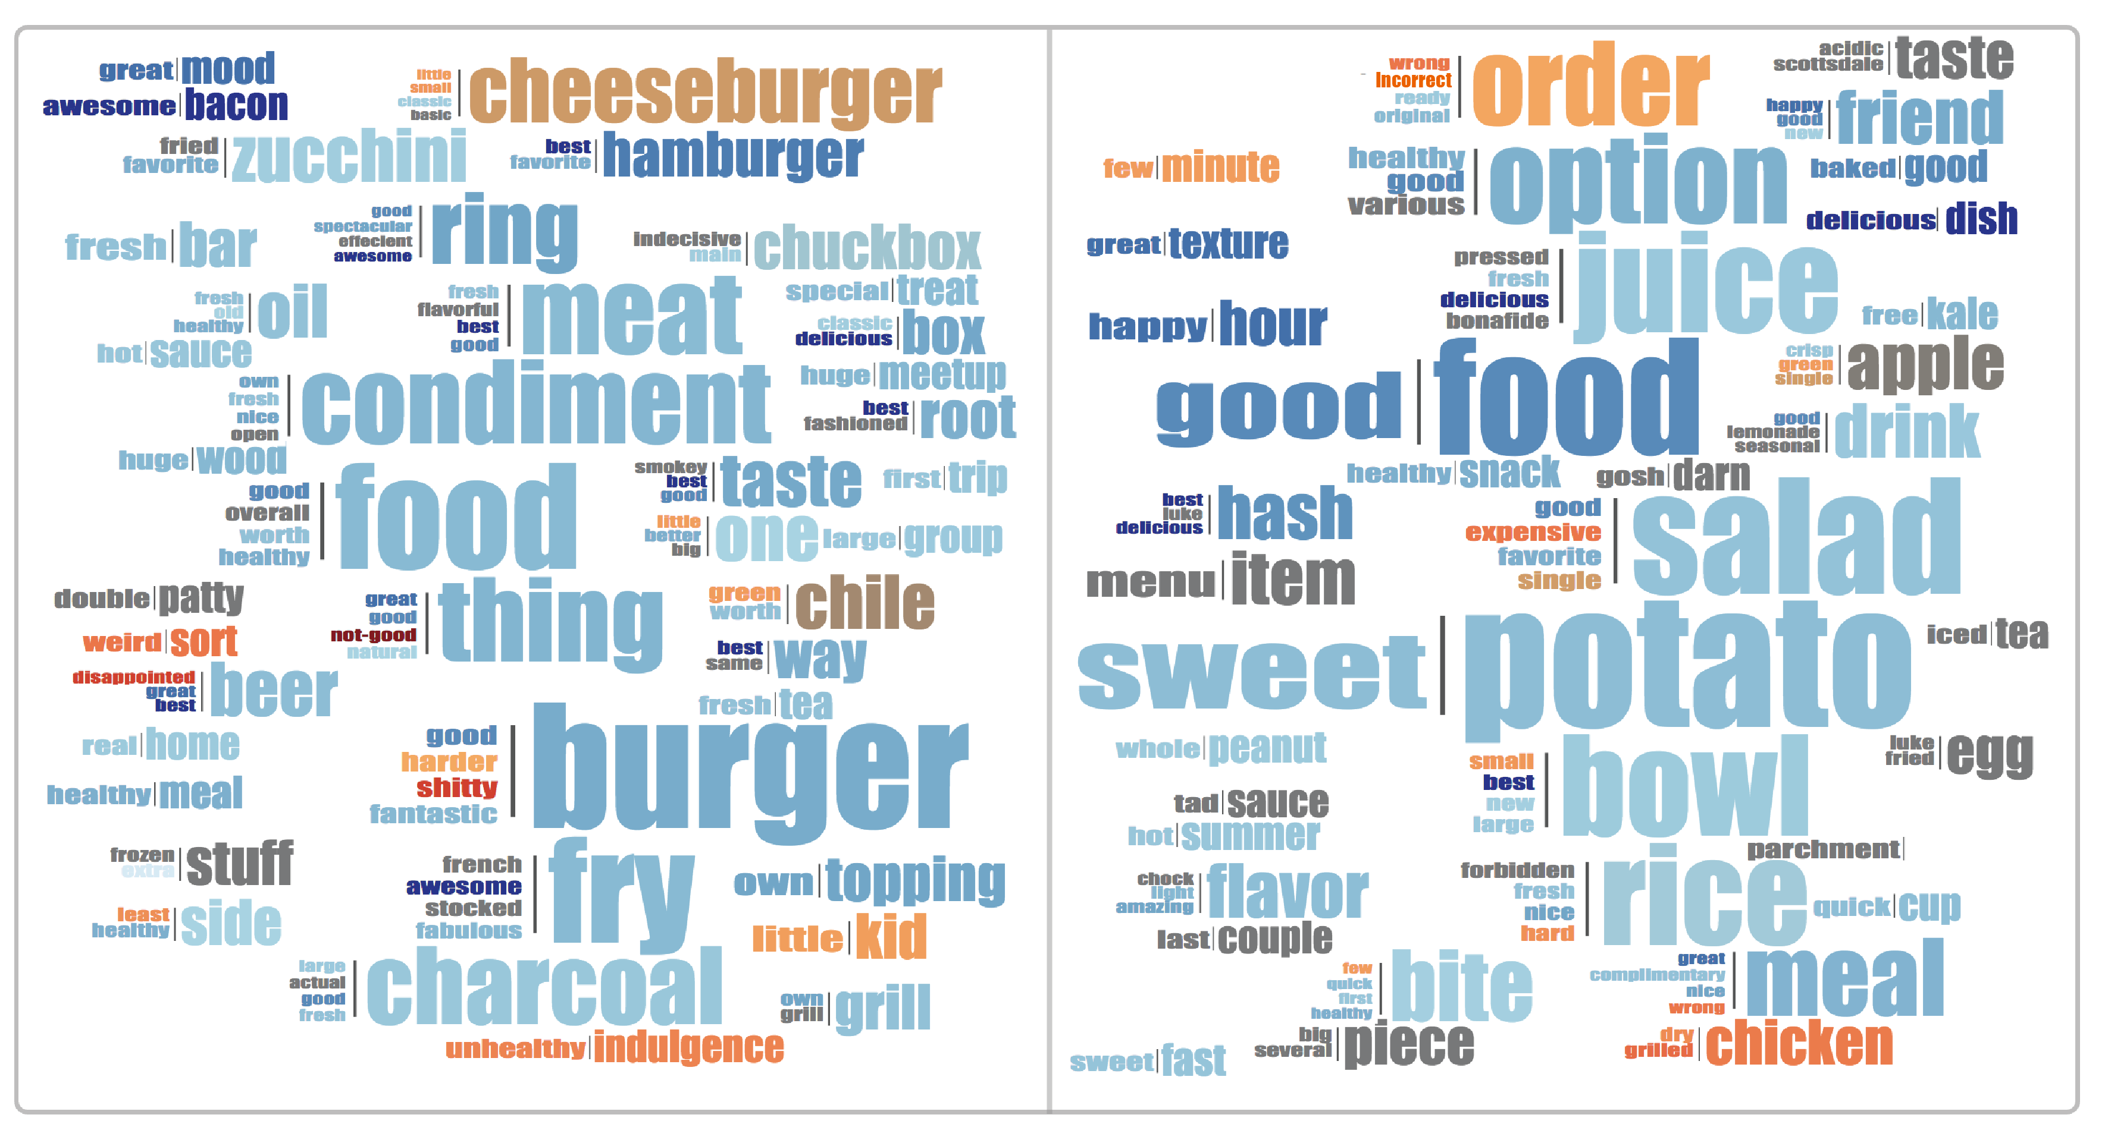
Detailed Comparison
Augmented word cloud view
food
Notes:
Here we show a example for comparing the reviews of the food from two restaurants.
For the left restaurant, it has best hamburger, favorite hamburger, classic cheeseburger, good burger, awesome bacon, fresh meat and fabulous fries.
If you love burger and meat, you probably like this restaurant.
But if you are a vegetarian, the right restaurant may be your choice, because they have sweet potato, good and favorite but expensive salad, fresh, nice rice and fresh, delecious juice.
So in this way, the users can quickly know the difference of food between the two restaurants.

Slide 29
Evaluation
Notes:
In this paper, we conducted both a case study and an in-depth user interview to demonstrate the effectiveness of our system. Since part of our case study findings have been reported in the previous slides, I will mainly introduce our in-depth user interview results.

Slide 30
In-depth User Interview
12 participants with at least 3 years online shopping experience
Procedures:
- Introduce our prototype system
- Free exploration
- Finish tasks of comparing local businesses
- Feedback collection and questionnaire
Notes:
We recruited 12 participants with at least 3 years online...

Slide 31
In-depth User Interview
Feedback
- Effectively supporting easy comparison: more insightful information is provided for both preliminary and detailed comparison
- Good usability: visual designs are easy to learn
- Limitations & suggestions: scalability, potential occlusion, NLP accuracy

Slide 32
Conclusion and Future Work
We present a carefully-designed visual analysis system to support easy comparison of local businesses using online reviews
Case study and in-depth user interview provide support for its effectiveness and usability
Further improve the language processing accuracy and study the images in the reviews
Notes:
For summary of this work,
.......
In future work, we plan to .... and it would be interesting to further study the images in the reviews for comparing local businesses.

Slide 33
Towards Easy Comparison of Local Businesses Using Online Reviews
Yong Wang¹, Hammad Haleem¹, Conglei Shi², Yanhong Wu³, Xun Zhao¹, Siwei Fu¹ and Huamin Qu¹
1
2
3
Notes:
Thank you.

