Slide 1
Don't Peek at My Chart: Privacy-preserving Visualization for Mobile Devices
Songheng Zhang
Dong Ma
Yong Wang
Notes:
Thank you for listening to my presentation, I hope you now have a better understanding of our work on privacy preserving visualization for mobile devices if you have any question or would like to discuss further please feel free to ask.

Slide 2
Take-away Message
Mobile data visualization is normally visible at both close and far viewing distances
We propose a privacy-preserving mobile data visualization that is visible at a close distance but invisible at a far distance
Notes:
In general, the takeaway message is that shoulder surfing attack occurs when the peeker is at a distance from the user. By adjusting the spatial frequency and luminance contrast of visual marks in a visualization, our method can make peekers after a certain distance hardly see the privacy-preserving visualization. In the future, we plan to apply our method to more visualization types and mobile devices.

Slide 3
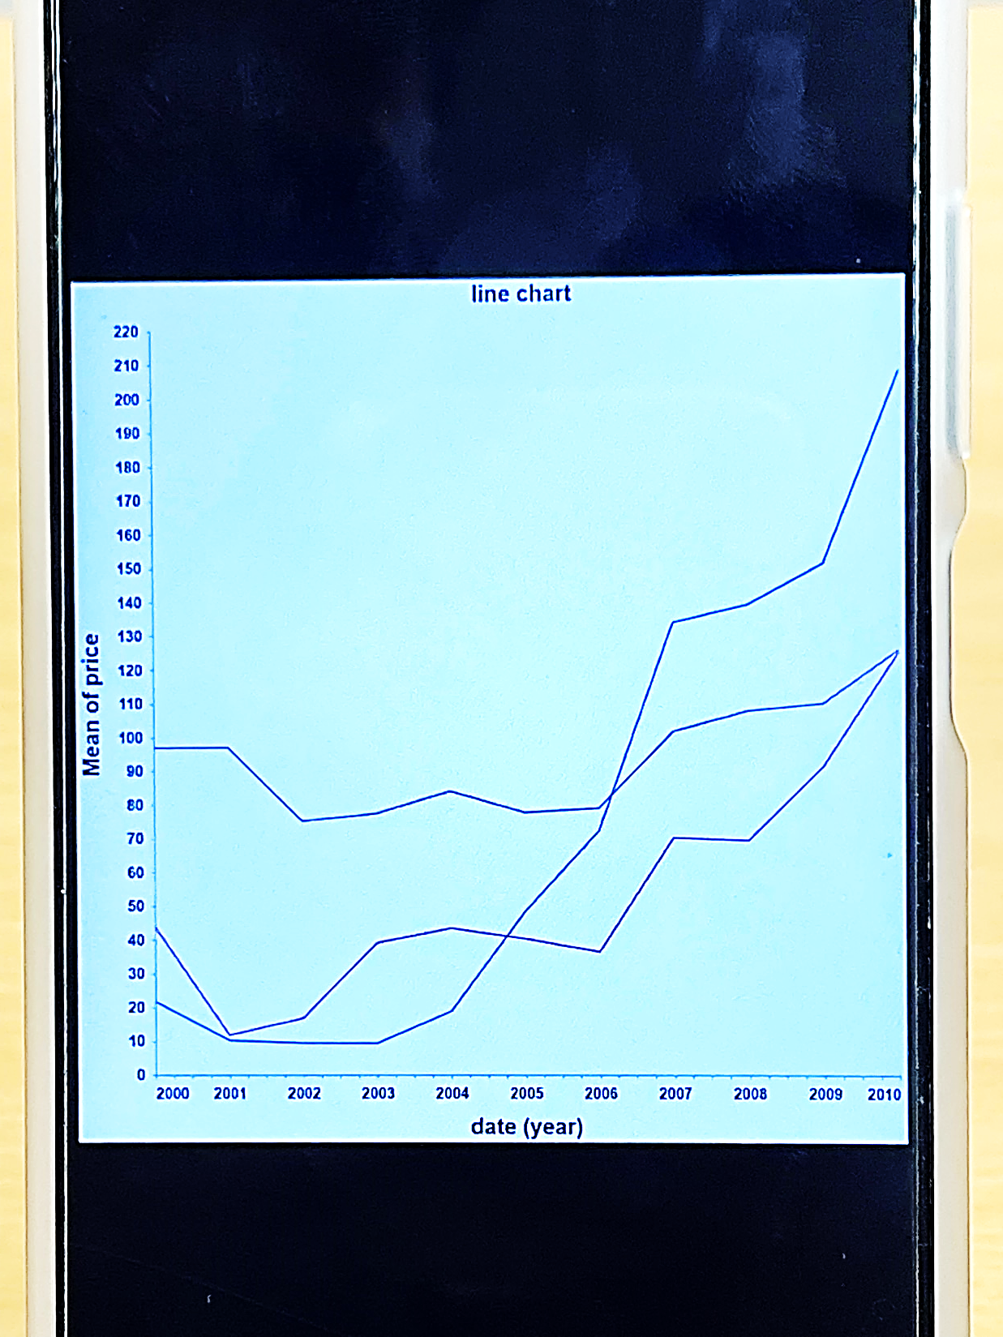
Close Viewing Distance
Far Viewing Distance

Slide 4
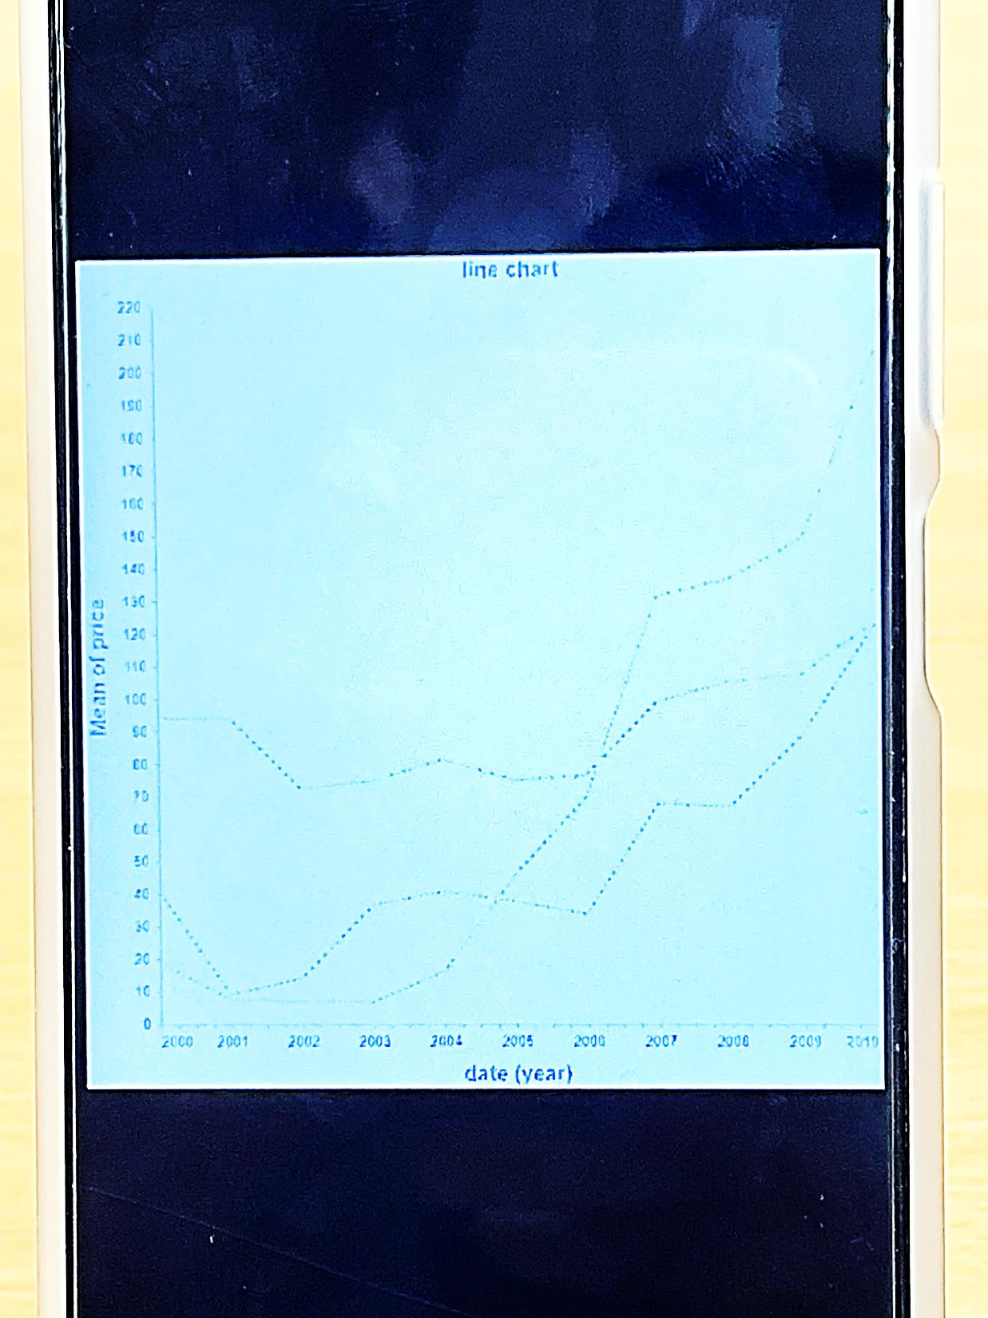
Close Viewing Distance
Far Viewing Distance

Slide 5
Background
Notes:
Before diving into technical details let me first introduce the overall background and motivation of this work.

Slide 6
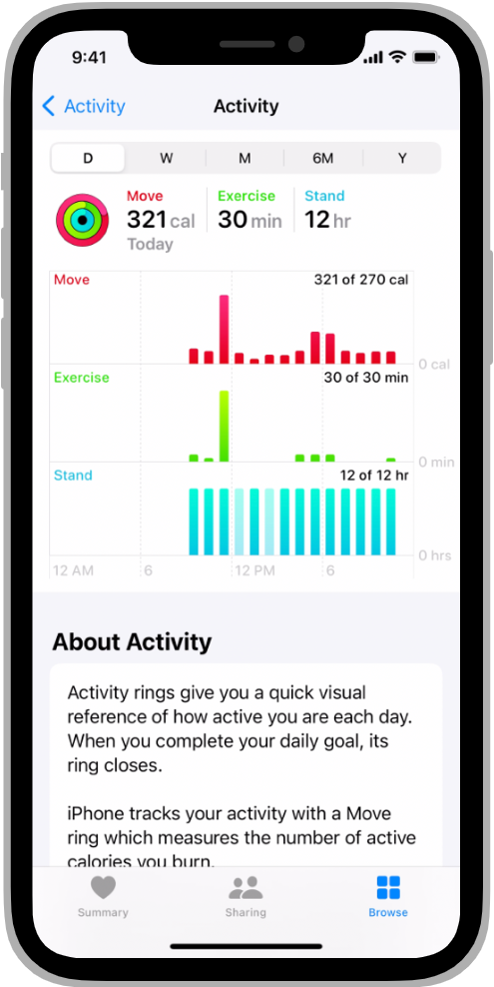
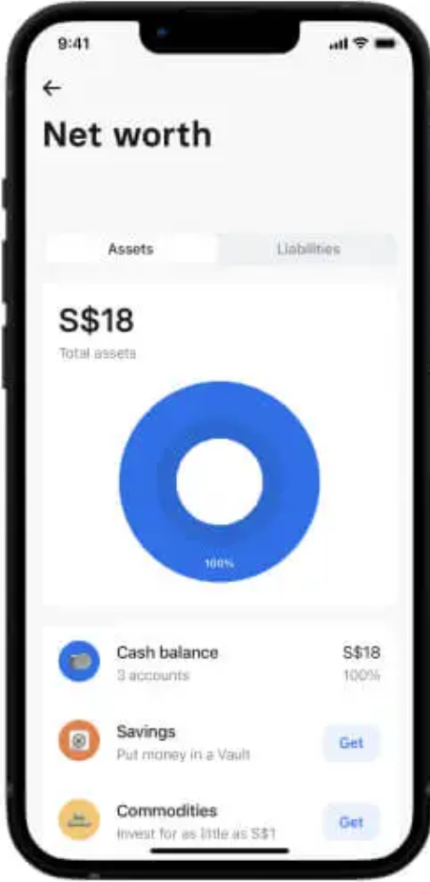
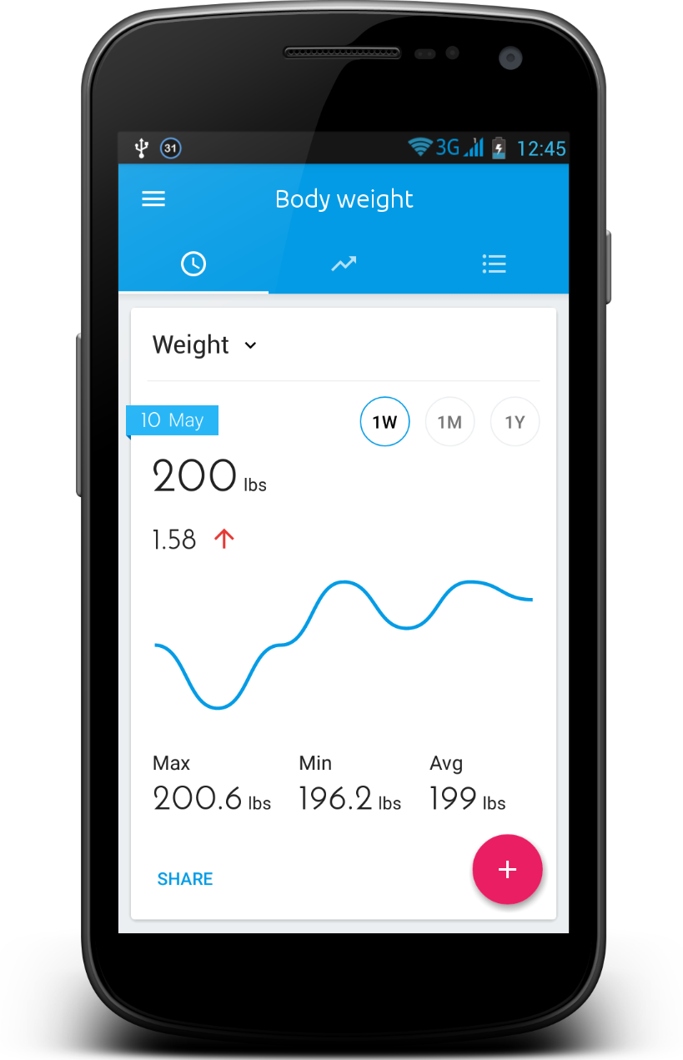
Mobile Data Visualization
Notes:
Poor graduate student punchline

Slide 7
Shoulder-Surfing Attacks
It happens everywhere!
Notes:
However, sensitive information showed in mobile data visualizations can be easily leaked to shoulder surfing attack. The shoulder surfing attack arises when users view
mobile data visualization in public areas as other people nearby can also easily see the information displayed on the mobile phone. This can be particularly problematic when you are commuting or waiting in line at a coffee shop

Slide 8
Challenges
The easy-to-view nature of mobile data visualization is a double-edged sword; it's handy but also makes it easy for others to peek
The privacy-preserving mobile data visualization must balance readability and privacy protection
Notes:
To solve this problem we need to propose a method to prevent shoulder surfing attacks on mobile data visualizations. However there are some challenges that we need to address. To sum up this problem, preventing shoulder surfing attacks on mobile data visualizations is challenged due to their glanceable nature of visualization. Additionally it's hard to balance users experience and privacy protection in mobile data visualization.

Slide 9
The Goal of Mobile Vis Privacy Protection
How can we maintain visualization visibility for users at proximity while effectively concealing it from peekers at a distance?
Notes:
So the specific question we address is, how can we maintain visualization of visibility for user at proximity while effectively concealing from peekers at a distance. This question lies at the heart of our research and drives our research efforts.

Slide 10
Approach
Notes:
To address this question, we propose a privacy-preserving visualization technique that we will introduce in detail throughout the presentation. Our approach aims to strike the right balance between the visibility and privacy protection.

Slide 11
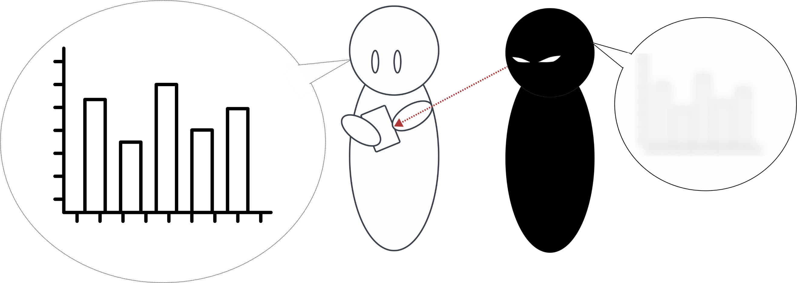
Our Approach
Users can see the visualization
Peekers hardly see the visualization
Notes:
Our method transforms a regular visualization into one that is easily visible to the user where difficult for peekers to see. As shown in the figure, the user using the mobile phone can easily see the privacy-preserving bar chart, which is generated by our method. However the peeker who is next to the users cannot get a clear view of the mobile data visualizations. the key lies in adjusting the spatial frequency and luminance contrast of visual marks in a visualization, which make it difficult for peekers to discern the content of the visualization.

Slide 12
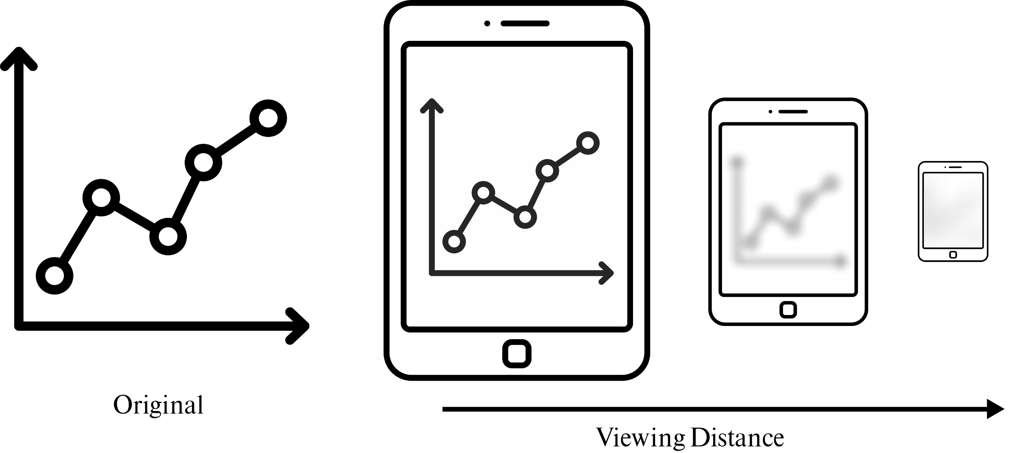
Our Approach
Notes:
The slide displays the simulated result of our privacy-preserving visualization. As you can see as the viewing distance increases, the visualization becomes increasingly difficult to discern. This is the desired effect as it helps protect users privacy while still allowing them to view their data.

Slide 13
Approach Overview
We propose a masking scheme to generate a privacy-preserving visualization.
Notes:
Our method proposes a masking scheme that can transform an original visualization into a privacy-preserving visualization. The masking scheme consists of two main modules: coarse-grained and fine-grained masking. The coarse-grained masking adjusts the original visualization, in terms of its spatial frequency and luminance contrast. At the fine-grained level, we consider different characteristics of visual marks and purpose customized masking schemes for them.

Slide 14
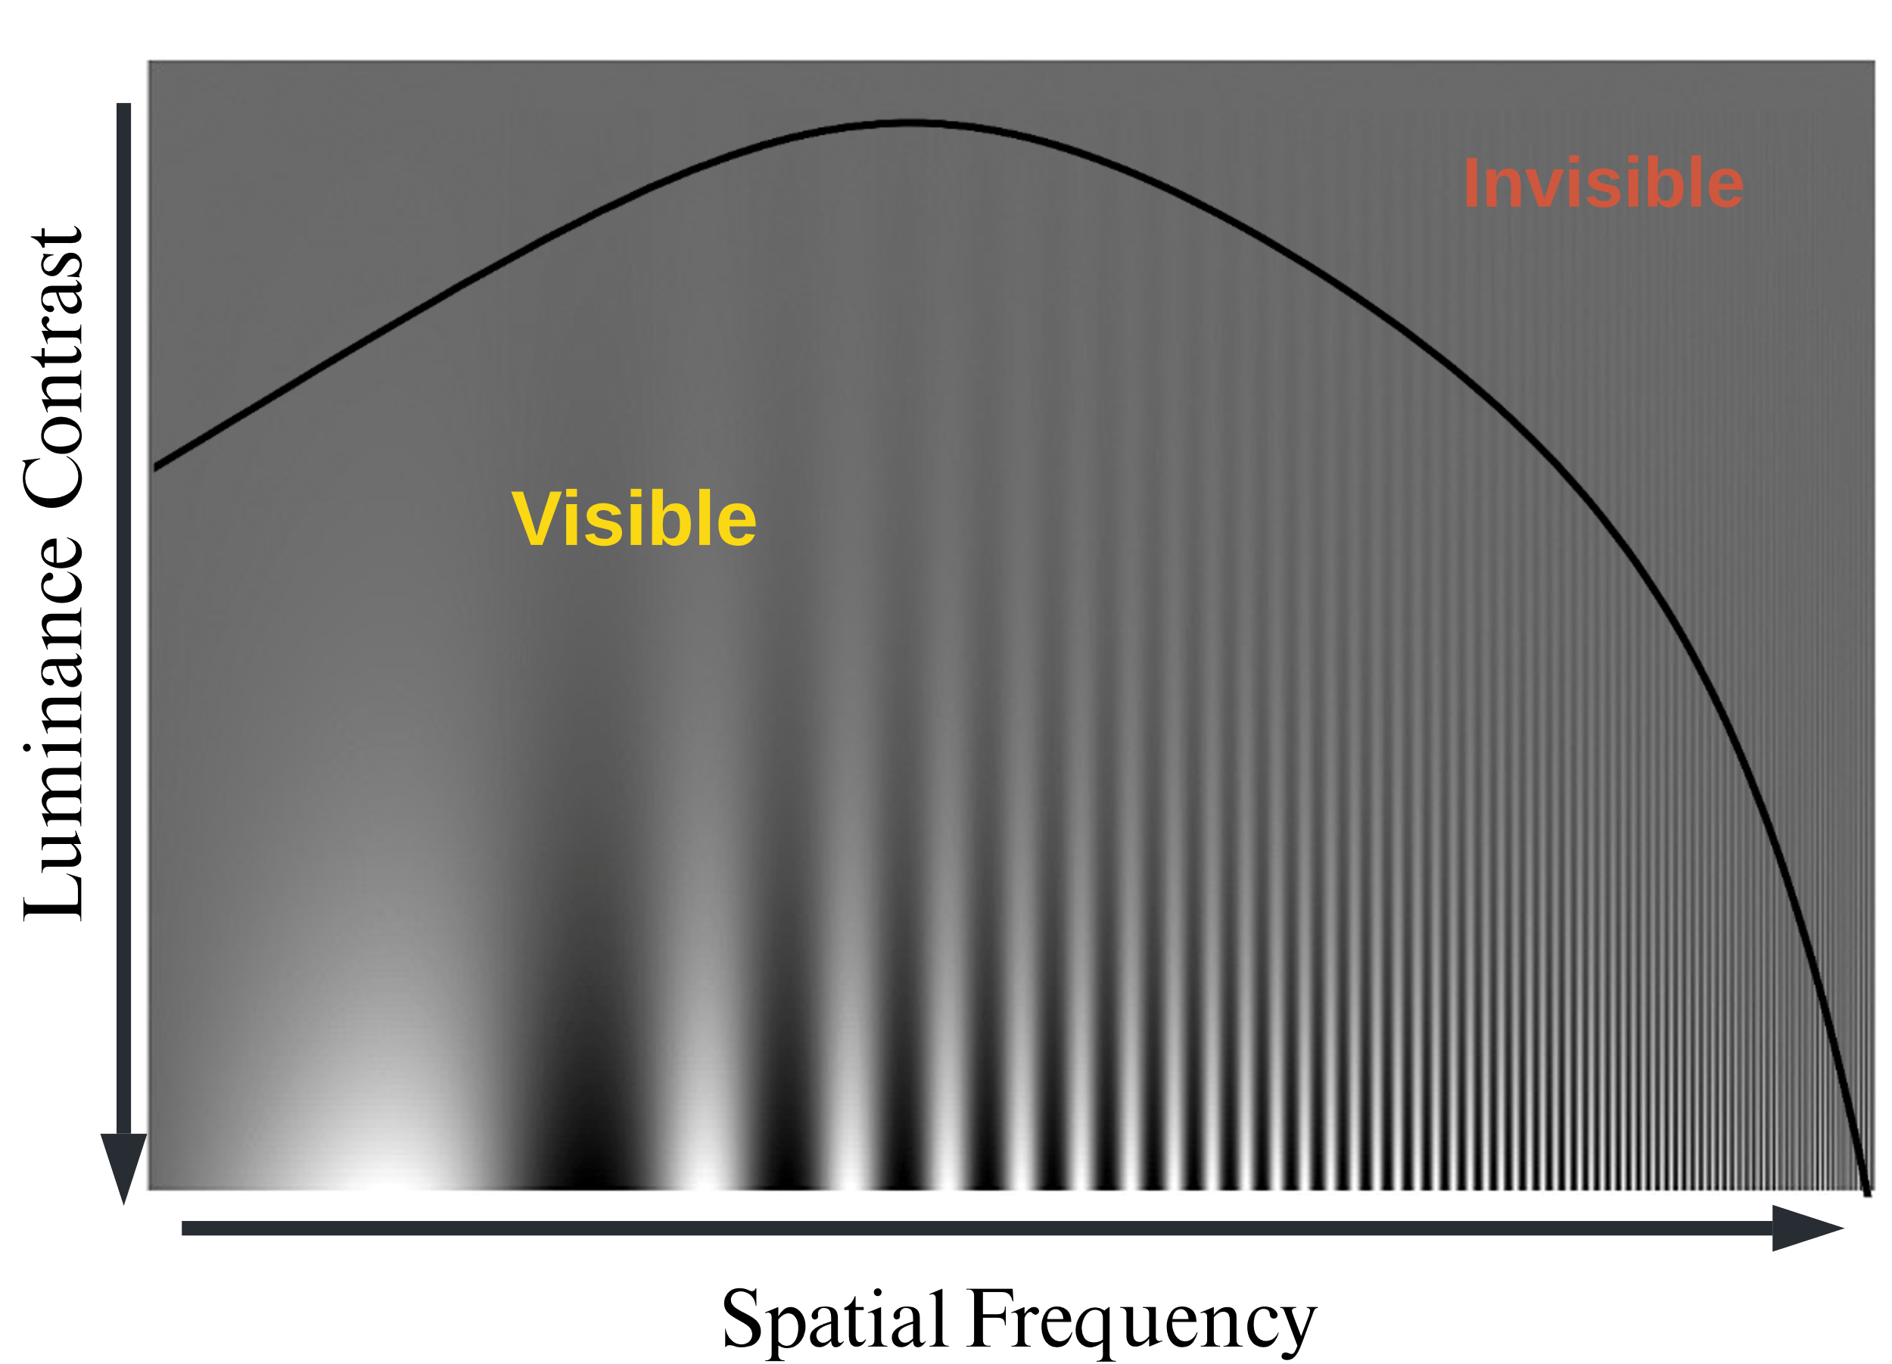
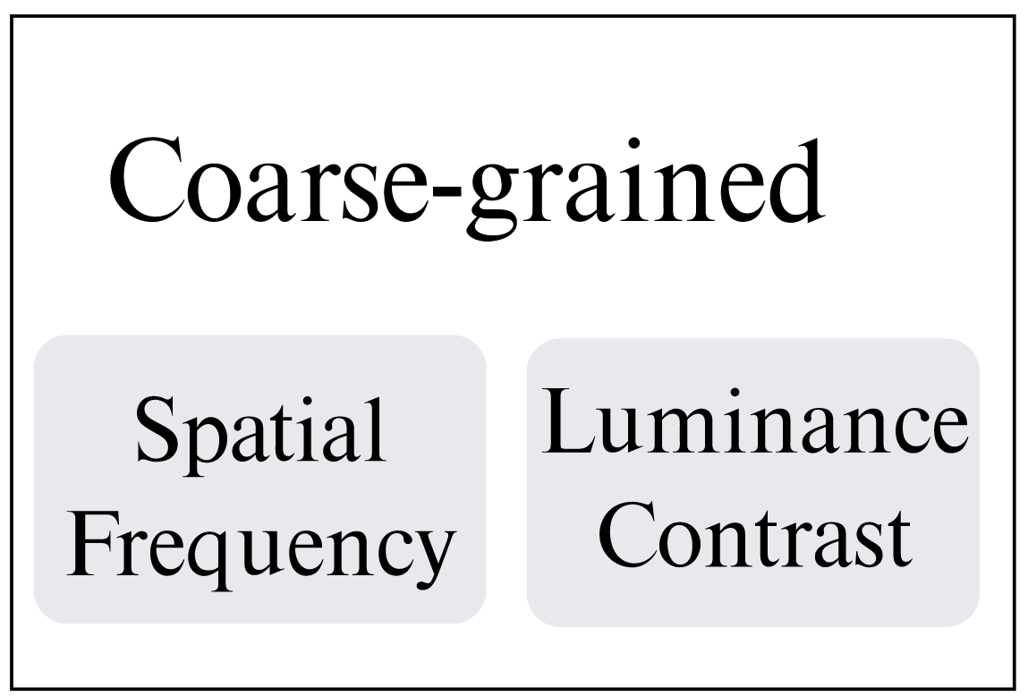
Coarse-grained level
Our method is inspired by the human vision system characteristics
Contrast Sensitivity Function^{[2]}
Inspired
[2] National Research Council (US) Committee on Vision. Emergent Techniques for Assessment of Visual Performance. Washington (DC): National Academies Press (US); 1985. CONTRAST SENSITIVITY FUNCTION. Available from: https://www.ncbi.nlm.nih.gov/books/NBK219042/
Notes:
Coarse-grained masking is inspired by the human V\vision system. That is, the ability of human to identify objects from their background is jointly affected by the spatial frequency and luminance contrast.

Slide 15
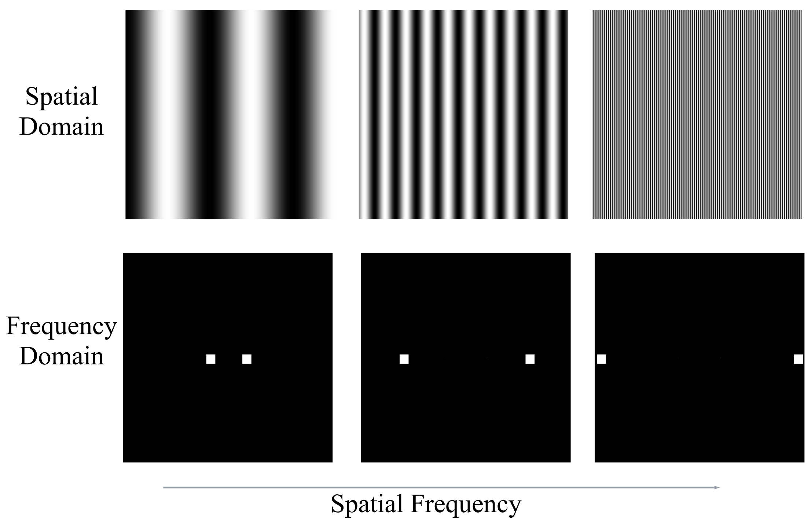
Coarse-grained level – Spatial Frequency
Spatial frequency relates to the frequency of color changes that humans perceive.
Notes:
Firstly, spatial frequency refers to the frequency of color changes. When color changes more rapidly, the corresponding frequency is higher. We can visualize an image spatial frequency by converting from a spatial domain to a frequency domain. It's important to know that spatial frequency is not only determined by the image itself but also depends on the human viewing distance. As people move farther from the image the spatial frequency they perceive becomes higher.

Slide 16
Coarse-grained level – Spatial Frequency
Spatial frequency relates to the frequency of color changes that humans perceive.
Notes:
Firstly, spatial frequency refers to the frequency of color changes. When color changes more rapidly, the corresponding frequency is higher. We can visualize an image spatial frequency by converting from a spatial domain to a frequency domain. It's important to know that spatial frequency is not only determined by the image itself but also depends on the human viewing distance. As people move farther from the image the spatial frequency they perceive becomes higher.

Slide 17
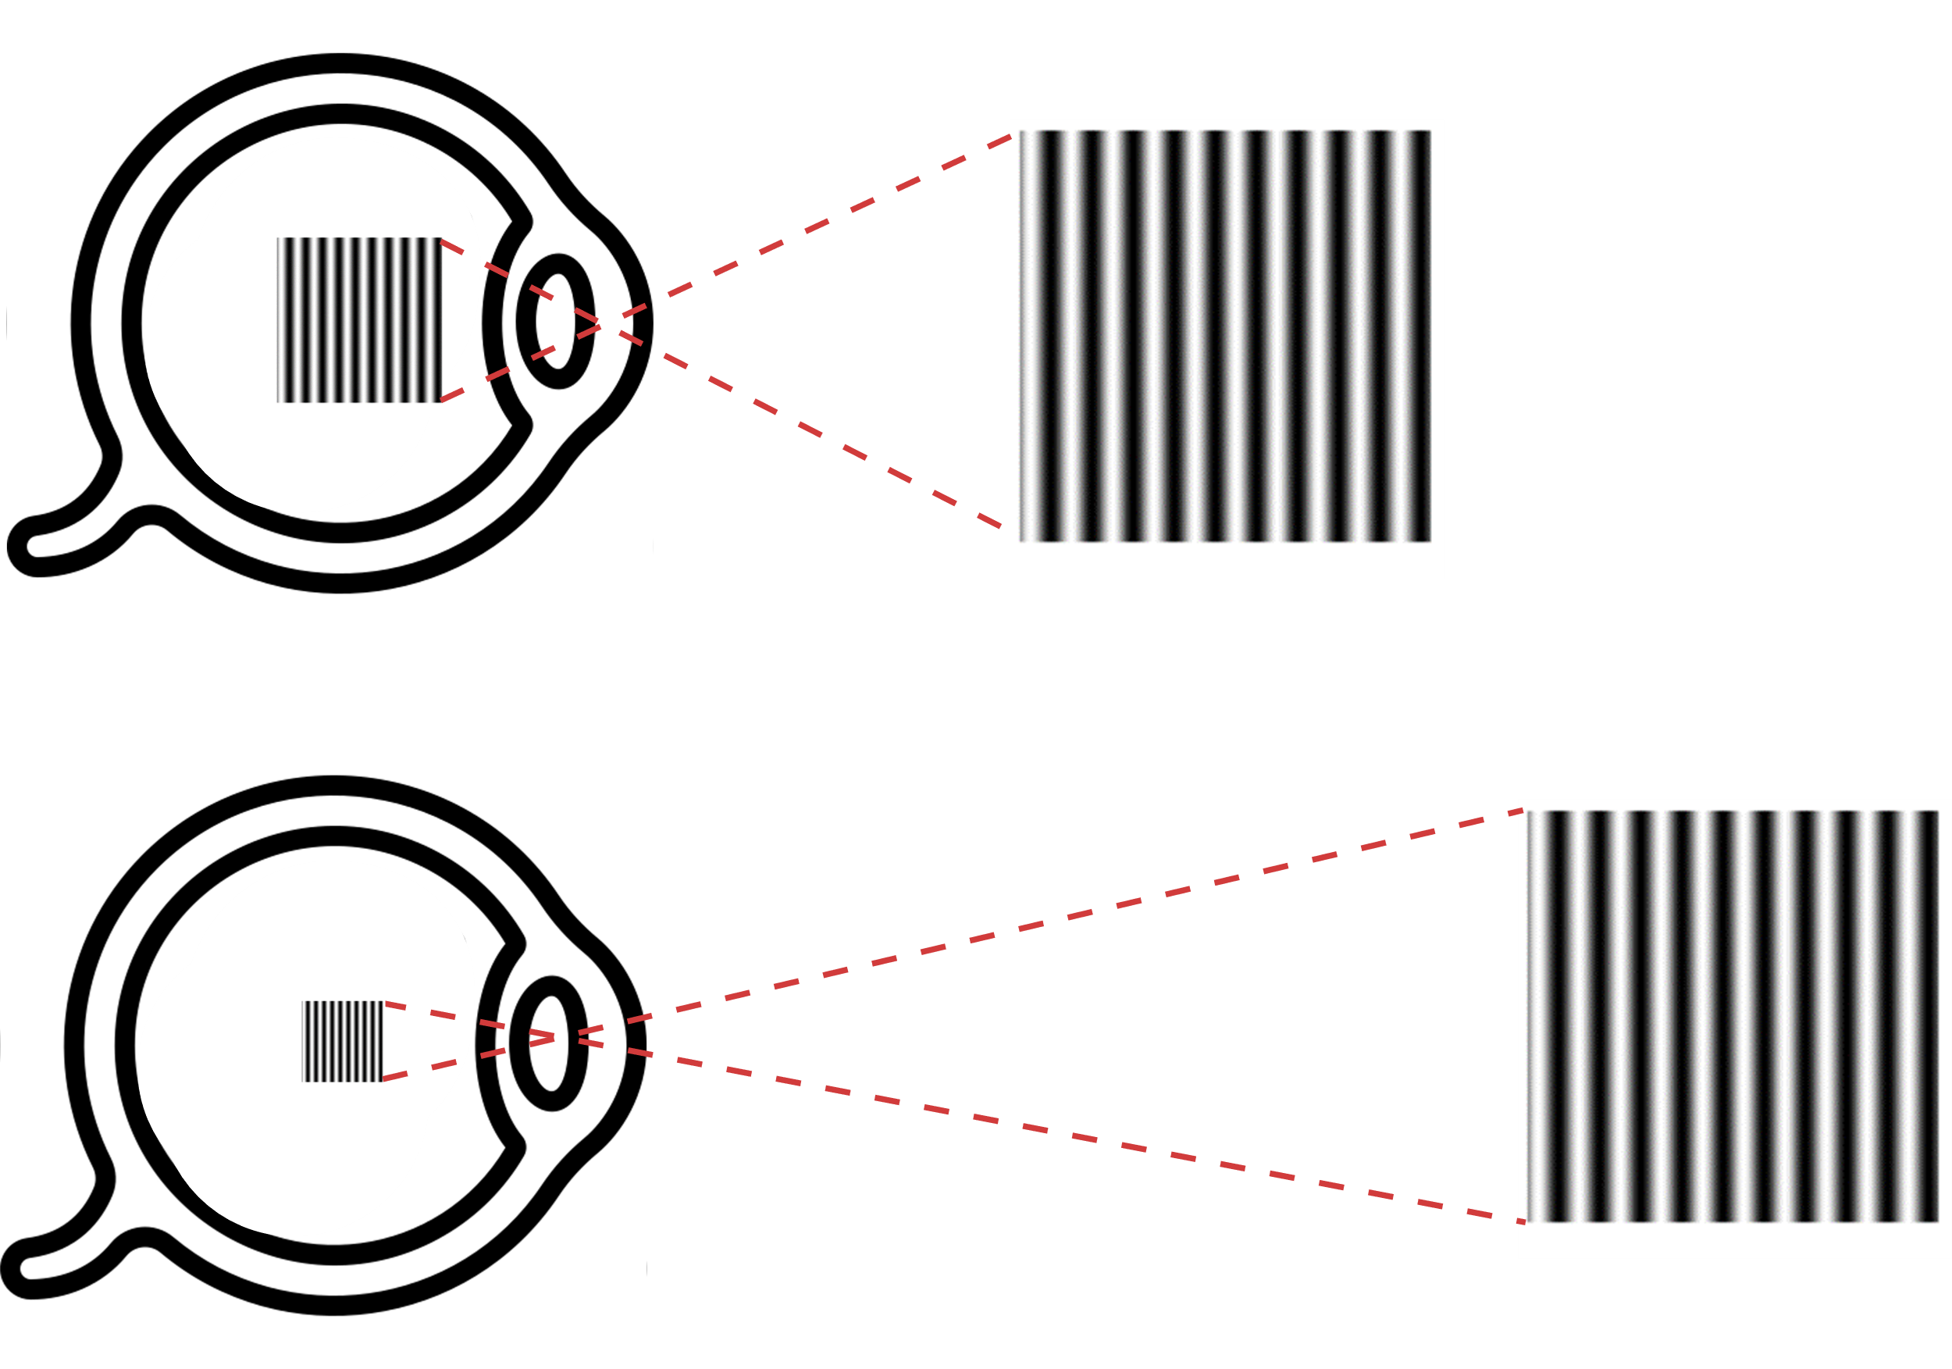
Coarse-grained level – Spatial Frequency
When viewing distance increases, the spatial frequency that humans perceive also increases.
Close Distance
Far Distance

Slide 18
Coarse-grained level – Luminance Contrast
Luminance contrast refers to the difference in brightness between the two colors.
Notes:
In addition to spatial frequency, human's ability to distinguish objects depends on the luminance contrast between objects. luminance contrast refers to the difference in brightness between two object colors. As the contrast decreases, it becomes harder for human to identify bright and dark bars.

Slide 19
Coarse-grained level
The human vision system is affected by the coupling effect of both spatial frequency and luminance contrast.
Notes:
To consider all these factors, researchers propose a contrast sensitive function which is the black curve as shown in the figure. This is the black curve and the contrast sensitive function curve depicts the coupling effect between spatial frequency and luminance contrast on human vision perception. Normally, as the spatial frequency increases, human needs higher luminance between the dark and bright bars to distinguish them.

Slide 20
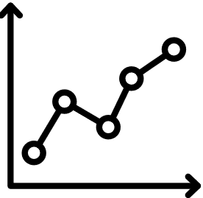
Coarse-grained level
The human vision system is affected by the coupling effect of both spatial frequency and luminance contrast.
far dist.
close distance
Notes:
To consider all these factors, researchers propose a contrast sensitive function which is the black curve as shown in the figure. This is the black curve and the contrast sensitive function curve depicts the coupling effect between spatial frequency and luminance contrast on human vision perception. Normally, as the spatial frequency increases, human needs higher luminance between the dark and bright bars to distinguish them.

Slide 21
Fine-grained level
Source: Visualization Analysis & Design^{[2]}: Chapter 5 by Tamara Munzner
[3] Munzner, Tamara. Visualization analysis and design. CRC press, 2014.
Notes:
As for the fine-grained level, we design different masking schemes for the different types of visualization marks, like rectangles, circles and points. Visual marks are the basic units of a visualization and they can be characterized into three types: the point lines and areas.

Slide 22
Fine-grained level
Occupy an area in a visualization
Line-based Mark
categorized
Area-based Mark
Source: Visualization Analysis & Design^{[3]}: Chapter 5 by Tamara Munzner
We utilized different schemes to process line-based marks and area-based marks!
[3] Munzner, Tamara. Visualization analysis and design. CRC press, 2014.
Notes:
we further categorized visual marks into line-based and area-based marks due to their difference in occupied areas, and design different masking schemes for different types of visualization marks.

Slide 23
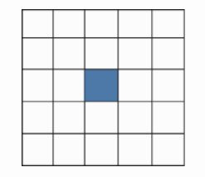
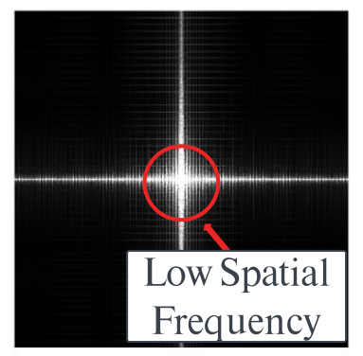
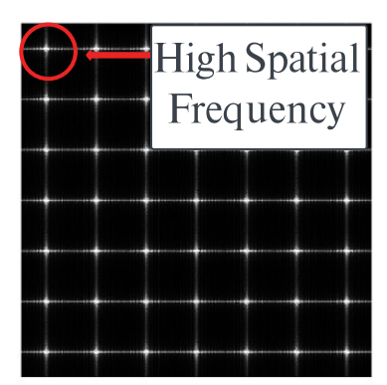
Masking Scheme for Area-based Marks
Spatial domain
Area-based mask
Area-based marks
High-spatial frequency mark
Frequency domain
Notes:
We design an area-based mask for area-based marks when where the pixel at the center of the mask is retained and other pixels are converted to the background color. The mask is tiled to cover the entire mark, resulting in area-based marks composed of discretized dots. The converted mark is then turned to high frequency.

Slide 24
Masking Scheme for Line-based Marks
Notes:
For line-based marks, we design a different mask that takes into account the characteristics of line-based marks. This mark ensures that the continuity of the line-based mark is maintained which is important for the readability of the visualization.

Slide 25
Masking Scheme for Line-based Marks
Notes:
Let's take a look at the example, figure (b) shows the original line chart and the figure (c) shows the line chart processed by the area-based mask if we use the area-based mask, there exists discontinuity in the dash red rectangles.

Slide 26
Masking Scheme for Line-based Marks
``
Notes:
However, if we use the line-based mask, the continuity of the line-based mark is maintained. This is crucial, as it ensures that users can still understand the visualization, while preventing shoulder surfing attacks. This continuity is essential because it allows users to quickly comprehend the visualization, without needing to spend extra time guessing the trend of broken lines.

Slide 27
Masking Scheme for Line-based Marks
We also apply the line-based mask on visualization axis and text because they are made of lines by nature
Notes:
We also apply the line-based marks on visualization axes and text, because they are made of lines by nature. The figure in the slide also displays the difference between axes and text processed by the area-based mask and line-based mask. The text and axes in figure (b) is processed by the area-based mask. As we can see in the red dash rectangle, the text and axes cannot be identified clearly. However, in the figure (c), text and axes are much clearer to human beings.

Slide 28
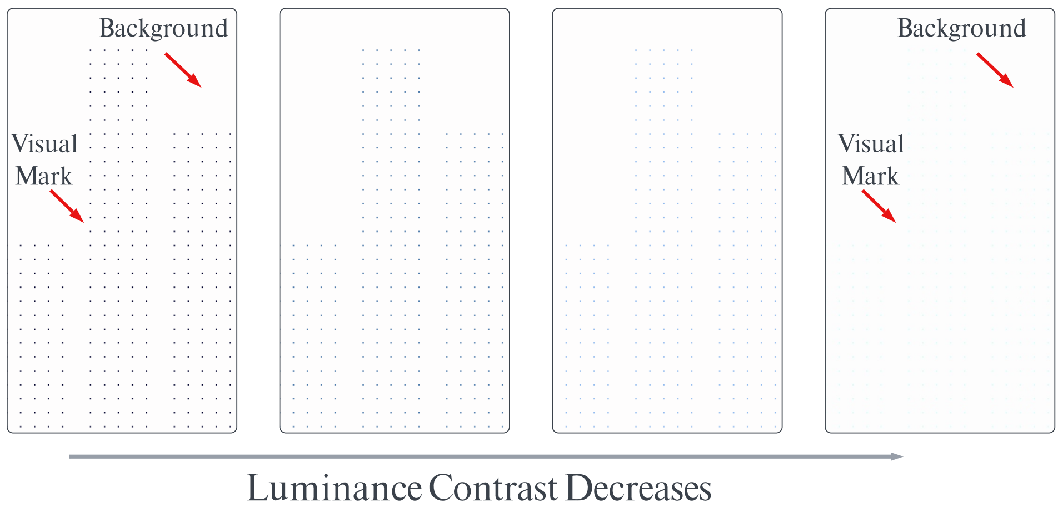
Masking Scheme for Area-based Marks
We change the luminance values of marks in the LAB color space
Notes:
We use the CIELAB color space when adjusting the luminance contrast of visualization instead of the RGB color space. the L channel of the CIELAB color space aligns well with the actual perception of luminance by the human vision system. By changing the luminance of the pixel of visual marks and background in the CIELAB color space, we can accurately control the luminance contrast between visual marks and the background.

Slide 29
Evaluation
Notes:
We conducted two studies to comprehensively evaluate our method.

Slide 30
Evaluation – Preliminary Study
Human perception of visual indicators is affected by two elements: luminance contrast and spatial frequency
To attain optimal privacy protection, we must identify the best combination of these two factors
Notes:
In the preliminary user study, we invited 16 participants to evaluate different masking schemes and luminance contrast, using a five-point Likert scale. This helps us to narrow down the design space and identify specific combination that ensures good visibility for users as well as effective privacy protection from peekers.

Slide 31
Evaluation – Preliminary Study
We designed a 5-scale rating to evaluate participants’ effort and time needed to see the visualization processed by our method.
Notes:
We design a five-point Likert scale to evaluate participants' effort and time needed to see the visualization processed by our method. As shown in the list, the 1 to 5 represent the time and effort the participants need to identify the visual marks in the visualization. 1 indicates that they cannot see any visual mark in the visualization, while 4 means that they can see the visual marks in the visualization with additional time and effort. 5 means that users can see the visual marks at a glance. =============== From the preliminary study result, we can find that there are specific combinations that can ensure good visibility for users as well as good privacy protection for peekers.

Slide 32
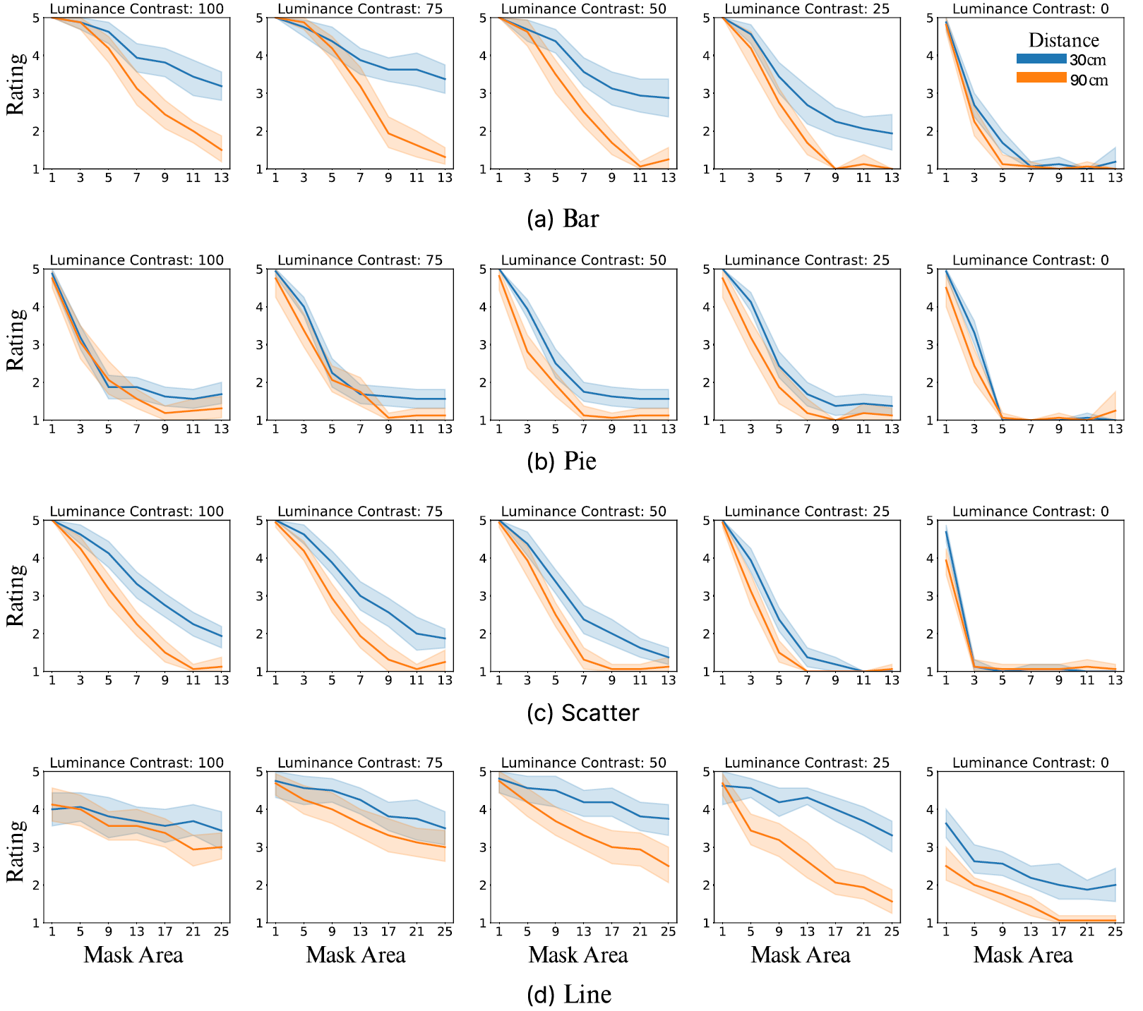
Evaluation – Preliminary Study
Four popular visualization types^{[3]}: bar, pie, scatter, and line
[4] Battle, Leilani, et al. "Beagle: Automated extraction and interpretation of visualizations from the web." Proceedings of the 2018 CHI conference on human factors in computing systems. 2018.
Notes:
We selected four popular visualization types for the study: bar chart, pie charts, scatter plot and line chart. According to the rating results, we identify specific combination that ensures good visibility for users as well as effective privacy protection.

Slide 33
Evaluation – User Study
According to the preliminary study result, we selected the best combination of two factors and further conducted a user study.
We recruited 18 participants to systematically assess the effectiveness of the method.
Notes:
Based on the preliminary study result, we conducted a user study to evaluate our method and recruited 18 participants. This study aims to assess the complete version of our approach with suitable variable in comparison to the baseline approach. The user study consists of quantitative evaluation and post-study interview.

Slide 34
Evaluation – User Study
Baseline methods:
Original Visualization: the original visualization is not processed by our approach.
Coarse-grained Visualization: the visualization is processed by only the coarse-grained masking scheme in our method.
Our method:
The visualization is processed by both the coarse-grained and fine-grained masking scheme.
Notes:
In the user study, we compare our method with two baseline methods: the original visualization without any processing and the coarse-grained visualization processed by the coarse-grained masking scheme. Based on our method, which processes the visualization by both the coarse-grained and fine-grained masking scheme.

Slide 35
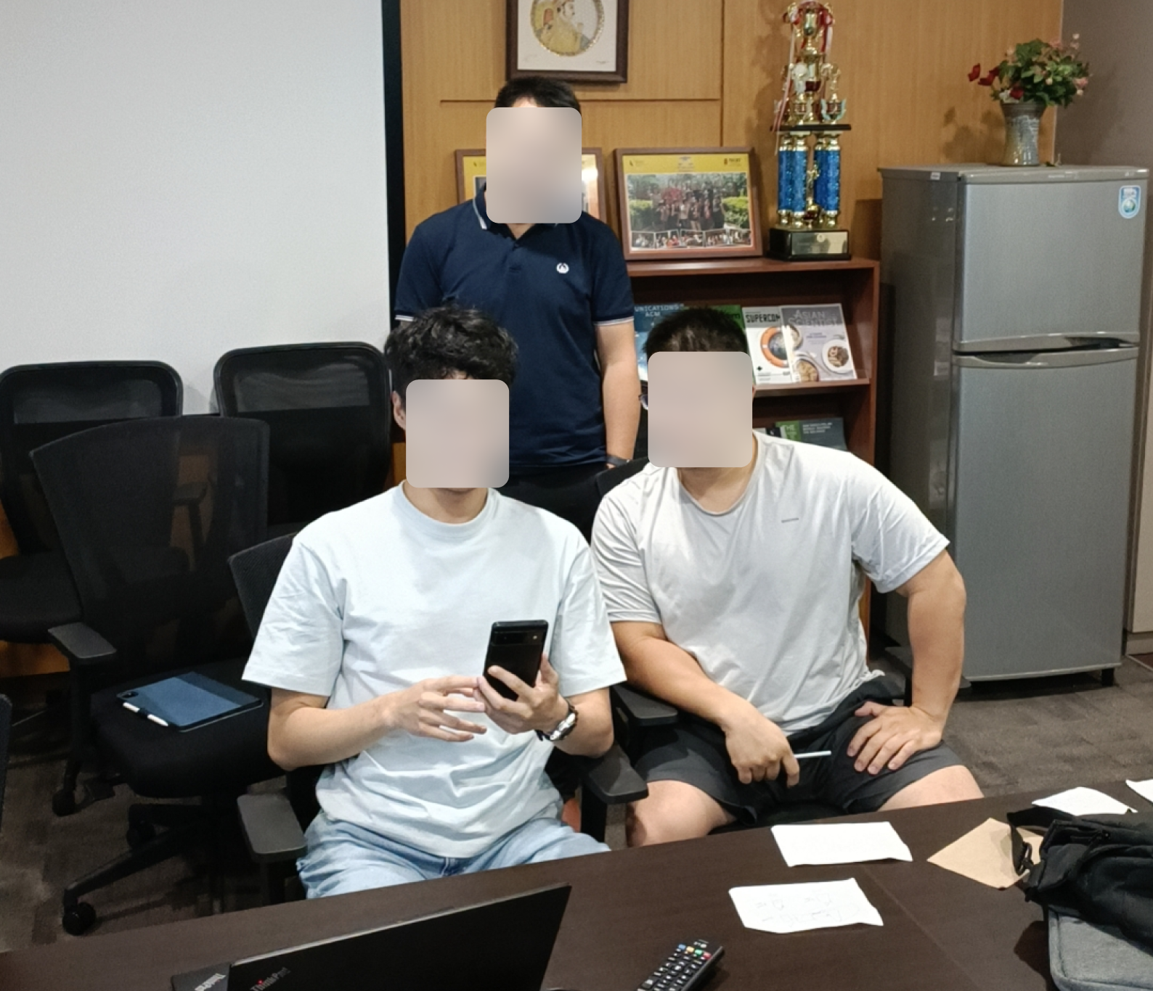
Evaluation – User Study
We conducted a within-subject study where the participants viewed the test visualization at three different distances: 30cm, 60 cm and 90 cm.
90
30
60
Notes:
We conducted a within-subject study where the participants viewed the test visualization at three different distances: 30 cm, 60 cm and 90 cm. This distances considered the representative daily mobile phone usage and shoulder surfing attack scenario. 30 cm denotes the distance between a mobile phone and users. 60 cm is the distance between a peeker and the user's phone when the peeker and user are sitting together, and 90 cm refers to the distance when the peeker sits behind the user in a public transportation like bus.

Slide 36
Evaluation – User Study
Visualization is composed of text, axes and visual marks^{[5]}.
Therefore, there are two tasks for rating: visual mark visibility rating and text readability rating.
We utilize the same rating criteria the same as the preliminary study.
[5] Poco, Jorge, and Jeffrey Heer. "Reverse‐engineering visualizations: Recovering visual encodings from chart images." Computer graphics forum. Vol. 36. No. 3. 2017.
Notes:
Since visualization is composed of text axes and visual marks, if the participants can clearly identify both text and marks they are able to comprehend the visualization. Therefore, there are two tasks for rating visual mark visibility rating and text readability rating. Additionally, we utilized the same rating criteria as in the preliminary study.

Slide 37
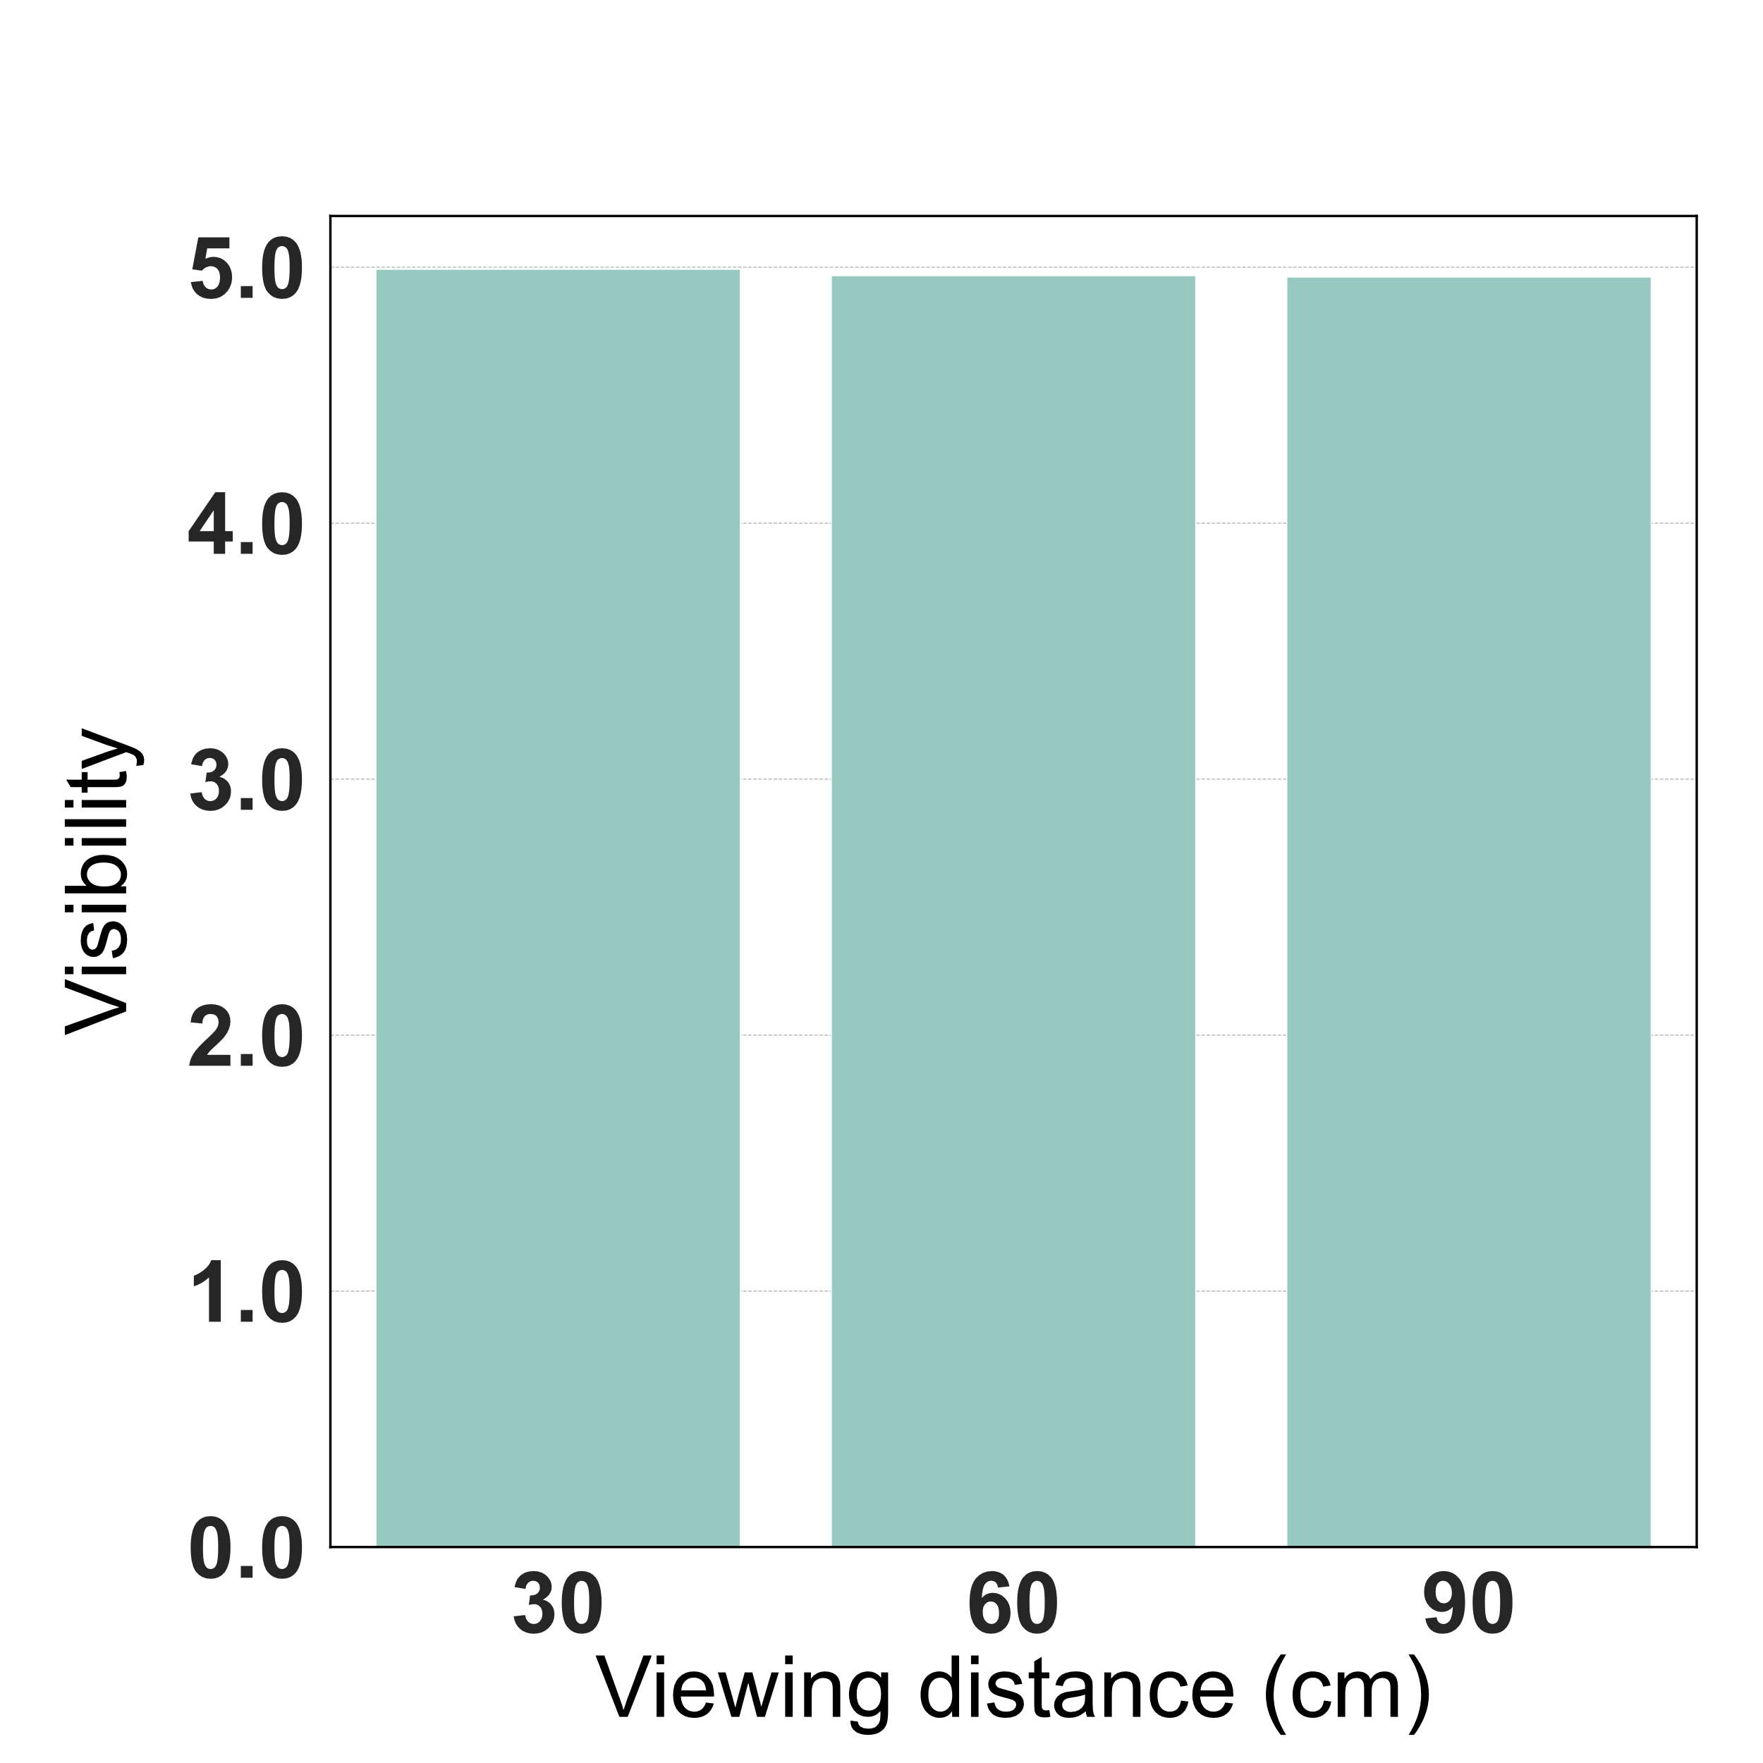
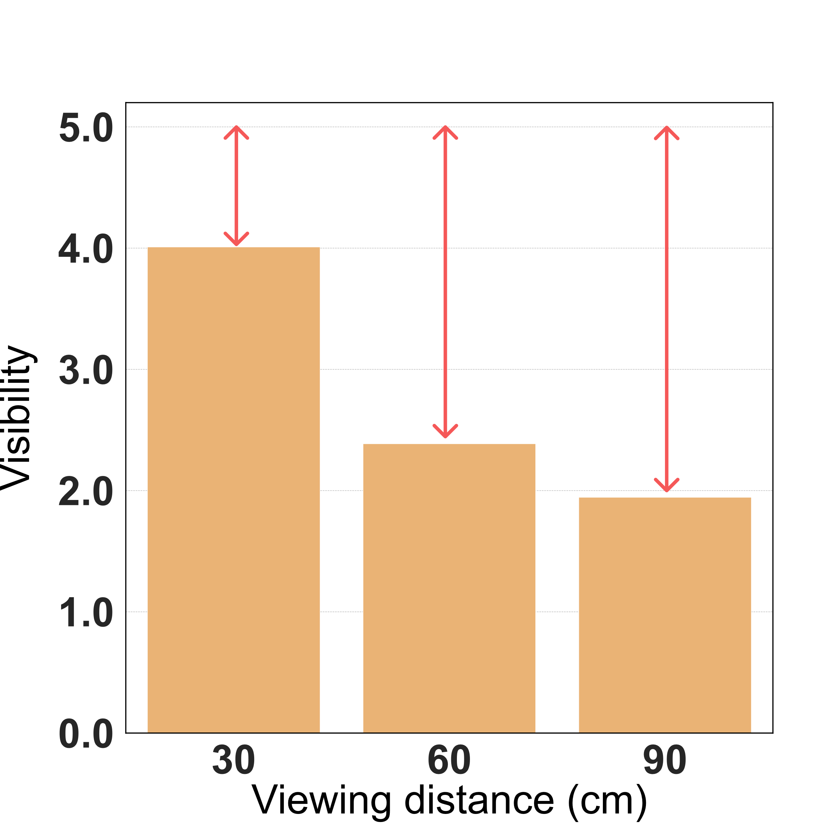
Evaluation – User Study
Our method can achieve good privacy protection at a far distance
Notes:
The figure shows the participants' average rating (of visual marks) for each of the three methods and three different viewing distance. Figure (a) shows that when a normal mobile phone using distance which is around 30 cm, participants can see the visual marks without any difficulty. However when participants are at 60 cm, or 90 cm away from the mobile phone, their ability to see the visual marks in the visualization drop rapidly. Particularly, at about 90 cm, they only perceived a small portion of visual marks in visualization. This indicates that our method successfully conceals visualizations from peekers while maintain visibility for the users.

Slide 38
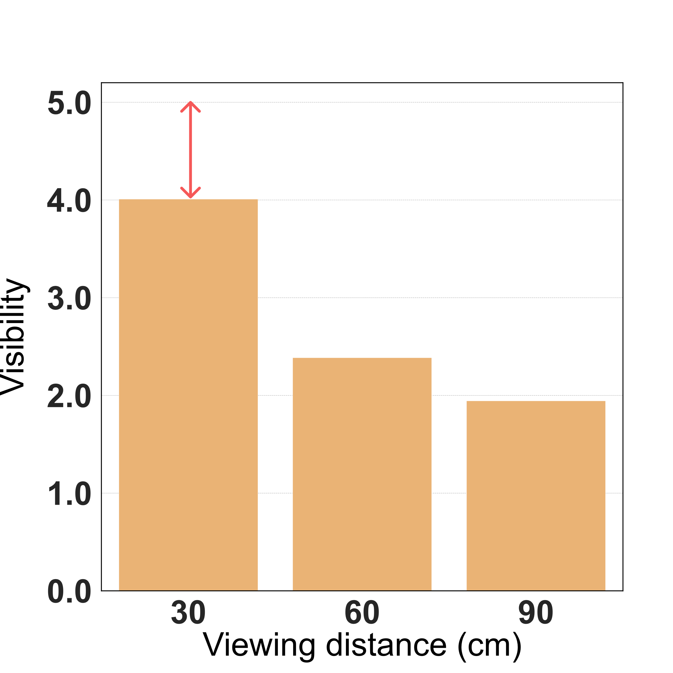
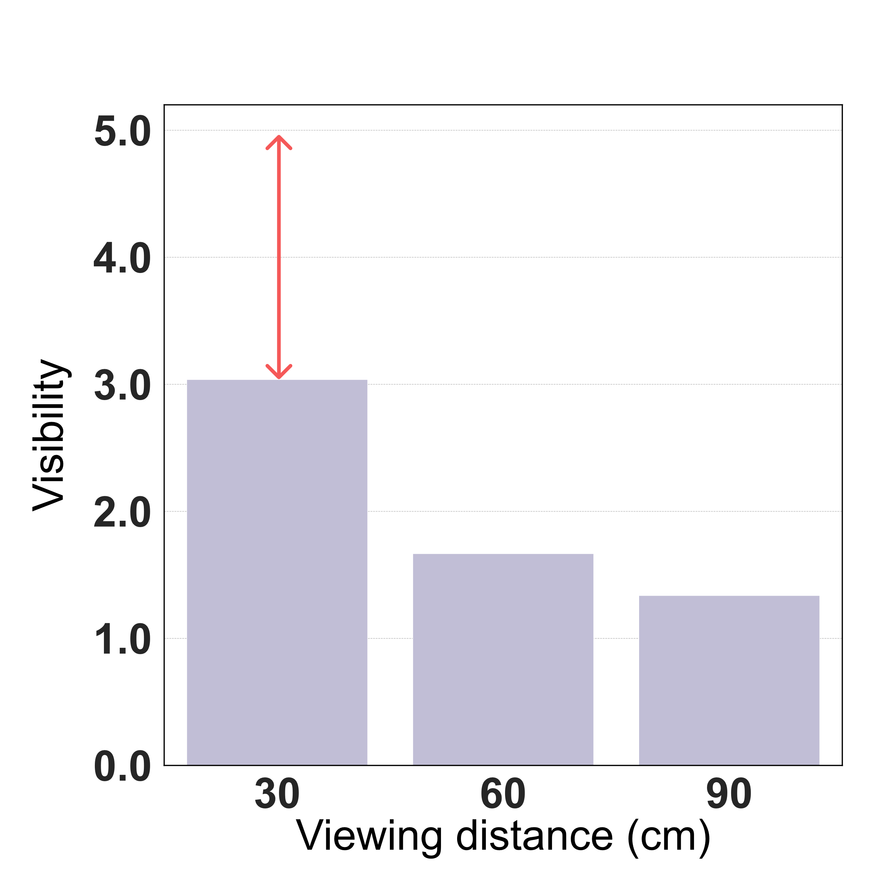
Evaluation – User Study
Our fine-grained method can achieve better visibility at a close distance
Notes:
The figure shows the participants' average rating (of visual marks) for each of the three methods and three different viewing distance. Figure (a) shows that when a normal mobile phone using distance which is around 30 cm, participants can see the visual marks without any difficulty. However when participants are at 60 cm, or 90 cm away from the mobile phone, their ability to see the visual marks in the visualization drop rapidly. Particularly, at about 90 cm, they only perceived a small portion of visual marks in visualization. This indicates that our method successfully conceals visualizations from peekers while maintain visibility for the users.

Slide 39
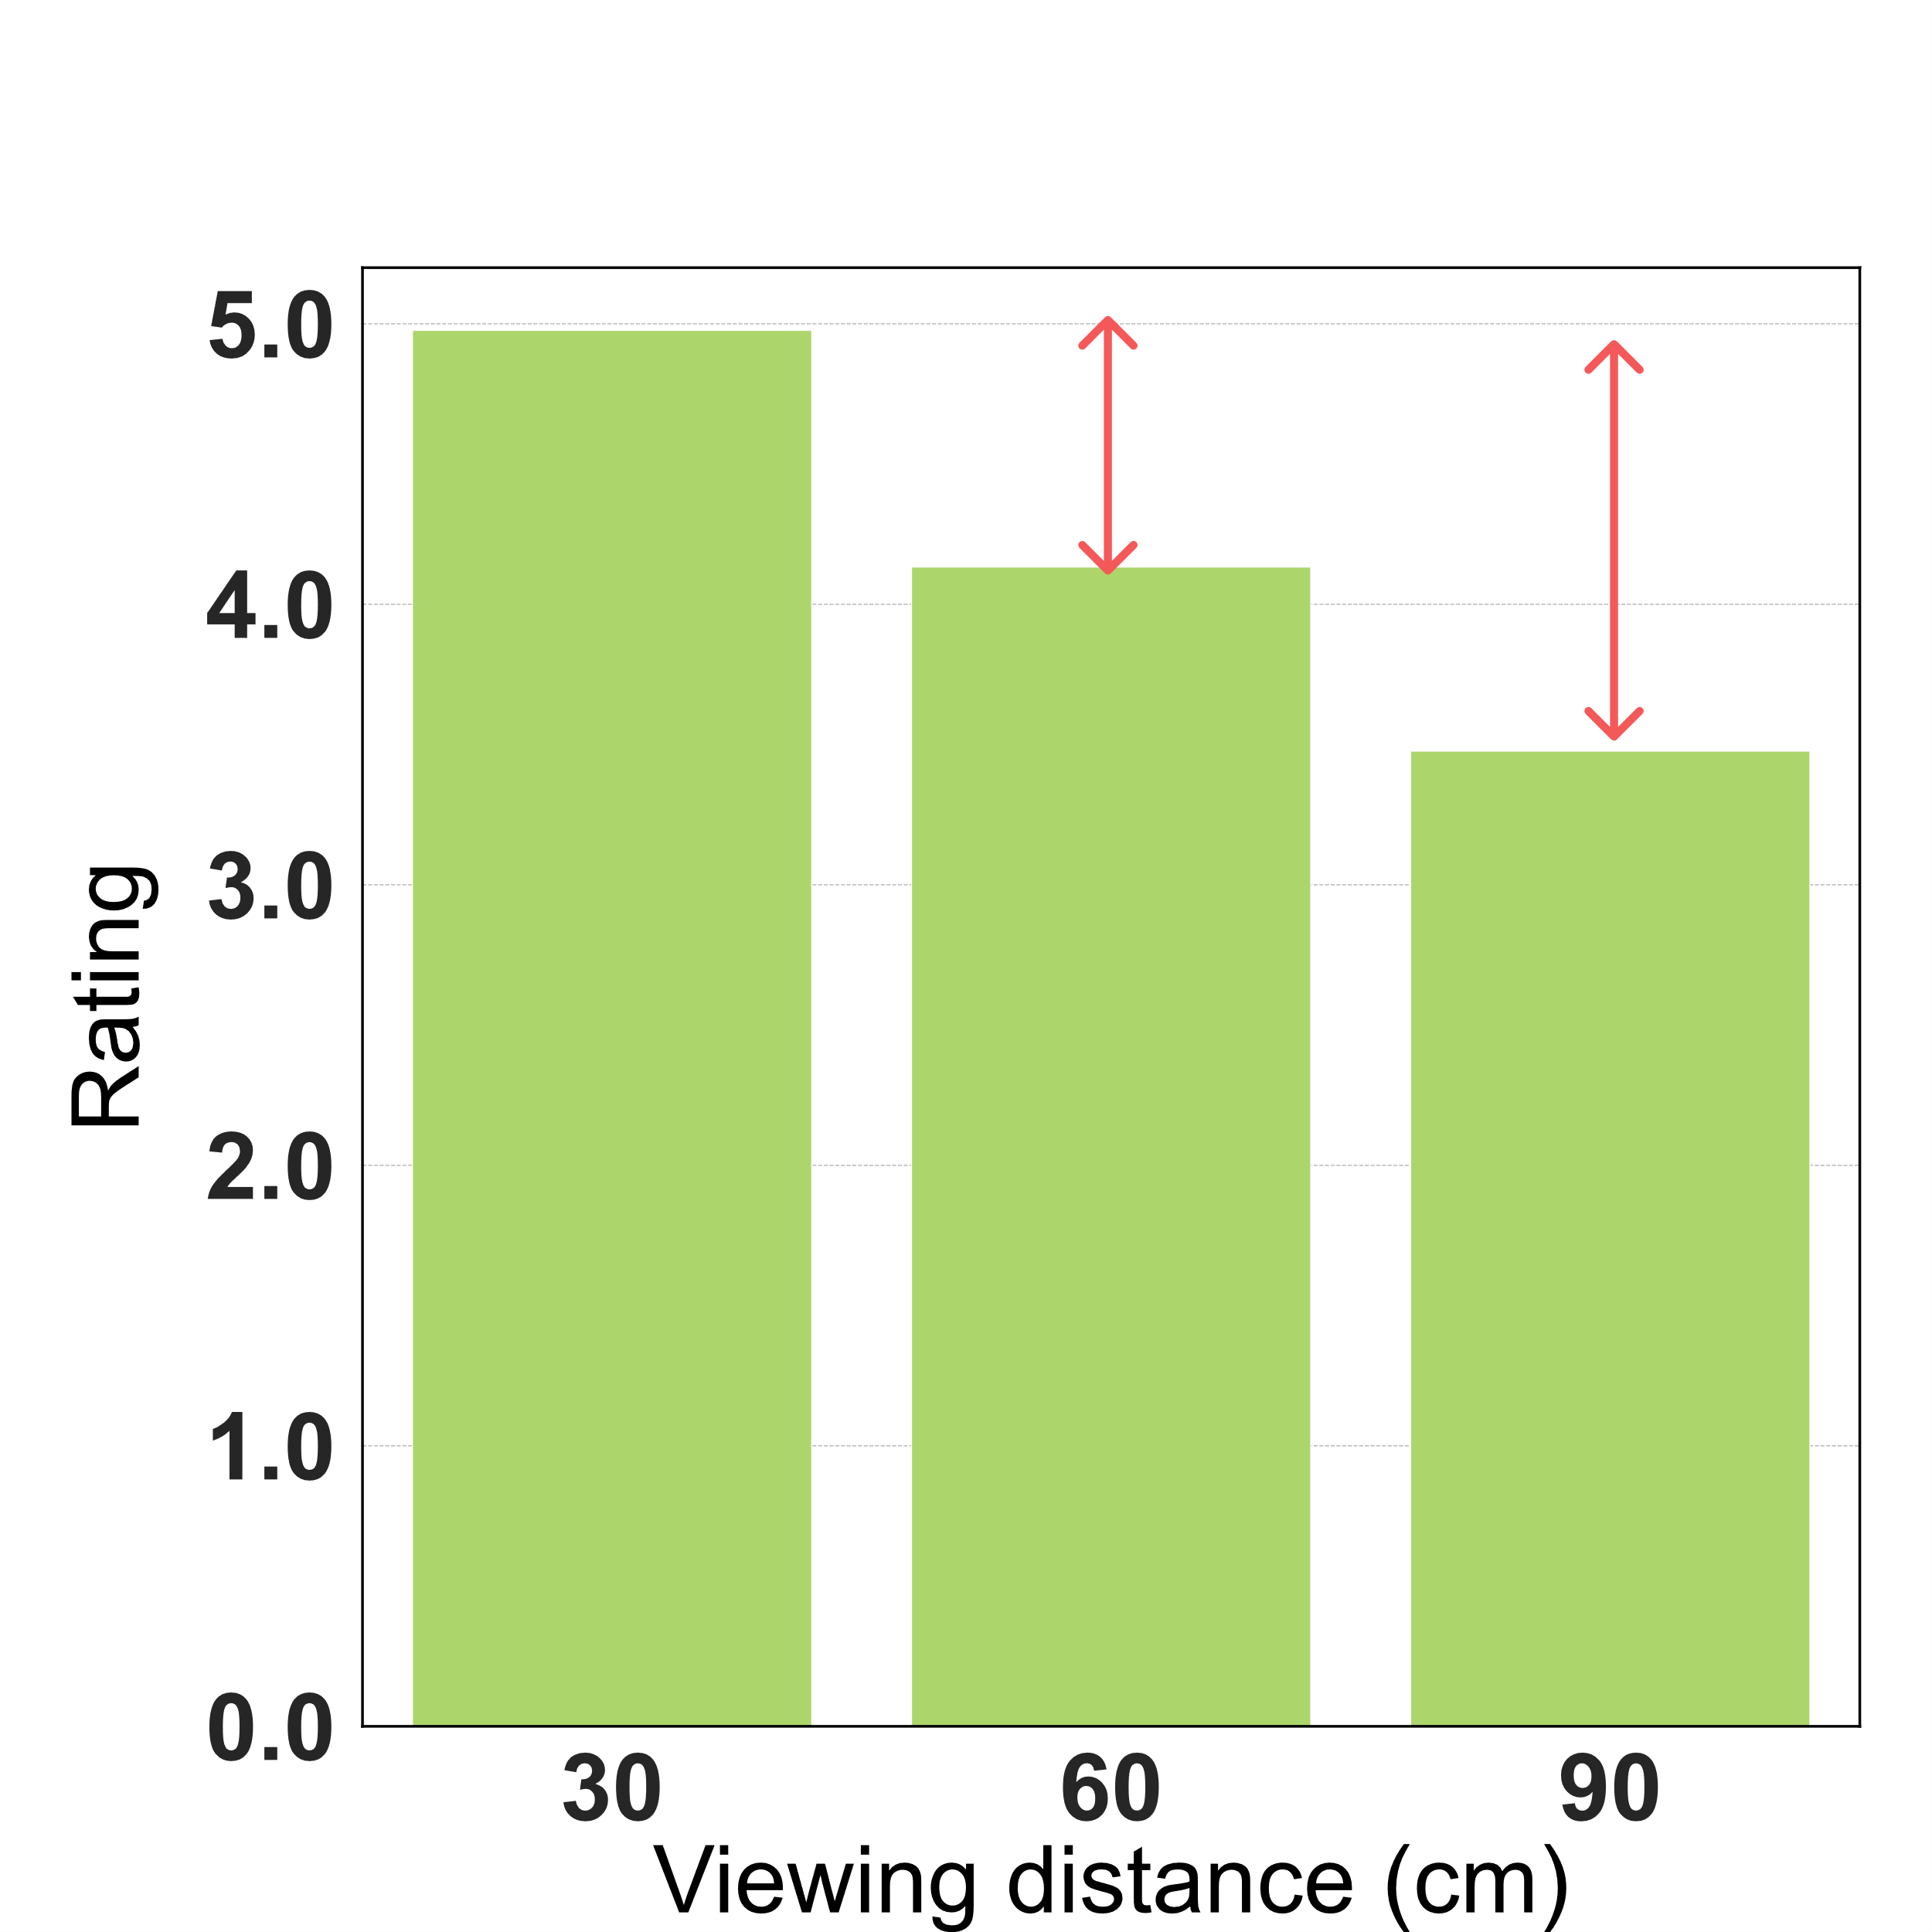
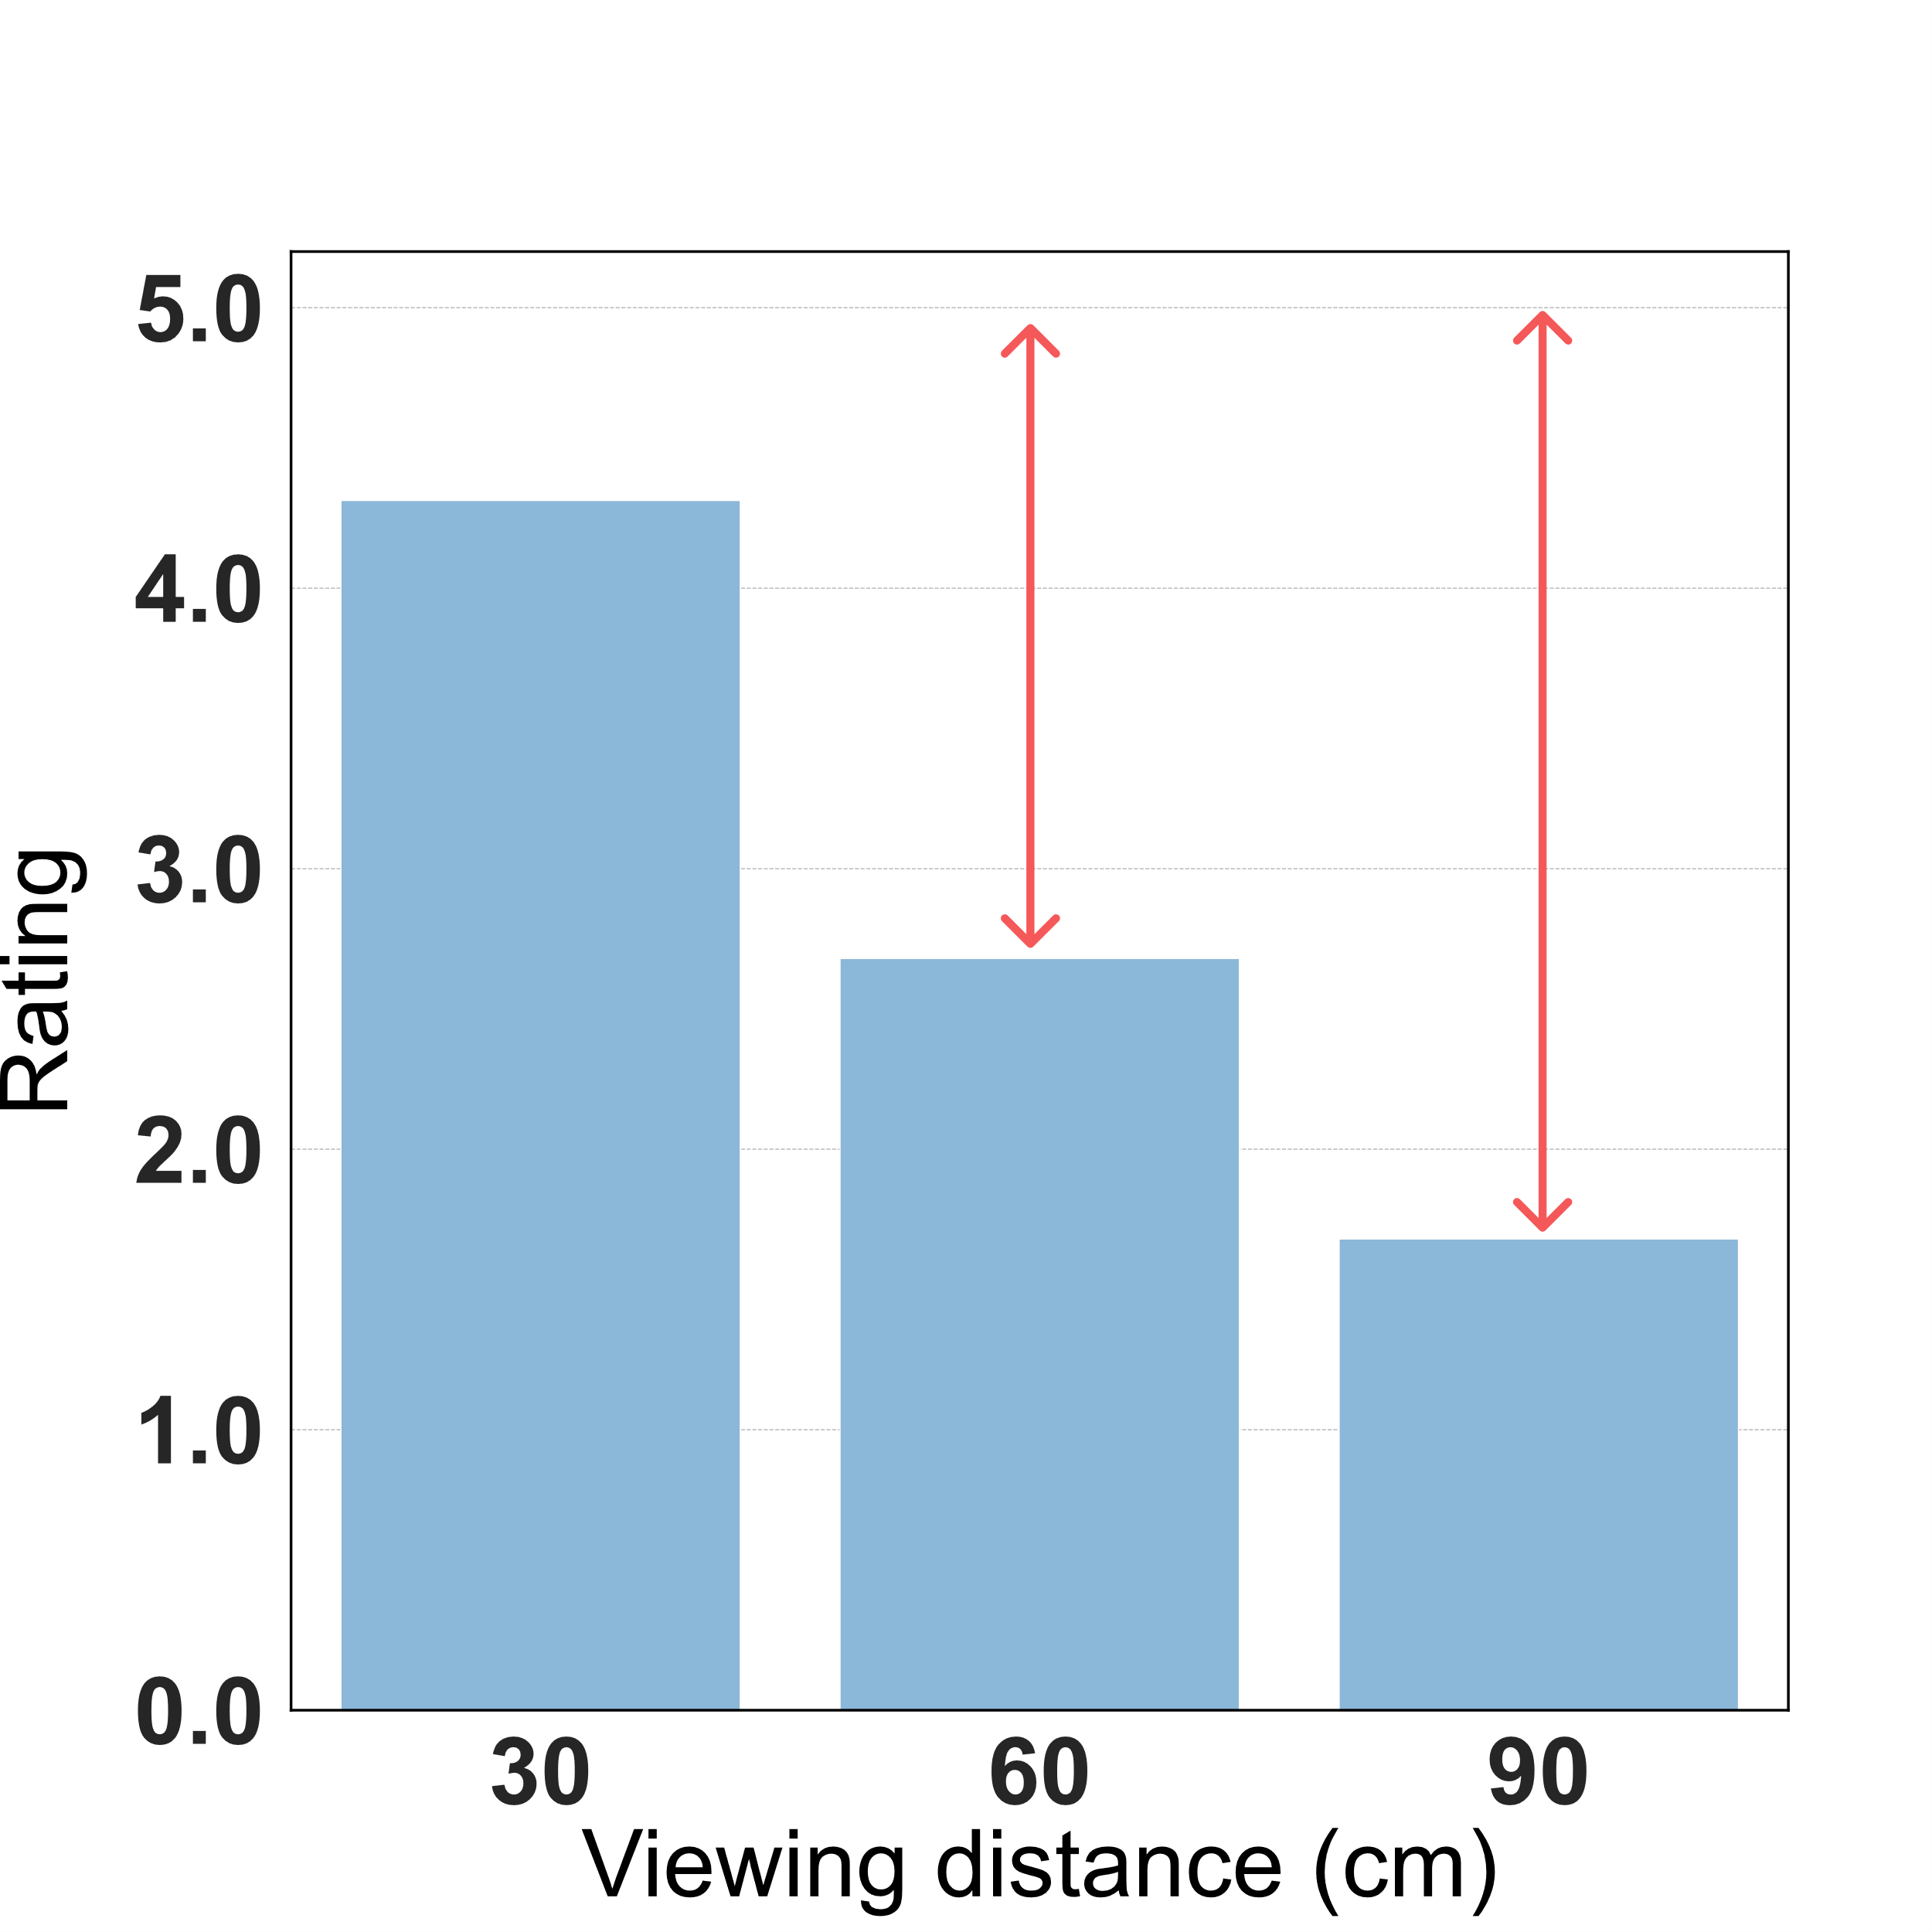
Evaluation – User Study
Our fine-grained method can achieve better privacy protection at a farther distance
Notes:
As for the text readability rating, figure (a) verifies that participants can read the same content in the processed test as in the original text, because the average rating significantly overcomes 4, which means that the participants can clearly see all the processed text by our method. As shown in the figure (b) and (c), participants
had difficulty identifying the text, once the viewing distance increased, resulting in a dramatic drop in their ratings.

Slide 40
Take-away Message & QA
Our method enables humans to see visualization at a close distance but hardly see it at a far distance
To this end, we utilize both the human vision system and visualization properties
Shzhang.2021@phdcs.smu.edu.sg
Notes:
In general, the takeaway message is that shoulder surfing attack occurs when the peeker is at a distance from the user. By adjusting the spatial frequency and luminance contrast of visual marks in a visualization, our method can make peekers after a certain distance hardly see the privacy-preserving visualization. In the future, we plan to apply our method to more visualization types and mobile devices.

