Slide 1
Quantum Computing
Background
Quantum computing has achieved great success in recent years
Notes:
My name is Shaolun from Singapore Management University. Surprise huh? There is actually a data visualization group in Singapore.
Anyway, before we get started, let’s do a survey. How many of you in this room have ever heard of quantum computing? Entanglement? How it actually work?
Prior work has found it is difficult to learn quantum computing. Because concept is abstract.
Our group tried to use visualization to explain qc and make it easy-to-understand than ever before.
So let’s get started with the background session.
We all know that quantum computing has achieved a great success in recent years, with a variety of applications demonstrating quantum speedups in areas
such as machine learning, cryptography, and finance.

Slide 2
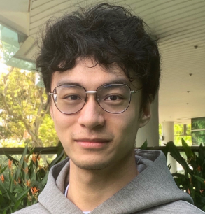
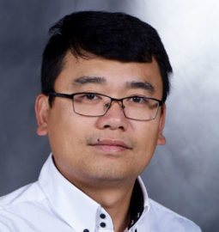
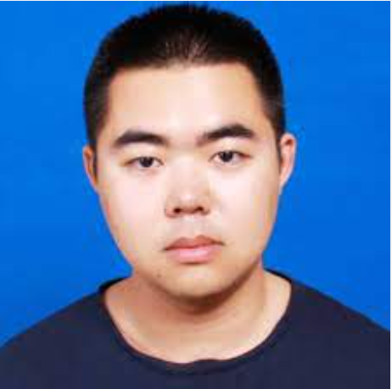
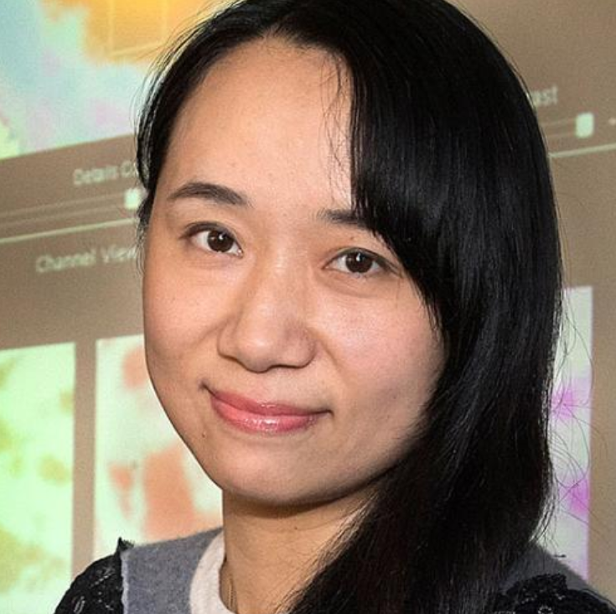
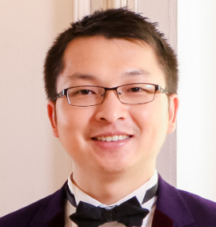
VENUS: A Geometrical Representation for Quantum State Visualization
Shaolun
RUAN
Ribo
YUAN
Qiang
GUAN
Yanna
LIN
Ying
MAO
Weiwen
JIANG
Zhepeng
WANG
Wei
XU
Yong
WANG
Notes:
In this work, I will present our work “VENUS: A Geometrical Representation for Quantum State Visualization.”
This work is in collaboration with all of my amazing co-authors, which are shown as follows.

Slide 3
VENUS: A Geometrical Representation for
Quantum State Visualization
We propose VENUS, a geometrical visualization for quantum state visualization
1. Probability visualization
It allows the explicit visualization and explanation of measured probability
2. Two-qubit state visualization
It supports both single-qubit and two-qubit state visualization
Notes:
So first, I want to briefly sum up our work without going in detail.
Generally, we propose a visualization approach to better support quantum state representation.
We use multiple coordinated 2D geometrical shapes visualize and further explain the measured probability of all basis states.
Moreover, we employed the same visualization methods to support both single-qubit and two-qubit states.
So first let’s get started with the background session.

Slide 4
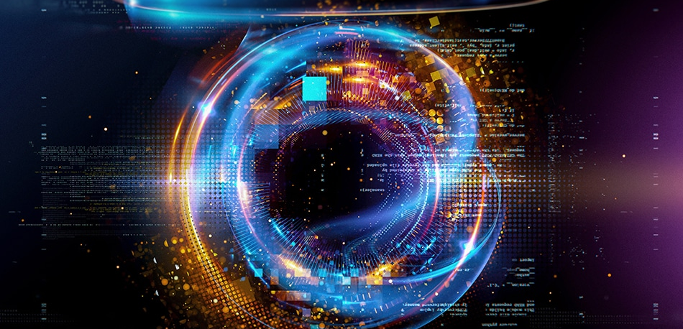
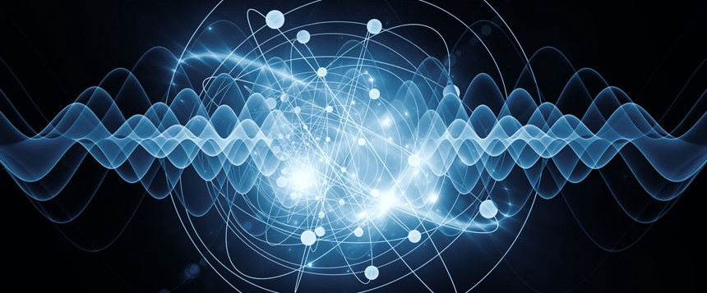
Quantum Superposition
Motivation
Quantum Entanglement
Notes:
What makes the quantum computing so powerful over its classical counterparts are two most fundamental properties, you may already know,
quantum superposition and quantum entanglement.

Slide 5
The visualization for the two fundamental properties are still complex.
Notes:
But for the visualization of these two properties, they are difficult to visualize.
So then I will introduce our solution to meet the two requirements respectively.

Slide 6
Background
Quantum superposition
Quantum Superposition
A qubit can be in the state |0⟩ or |1⟩ simultaneously
Background
6
Notes:
So let’s get started with quantum supersposition.
quantum superposition refers to the unknown quantum states before they are measured.
After measuring a qubit, it collapses into either the state |0⟩ or |1⟩ based on the deterministic probabilities of all possible basis states.

Slide 7
Quantum Superposition
Visualization for explaining probability
50%
50%
for State |0⟩
for State |1⟩
Quantum superposition
Notes:
People often use probability to describe this quantum superposition, for example, 50% for the measurement of state 0 and 1. And also, as you know, the story of Schrodinger's cat. To describe the probability, uncertainty

Slide 8
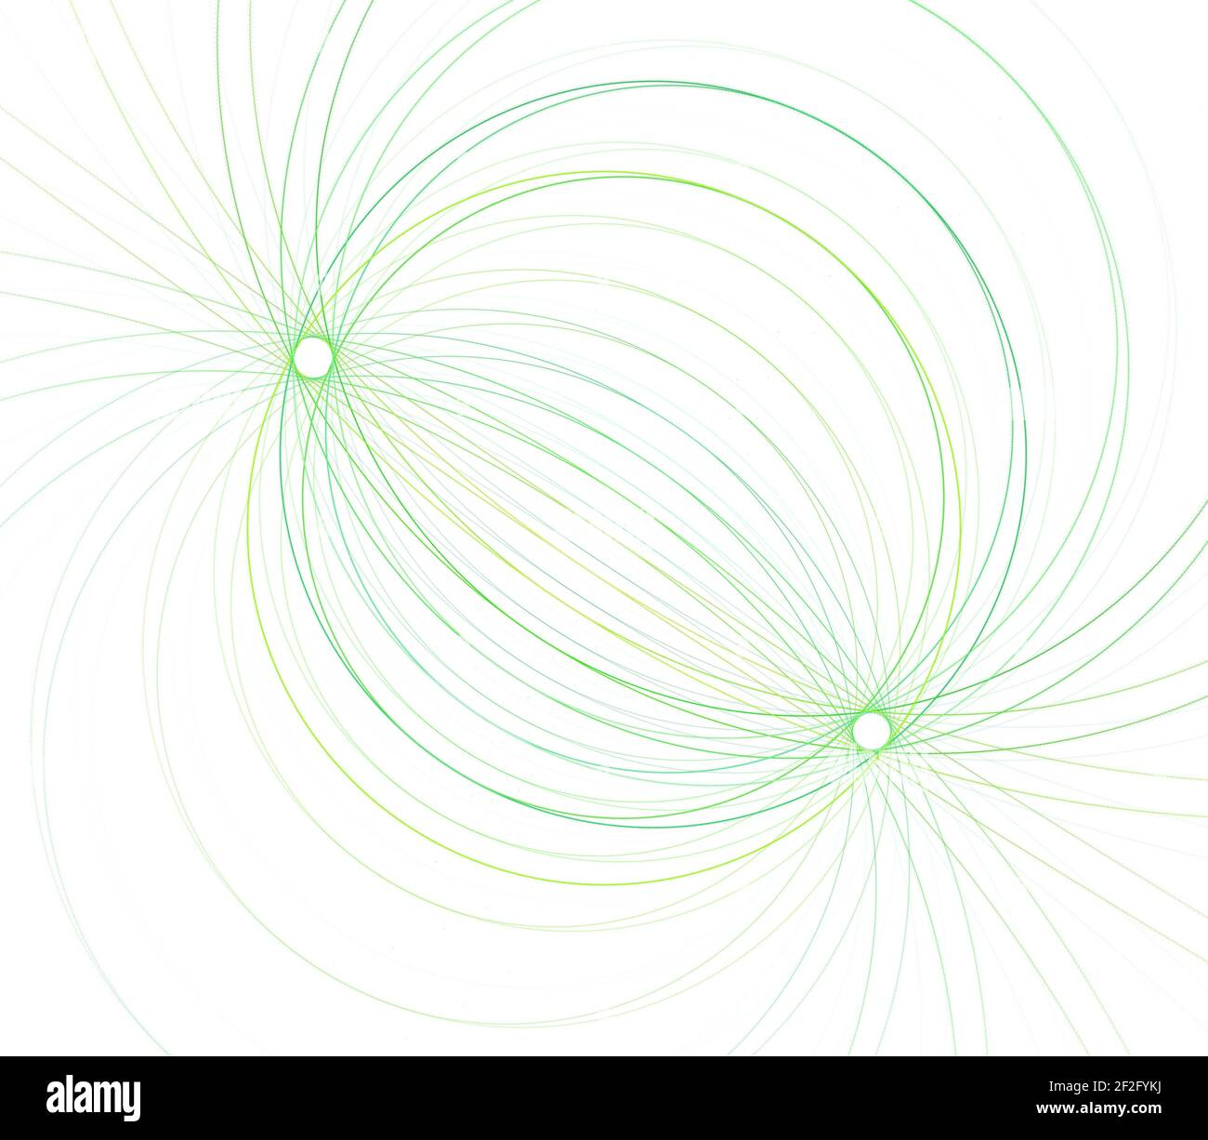
Quantum Superposition
Visualization for explaining probability
It is important to visualize and explain the measured probability of basis states
e.g., the probability of state |0⟩ is, say 0.5,
but why?
Quantum superposition
Notes:
However, this important property cannot be intuitively observed and easily understand.
For example, let’s say the probability of state 0 is 0.5, how can we understand and trust this measured value?
So, to make the measured probability easier to understand, the visualization should help users to achieve a mathematical intuitiveness of the probability determination.

Slide 9
VENUS
For measured probability visualization
VENUS supports the visualization and explanation of measured probability of each basis state
Visualization of measured probability
Explanation of measured probability
Quantum superposition
9
Notes:
To this end, we introduce, which can first
uses the (CL) area of semi-circles to visualize measured probability.
And it also uses the (CL) line segments which circumscribes the semi-circle to explain this measured probability.
So now I will illustrate the design principle, like what is the inner line segments indicate, and how they explain the probability.

Slide 10
VENUS
For measured probability visualization
Single-qubit state visualization:
Step 0: state vector foundation
Quantum superposition
Notes:
A certain quantum state, for example, phi, can be represented as this formula.
Alpha represents the coefficient for state 0, and beta is the coefficient for state 1. We can call this coefficient the amplitude.
And alpha and beta can be written as this formula, which consists of a real part and a imaginary part cuz the amplitude is actually the complex number.
More specifically, we encode the absolute values of real parts (i.e., a and c) and imaginary parts (i.e., b and d) of each amplitude by the line segments in black and grey (CL), respectively. The two line segments can natually formed a right triangle (CL).

Slide 11
VENUS
For measured probability visualization
Single-qubit state visualization:
Step 1: visualize and explain measured probability
$$\operatorname{Pr}{|0⟩}={\left|α\right|}^{2}={\left|a\right|}^{2}+{\left|b\right|}^{2}$$
- Pythagorean theorem
Quantum superposition
Notes:
And then, the question is how could we visualize the probability using the line segment?
We already know that the measured probability of, say state 0, equals to the sum of the square of a and b, which is actually the square of the diameter of the semi-circle, as shown here
At the same time, the area of the semi-circle (CL) can be written in terms of the square of the diameters as well, based on the Pythagorean Theorem.
.

Slide 12
VENUS
For measured probability visualization
Single-qubit state visualization:
Step 1: visualize and explain measured probability
$$\operatorname{Pr}{|0⟩}=\frac{π}{8}∙S_{semicircle}$$
Quantum superposition
Notes:
.
So we can find that the area of the semicircle (CL) is proportional to the probability of the quantum state.
Building upon this, we can then see the relationship between the two probabilities via the comparison of the semicircle area.
And you may already find that we can see the semi-circle area determination based on the line segments which circumscribed the semi-circle.

Slide 13
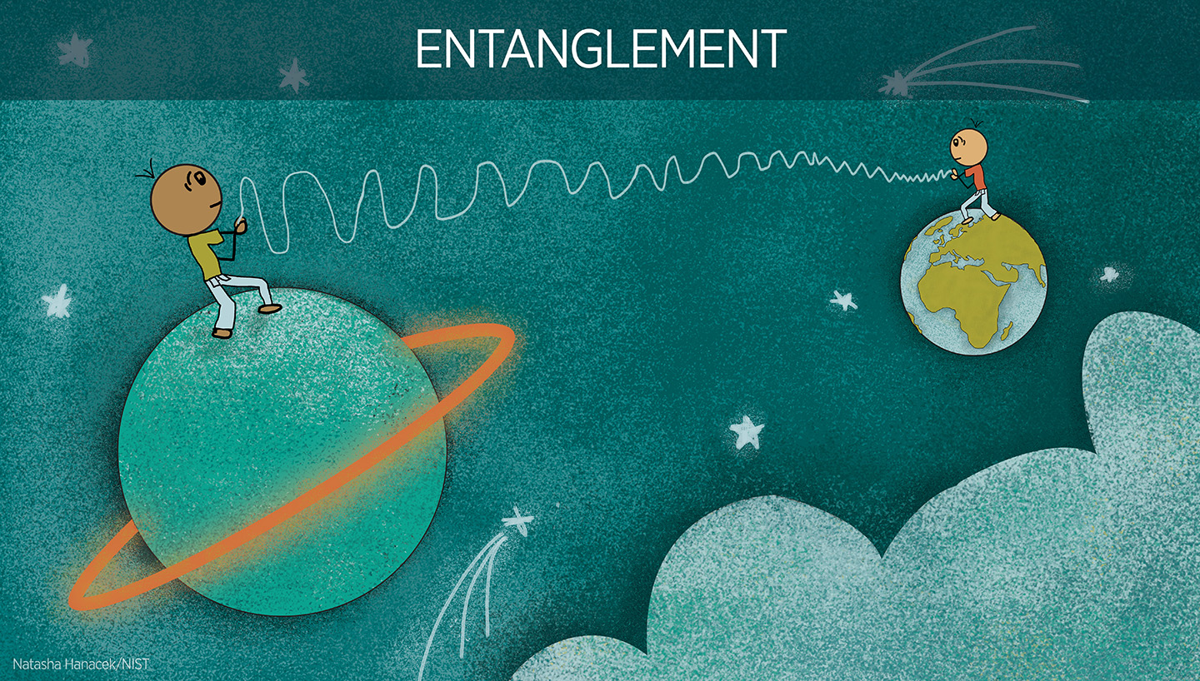
Quantum Entanglement
Visualization for quantum state with over 1 qubit
Quantum entanglement
One qubit can be impacted by the other entangled qubit directly
Notes:
Ok. now The visualization for quantum superposition has now been improved. But there is also problem for quantum entanglement.
Quantum entanglement, supports the correlations between multiple single qubits.
It means that manipulating one qubit can directly impact the state of the other qubit(s).
So now you may already find that the entanglement requires at least two qubit right?

Slide 14
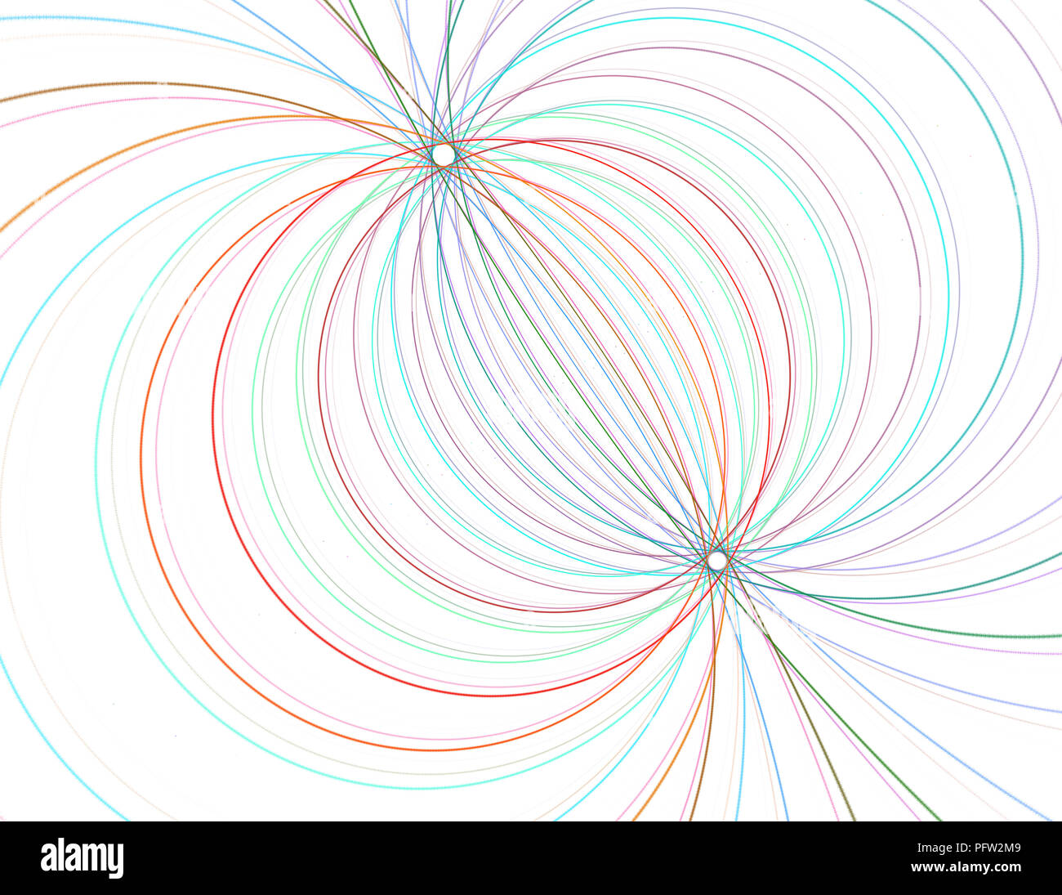
Motivation
Visualization for multi-qubit state
It is important to visualize the quantum state with more than one qubit
which is the basic requirement for quantum entanglements
Quantum superposition
Quantum entanglement
Notes:
However, the visualization approach to support the quantum state with more than one qubit, which serves as the foundation of the entanglement, is still under-explored.

Slide 15
VENUS
Visualization for two-qubit state
Two-qubit state
Quantum superposition
Quantum entanglement
Notes:
So as shown here, again, is the visualization of VENUS for the single-qubit state
So we just extend two right triangles (CL) on the two sides of the original right triangle.
As you can see, based on this encoding, the visualization can preserve all geometrical properties I mentioned before.

Slide 16
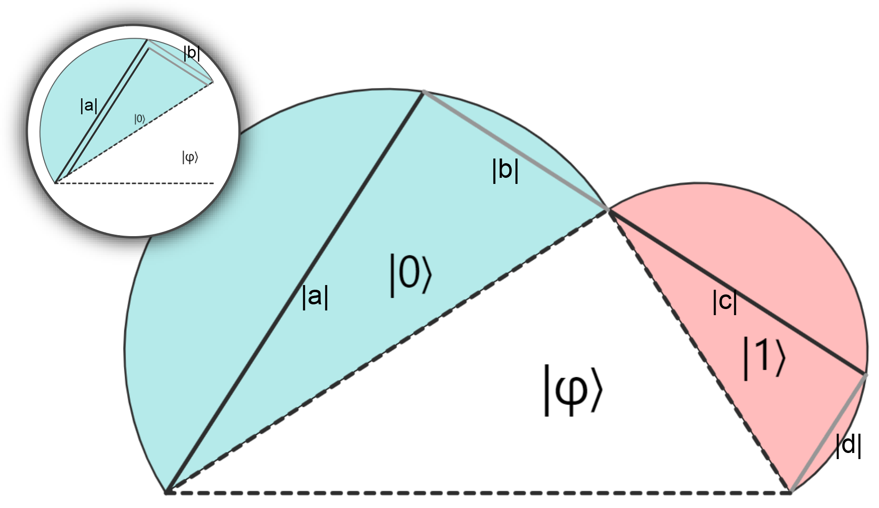
Evaluation
Demo showcase
Quantum classifier
Iris dataset [4]
[4] Iris dataset. https://archive.ics.uci.edu/ml/datasets/iris
Notes:
So now I will briefly demonstrate our visual design VENUS using a concrete example, which is a Quantum Classifier based on the two-feature Iris dataset.

Slide 17
Evaluation
Demo showcase
Quantum Neural Network example
If the Prob(state=0)=0.4, Prob(state=1)=0.6, the prediction will be state 1.
How this model changes the initial quantum state is not transparent.
Notes:
The quantum circuit shown in the figure is the architecture of QNN, and the block inside the circuit are quantum gates implementing this circuit
The principle of QNN is simple, the final prediction is determined by the basis state with the largest probability.
And every time the quantum states go through a gate, the state will be modified according to the respective gate.
So we intend to see how the quantum state will be changed along the circuit using our visualization approach VENUS.

Slide 18
Evaluation
Demo showcase
Quantum Neural Network example
1
2
3
4
Notes:
We first randomly select a data point to see the evolution of its prediction, and evenly output the quantum state in four epoch.

Slide 19
Evaluation
Demo showcase
Quantum Neural Network example
1
2
3
4
Notes:
From Figure A1, we can easily identify that the probability of label 0 is significantly larger than that of label 1, (CL) indicated by the area of the respective semicircle.
It shows the initial state of the data point at the beginning stage of the training.

Slide 20
Evaluation
Demo showcase
Quantum Neural Network example
1
2
3
4
Notes:
After Epoch 25, (CL) the area of the two semi-circles are almost the same,
and we can see that this is because of the decrease (CL) of the imaginary part of the amplitude for state 0.

Slide 21
Evaluation
Demo showcase
Quantum Neural Network example
1
2
3
4
Notes:
And then, the semicircle area of state 1 is significantly larger than (CL) that of state 0 at Epoch 50 and (CL) almost remains the same at Epoch 100.
We can find the reason of this change is due to the increase (CL) of the real part of amplitude of state 1.
The model now can predict the label of the data point as 1 at the Epoch 100 cuz it has a larger area

Slide 22
Evaluation
Demo showcase
Quantum Neural Network example
1
2
3
4
Notes:
And we can also find that the area of the semi-circle in red of state 1 has increased along with the training process, and we can also find how the probability was affected by the evolution of state vectors indicated by the line segments within the semicircles.
Also, these findings provide us with good guidelines for model tuning. For example, before the training begins, to make the model more sensitive for label 1, we can choose those data points with large real part of state 1 for the training set
because we know that this model will generally “increase” the length of real part of state 1 to make it to be predicted as label 1.

Slide 23
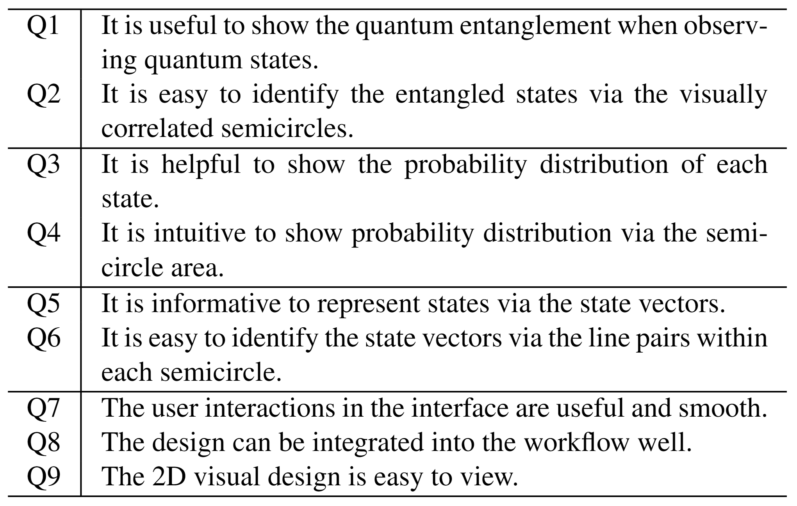
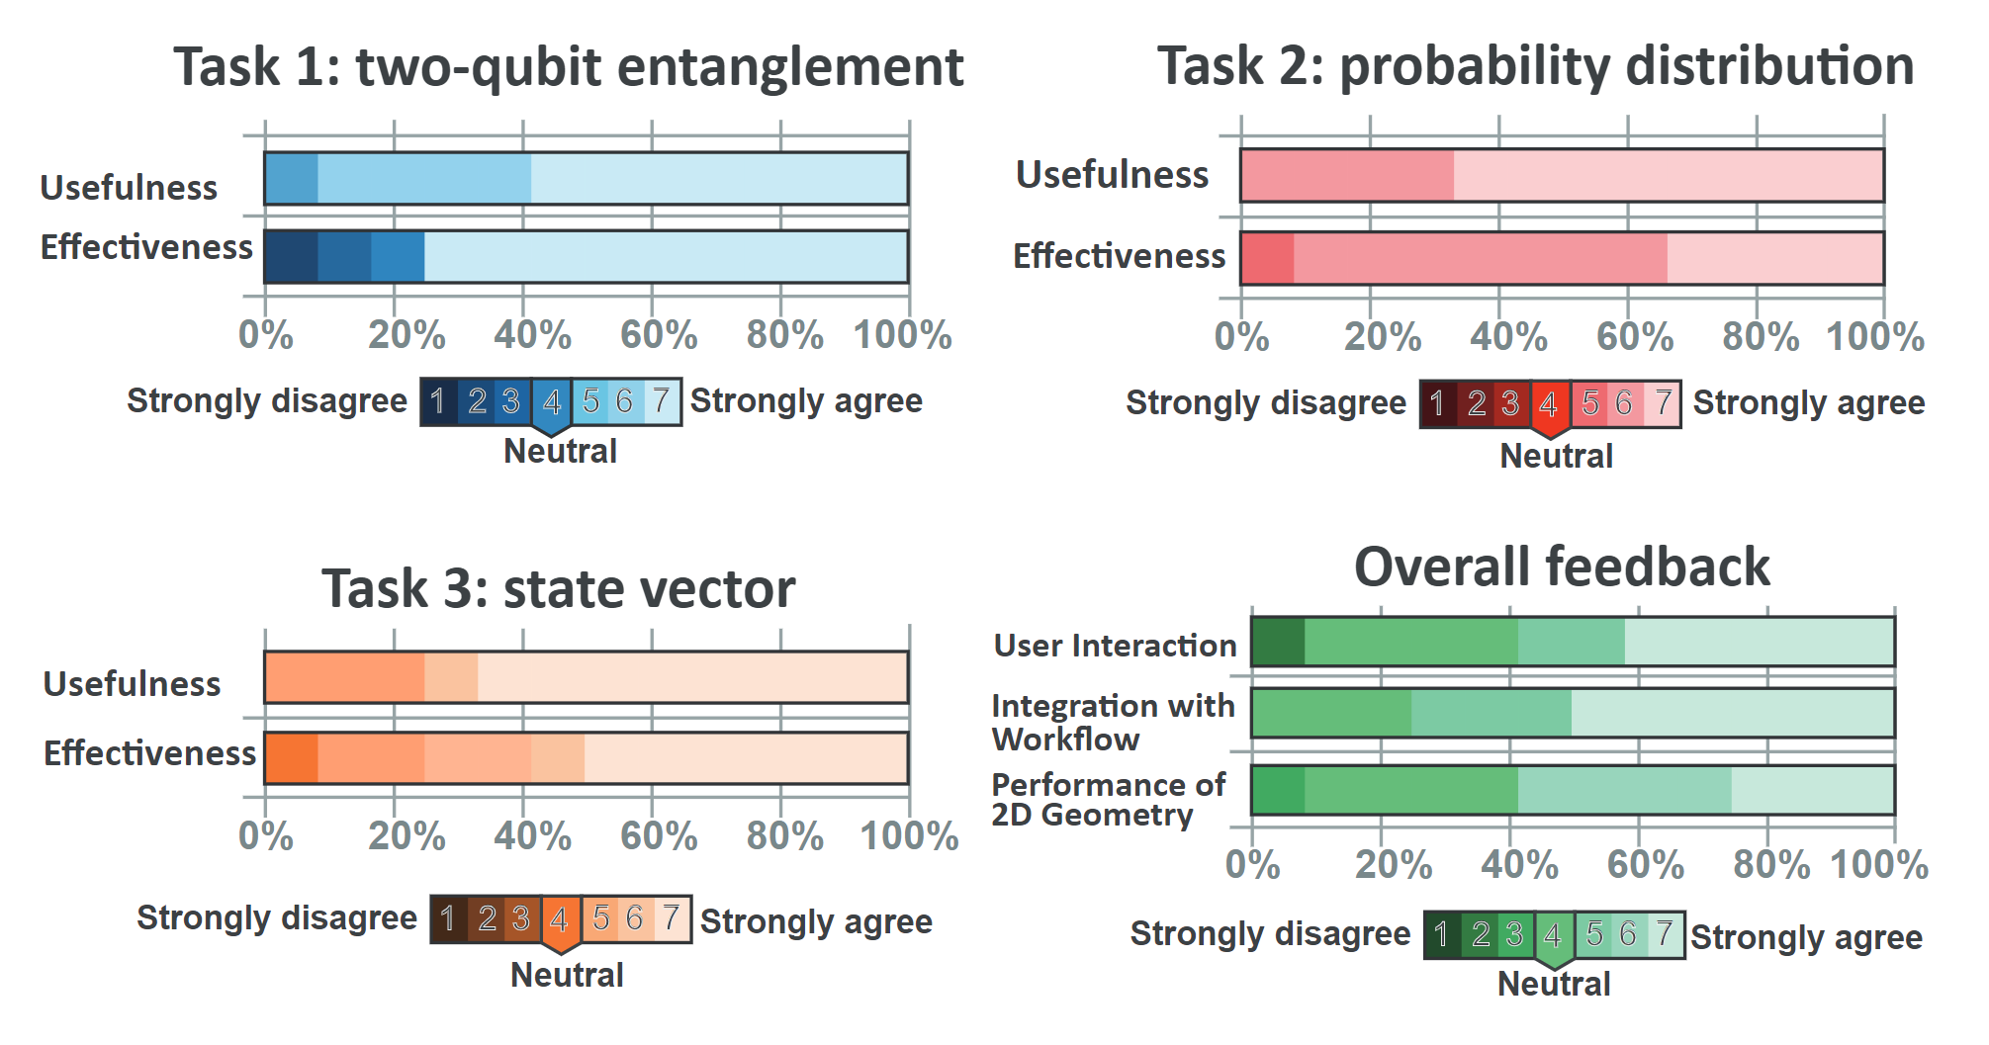
Evaluation
Expert interview
Questionnaire
Results:
“I like the idea of using the probability calculation equation to naturally visualize the probability distribution. I can directly check the probability without any manual calculation.”
Notes:
In addition to the case study, we also conducted carefully-designed expert interviews with 14 domain experts to evaluate the performance of VENUS for given tasks.
We also invited every participant to rate the VENUS using a 7-Likert scale.
Detailed ratings and questionnaire example are shown in this slide.
The result shows that our visualization VENUS can effectively help them to visually analyze the quantum entaglement and superposition in their routine tasks

Slide 24
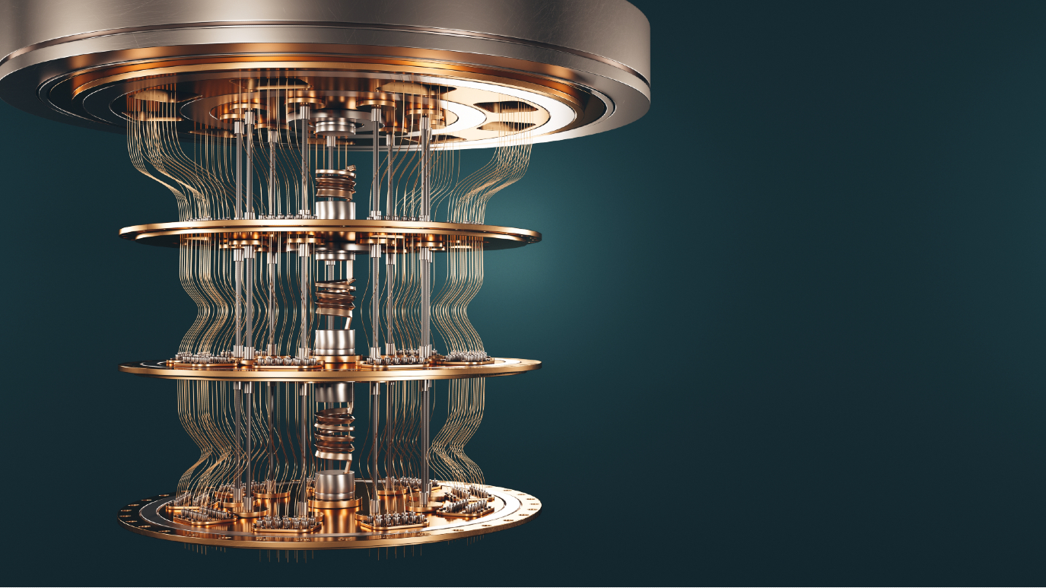
Future Work
In the future, we aim to improve
time-consuming input of state vectors
scalability of qubit numbers
Future work
24
Notes:
So now you may get a sense of the VENUS’s design principle and how it is used in the quantum computing tasks.
Despite this, there is still future work.
First, the update of VENUS is driven by the input number of amplitudes, which requires users to input the real and imaginary parts of amplitudes manually.
Participants reported that it is kind of inconvenient to type in the amplitude values. In the future, we will make this process smoother, say automatically extracting the values of state vectors on the screen.
Second, compared with Block Sphere, it can effectively visualize the quantum state with 2 qubits. However, we are still exploring the methods to support qubits more than 2 to fit into more specific scenarios in quantum computing.

Slide 25
Conclusion
We propose VENUS, a geometrical visualization for quantum state visualization
1. Probability visualization
It allows the explicit visualization and explanation of measured probability
2. Two-qubit state visualization
It supports both single-qubit and two-qubit state visualization
Notes:
To sum up, we propose a visualization approach to better support quantum state representation.
Based on the visualization of state vectors, we use multiple coordinated 2D geometrical shapes to explain the measured probability of all basis states.
Moreover, we employed the same visualization methods to allow VENUS to support representations of single-qubit and two-qubit states.

Slide 26
Thank you for your attention!
Q&A
Email: slruan.2021@phdcs.smu.edu.sg
My homepage: https://shaolun-ruan.com/
Notes:
That’s all for the presentation of our paper.
If you have any questions or suggestions, please feel free to contact me via email.
My personal homepage and QR code are also shown below.
Thank you for your attention!
I’m open to any questions!

Slide 27
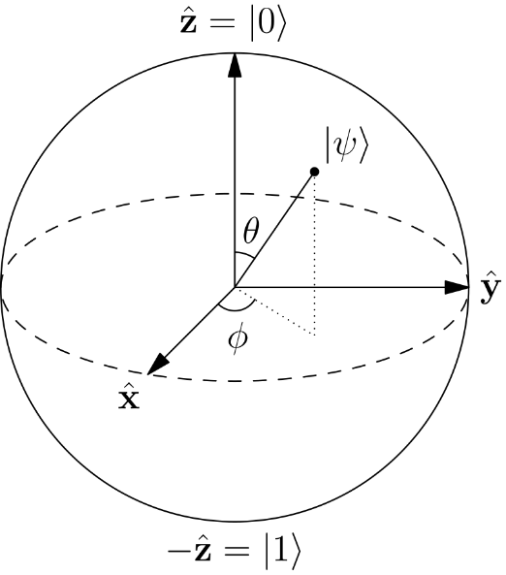
Existing work
For measured probability visualization
Bloch Sphere [1]
A widely-used approach to visualize quantum states today
[1] Bloch, Felix. "Nuclear induction." Physical review 70.7-8 (1946): 460.
Quantum superposition
Notes:
For now, there is an existing work, called Bloch Sphere, a most widely-used visualization technique in the area of quantum computing.
As shown in this slide, the Bloch Sphere uses a point on the unit sphere to represent the amplitudes of a pure single-qubit state.
However, despite its prevalence, several issues still exist when utilizing the Bloch Sphere.

Slide 28
Existing work
For measured probability visualization
Bloch Sphere cannot visualize and explain the
measured probability
Quantum superposition
Notes:
Second, while the Bloch Sphere can represent quantum states, it does not provide an intuitive display of the probability of all basis states, and cannot further explain the probability.
But probability is a fundamental characteristic of quantum states, as it directly reflects superposition.

Slide 29
Existing work
Bloch Sphere’s issues
Issue 2
For Motivation 2,
Bloch Sphere cannot visualize for
more than one qubit [2]
Because Bloch Sphere only support pure single-qubit state
[2] Bardin, Joseph C., Daniel H. Slichter, and David J. Reilly. "Microwaves in quantum computing." IEEE journal of microwaves 1.1 (2021): 403-427.
Quantum superposition
Quantum entanglement
Notes:
First, the Bloch Sphere cannot visualize quantum states with more than one qubit.
When two qubits become entangled, the Bloch Sphere's visualization method fails, cuz the entangled quantum state cannot be reduced to three dimensions in the same manner.

Slide 30
VENUS
Visual design
Link the two amplitudes using the normalization constraint
Quantum superposition
Quantum entanglement
Notes:
Furthermore, we also encode the normalization constraint into the visual design.
Given that the sum of the square of the amplitudes equals to 1. It’s make-sense because the square of the amplitude represent the probability, and the sum of all probabilities must equal to 1.
From the earlier mentioned constraints, if we connect the two semi-circles by a right triangle, where the two legs of the right triangles are the semi-circle’s diameters, then the length of the Hypotenuse of this right triangle in white will always be 1.
This design can enhance the user’s confidence of the quantum states, and can also evaluate the validity of a certain quantum state.

Slide 31
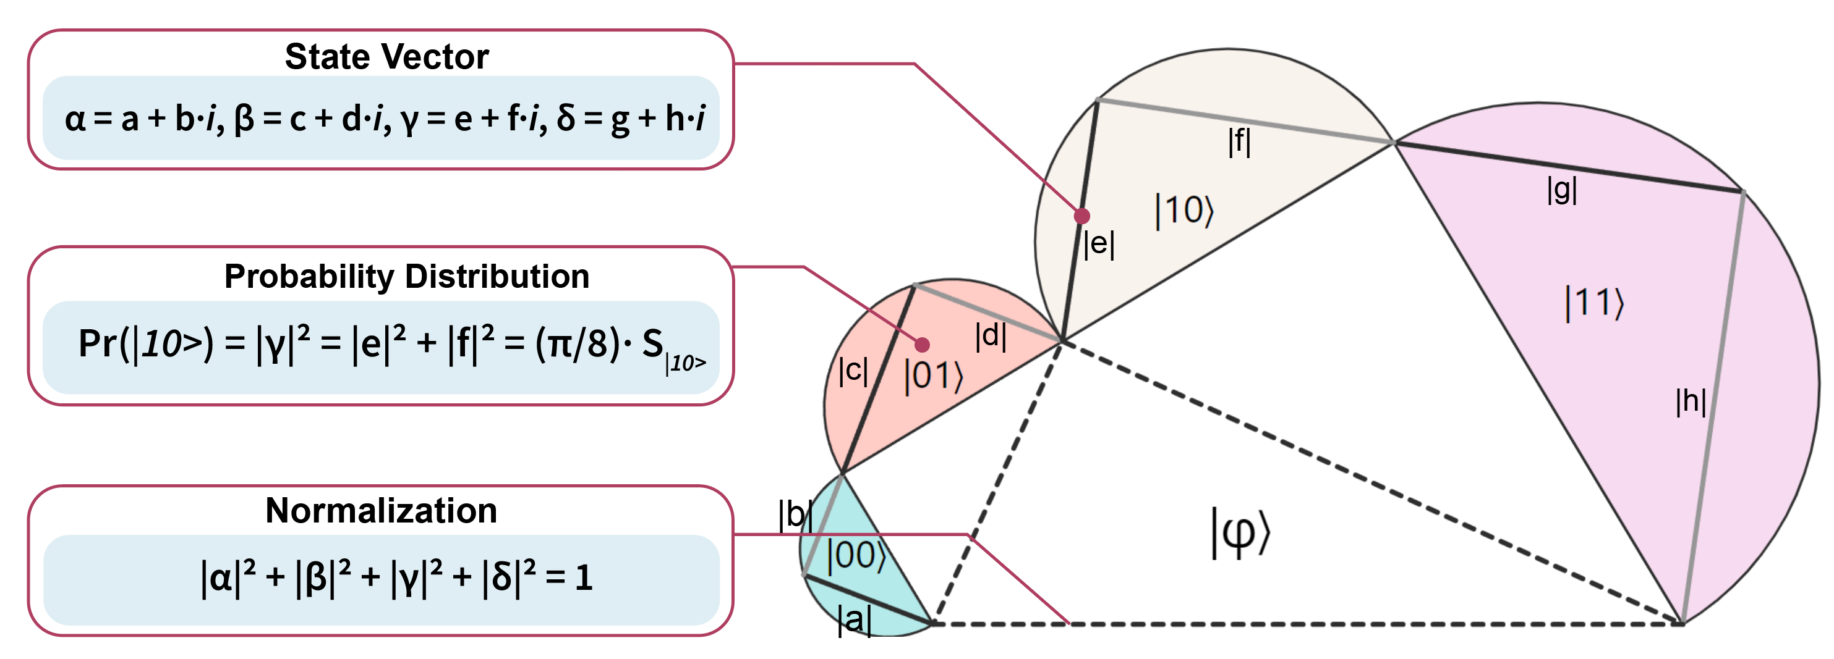
VENUS
Visual design
Extend single-qubit version to the two-qubit state
Quantum superposition
Quantum entanglement
Notes:
In this scenario, the design has four amplitudes. and, thus, eight line segments to represent the state vectors.
Also, the probabilities of four basis states, i.e., 00, 01, 10, 11, can be represented by the areas of the four semi circles.
So now you may get a rough idea about the visual design introduction of VENUS.

