Slide 1
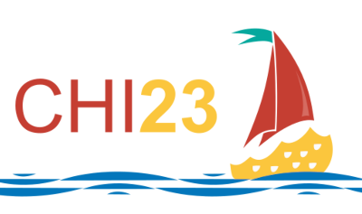
NFTDisk: Visual Detection of Wash Trading
in NFT Markets
Xiaolin Wen^{1,2}
Yong Wang²
Xuanwu Yue³
Feida Zhu²
Min Zhu¹
Notes:
Hello, everyone, this is Xiaolin Wen, from Sichuan University.
Today I am going to present my work: NFTDisk: Visual Detection of Wash Trading in NFT Markets.
This paper is a joint study by researchers from Sichuan University, Singapore Management University, and Baiont Technology.
First I will introduce the background of our paper.

Slide 2
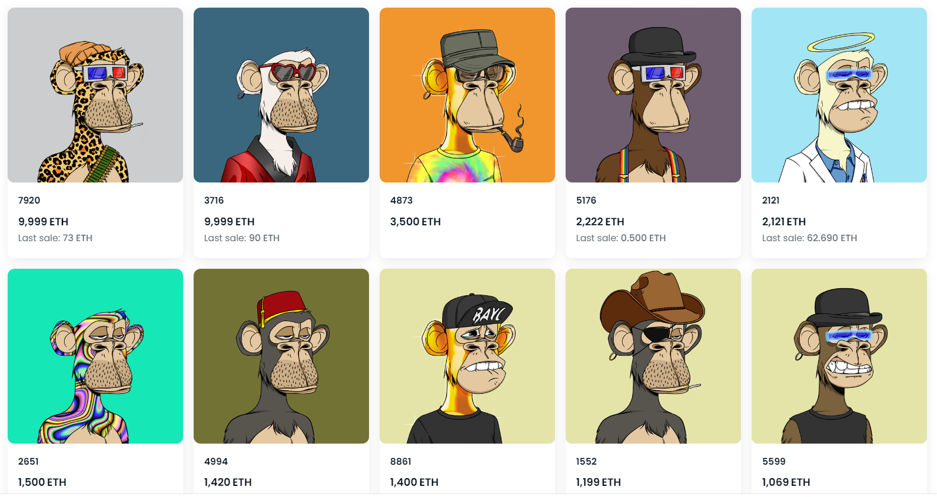
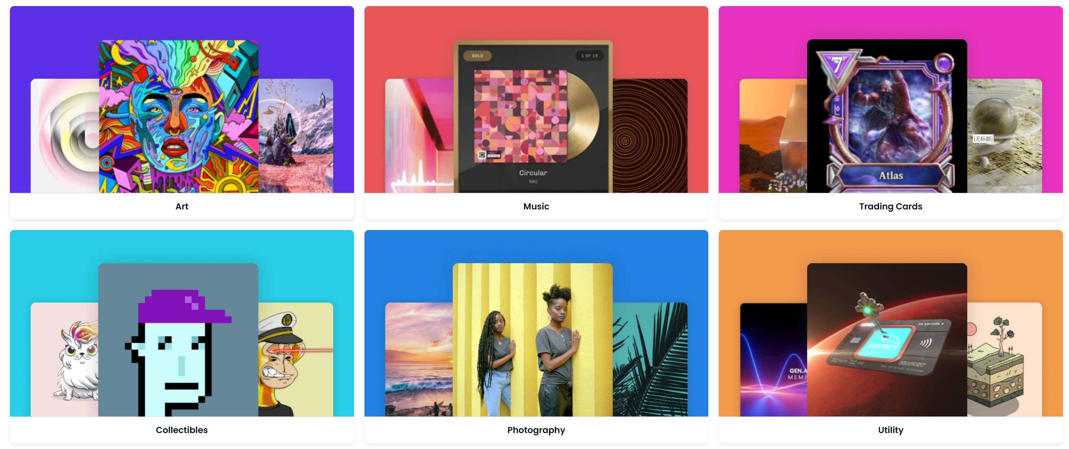
Background
NFT (Non-Fungible Token)
NFT Investors
NFT Markets
Fraudulent Activities
Notes:
In the right figure, we can see many small images, each one of them can sell for thousands of dollars.
These are kinds of NFTs.
NFTs are tradable ownerships of some digital assets, such as images, videos and virtual creations.
NFTs can be traded in NFT markets.
However, the huge potential of NFT markets attracts a large number of investors, and at the same time, many fraudulent activities also follow.

Slide 3
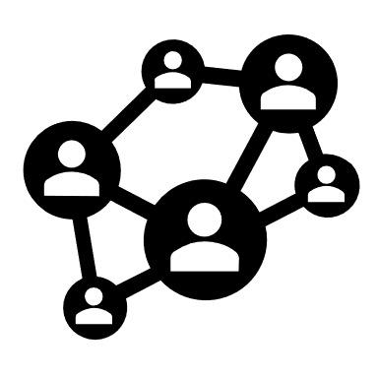
Background
Wash Trading
Create
Mislead
Colluding Addresses
Fake Trade Volumes
NFT Investors
Notes:
Among them, wash trading is one of the most common frauds in NFT markets, which manifests as a group of colluding addresses pretending to trade NFTs.
to create fake trading volumes and prices to mislead investors.
So many investors got loss from it.

Slide 4
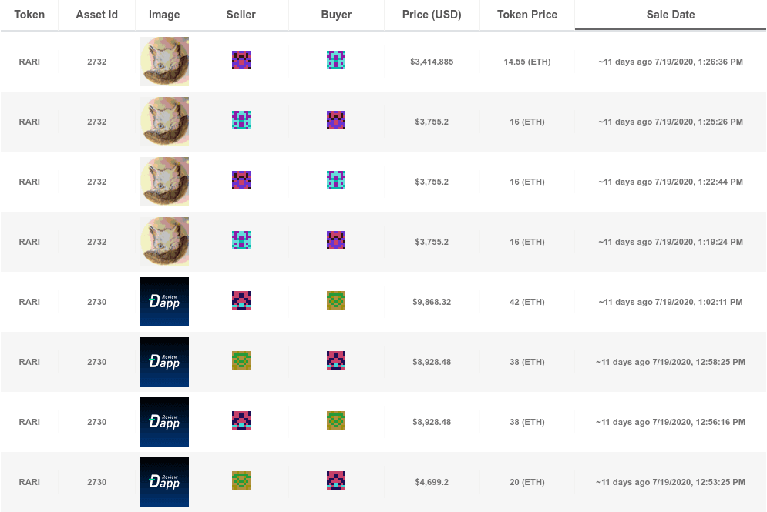
Motivation
Automatic Detection^{[1]}
Manual Inspection
Automatic Detection can only find a subset of wash trading due to their sophisticated patterns.
Manual Inspection is usually required, but it is hard to get useful information directly from the original transactions.
[1] von Wachter V, Jensen J R, Regner F, et al. NFT Wash Trading: Quantifying suspicious behaviour in NFT markets[J]. arXiv preprint arXiv:2202.03866, 2022.
Notes:
To save those investors, some one proposed automatic algorithms to detect wash trading.
But wash traders are very very smart, and they create very sophisticated wash trading patterns to avoid detection.
Therefore, Automatic Detection can only find a subset of wash trading.
Manual Inspection is usually required, but currently investors can only use original transaction records and some simple visualizations,
it is hard to get useful information for investment decisions by these ways.

Slide 5
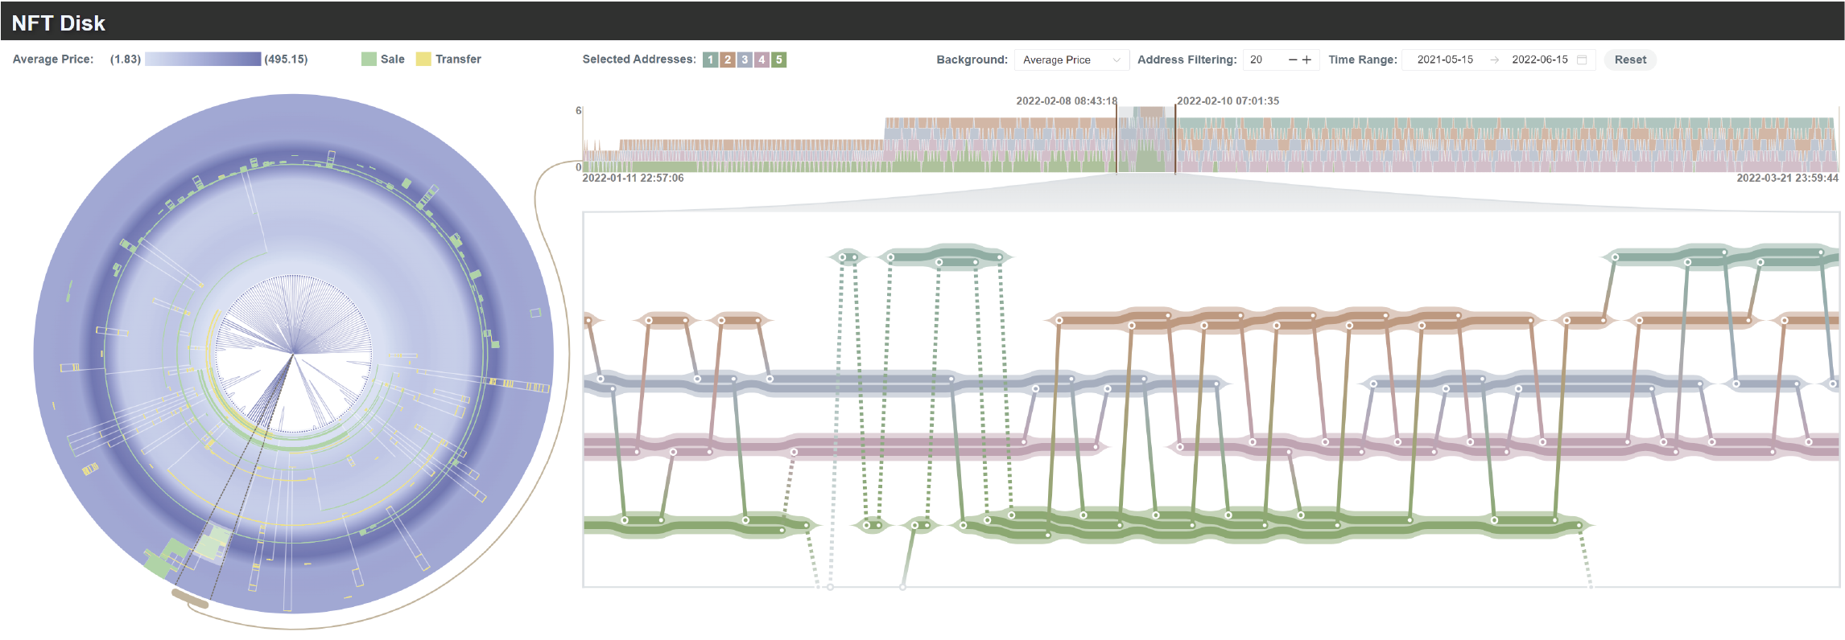
NFTDisk
NFTDisk: a novel visualization for investors to visually identify wash trading activities in NFT markets.
Notes:
To solve this problem, we propose NFTDisk, a novel visualization for investors to visually identify and analyze wash trading activities in NFT markets.
Here shows the interface of NFTDisk, it looks like a big disk with music flow around it.

Slide 6
NFTDisk
Disk Module
Flow Module
Notes:
NFTDisk contains two visualization modules: the disk module and the flow module.

Slide 7
NFTDisk
Overview Transactions
Suspicious addresses
Disk Module
Notes:
The disk module is a radial visualization with a disk metaphor to provide a quick overview of NFT transactions over time to help users recognize suspicious address groups.

Slide 8
NFTDisk
Show NFT flows among suspicious addresses
at multiple levels.
Flow Module
Notes:
The flow module is a flow-based design to visualize NFT flows at multiple levels.
It can help investors check whether wash trading occurred and their patterns.

Slide 9
Disk Module
Outer Ring
Inner Circle
Notes:
So first let us see the big disk.
The disk module consists of the outer ring and the inner circle.

Slide 10
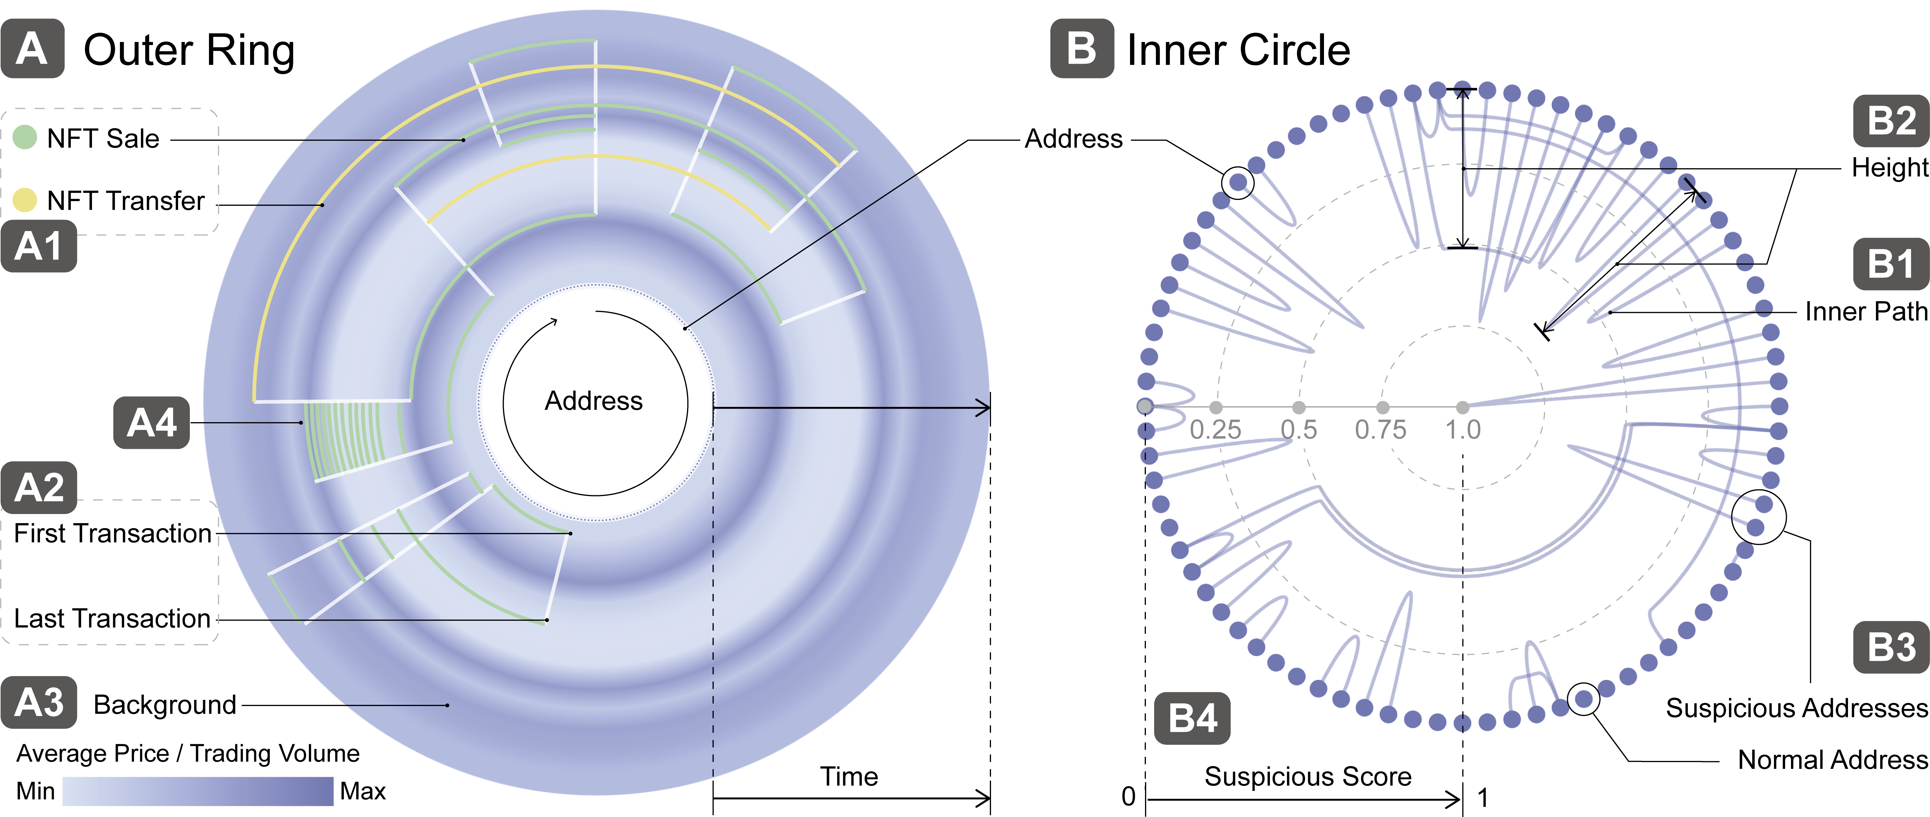
Disk Module
Here shows the interface of NFTDisk, it looks like a big disk with music flow around it.
around it.
Here shows the interface of NFTDisk, it looks like a big disk with music flow around it.
Notes:
In the outer ring, the addresses are placed evenly around the circle, with each address occupying a radius of the circle at a specific angle.

Slide 11
Disk Module
Here shows the interface of NFTDisk, it looks like a big disk with music flow around it.
around it.
Here shows the interface of NFTDisk, it looks like a big disk with music flow around it.
Notes:
The passage of time, or the timeline, is represented by moving along the radius from the inner circle to the outer circle.

Slide 12
Disk Module
Here shows the interface of NFTDisk, it looks like a big disk with music flow around it.
it.
Here shows the interface of NFTDisk, it looks like a big disk with music flow around it.
Notes:
NFT transactions are encoded by the arcs between the two angles which represent the two addresses involved.
The distance of the arcs to the center of the circle depends on when the transaction took place.
The arcs have two colors encoding the status of transactions: green for “Sale” status and yellow for “Transfer” status. \

Slide 13
Disk Module
Here shows the interface of NFTDisk, it looks like a big disk with music flow around it.
it.
Here shows the interface of NFTDisk, it looks like a big disk with music flow around it.
Notes:
In the outer ring, repeated transactions can form an obvious green block, and these addresses might be suspicious to collude and conduct wash trading.
Investors can identify suspicious addresses by these green blocks.

Slide 14
Disk Module
Here shows the interface of NFTDisk, it looks like a big disk with music flow around it.
it.
Here shows the interface of NFTDisk, it looks like a big disk with music flow around it.
Notes:
A radial gradient blue background is used to show the monthly average price or trading volume, where the depth of the blue indicates the specific value, and the change over time is represented by the inner circle to the outer circle.
It can help evaluate the impact of wash trading on this NFT collections.

Slide 15
Disk Module
Here shows the interface of NFTDisk, it looks like a big disk with music flow around it.
flow around it.
Here shows the interface of NFTDisk, it looks like a big disk with music flow around it.
Notes:
We use the white lines along the radius to link the first and the last transaction of the addresses, it can help investors identify whether the address is a new investor or not.

Slide 16
Disk Module
.
Notes:
In the inner circle, we introduce the suspicious score to indicate the colluding possibility of address pairs.

Slide 17
Disk Module
.
Notes:
In the inner circle, we introduce the suspicious score to indicate the colluding possibility of address pairs. It is placed on the radius of the inner circle.

Slide 18
Disk Module
.
Notes:
The height of the inner paths represents their suspicious score.
The higher the height of the inner path, the higher the suspicious score of the address pair.

Slide 19
Disk Module
Notes:
Investors can easily find suspicious addresses in the disk module.

Slide 20
Flow Module
Flow Module
Notes:
The flow module consists of a stacked area chart and a flow-based chart. -→

Slide 21
Flow Module
Stacked Area Chart
Notes:
The flow module consists of a stacked area chart and a flow-based chart. →

Slide 22
Flow Module
Flow-based Chart
Notes:
The flow module consists of a stacked area chart and a flow-based chart.

Slide 23
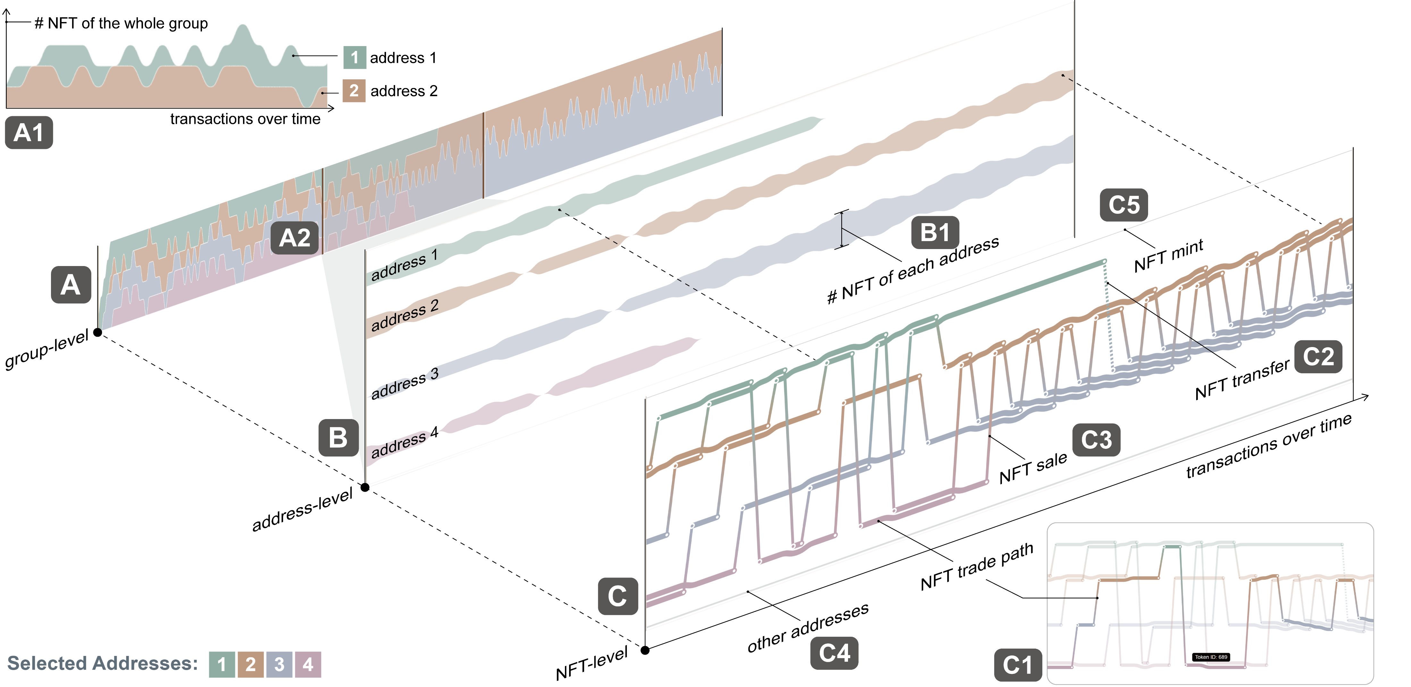
Flow Module
Notes:
It covers the three levels: the group level, address level and NFT level.
The stacked area chart shows the NFTs held by selected addresses at the group level.

Slide 24
Flow Module
Notes:
The flow-based chart can demonstrate both the NFTs held by each address and the transaction history of these NFTs.

Slide 25
Flow Module
Notes:
The flow-based chart can demonstrate both the NFTs held by each address and the transaction history of these NFTs.

Slide 26
Evaluation
Two case studies
User interview with 14 real NFT investors
Notes:
After introducing the NFTDisk, we want to know can it work well?
To evaluate the effectiveness and usability of NFTDisk, we conducted two case studies and an user interview with 14 NFT investors.

Slide 27
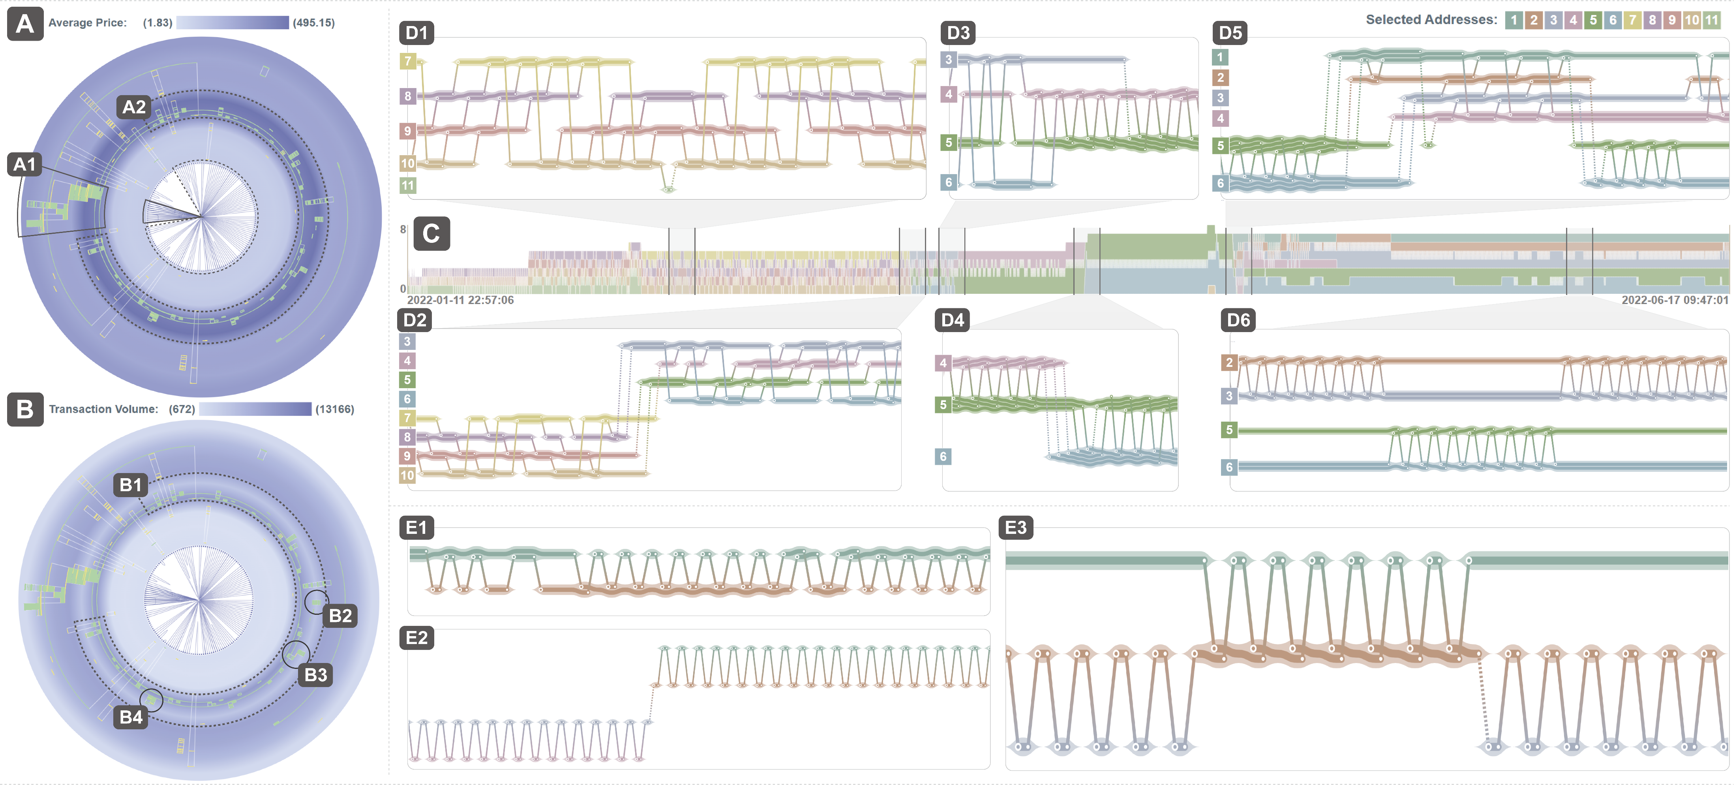
Case Study
Notes:
We use a video to show how users analyze wash trading in the NFT collection named Meebits with NFTDisk.

Slide 28
Case Study
https://drive.google.com/file/d/1UYalvRuwMsUcSFO73rsr50BFOA4utCSY/view?usp=sharing
Notes:
We use a video to show how users analyze wash trading in the NFT collection named Meebits with NFTDisk.

Slide 29
User Interview
Online study with 14 NFT investors (4 females, 10 males, age_{mean} = 28)
Task:
T1. Initialize the visualization by using interactions components to filter out undesired information.
T2. Observe the Disk Module to find suspicious addresses and time periods and brush to select them.
T3. Analyze the NFT flows at the group level by the stacked area chart of the Flow Module.
T4. Brush a period in the stacked area chart and check the detailed NFT flows in the flow-based chart.
Tutorial
Task Phase
Questionnaire
Interview
60 minutes
Notes:
In the user interview, we invited 14 NFT investors to use NFTDisk to analyze three NFT collections and evaluate the system.
Participants first complete a tutorial;
Then, using NFTDisk following four tasks;
Finally, they were asked to complete post-study questionnaires and interviews.

Slide 30
User Interview
Here shows the interface of NFTDisk, it looks like a big disk with music flow around it.
Workflow Effectiveness
Visual Design and Interactions
Usability
Notes:
The questionnaire is designed to evaluate the workflow effectiveness, visual design and interactions, and usability.
The results shows that NFTDisk was highly rated by the participants.
They agree with that NFTDisk was more useful and effective than previous methods for exploring wash trading behaviors in NFT collections

Slide 31
Summary
Cooperated with NFT investors to collect design requirements;
Proposed NFTDisk to help investors detect and analyze wash trading;
Conducted case studies and user interview to evaluate NFTDisk;
Notes:
Overall, Wash trading is rampant in NFT markets, and we proposed an amazing visualization tools to protect investors from wash trading and save their money.

Slide 32
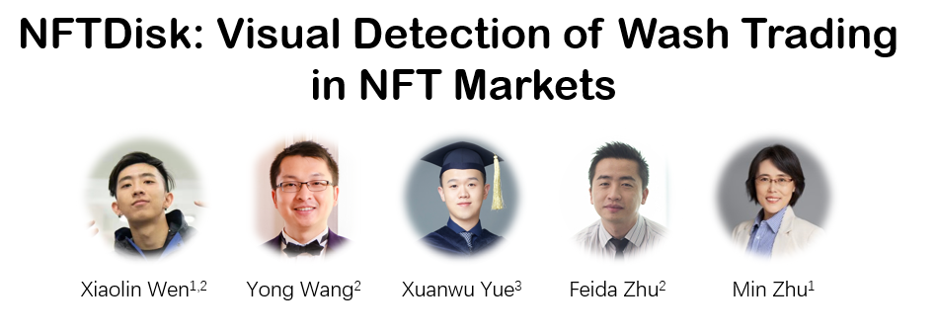
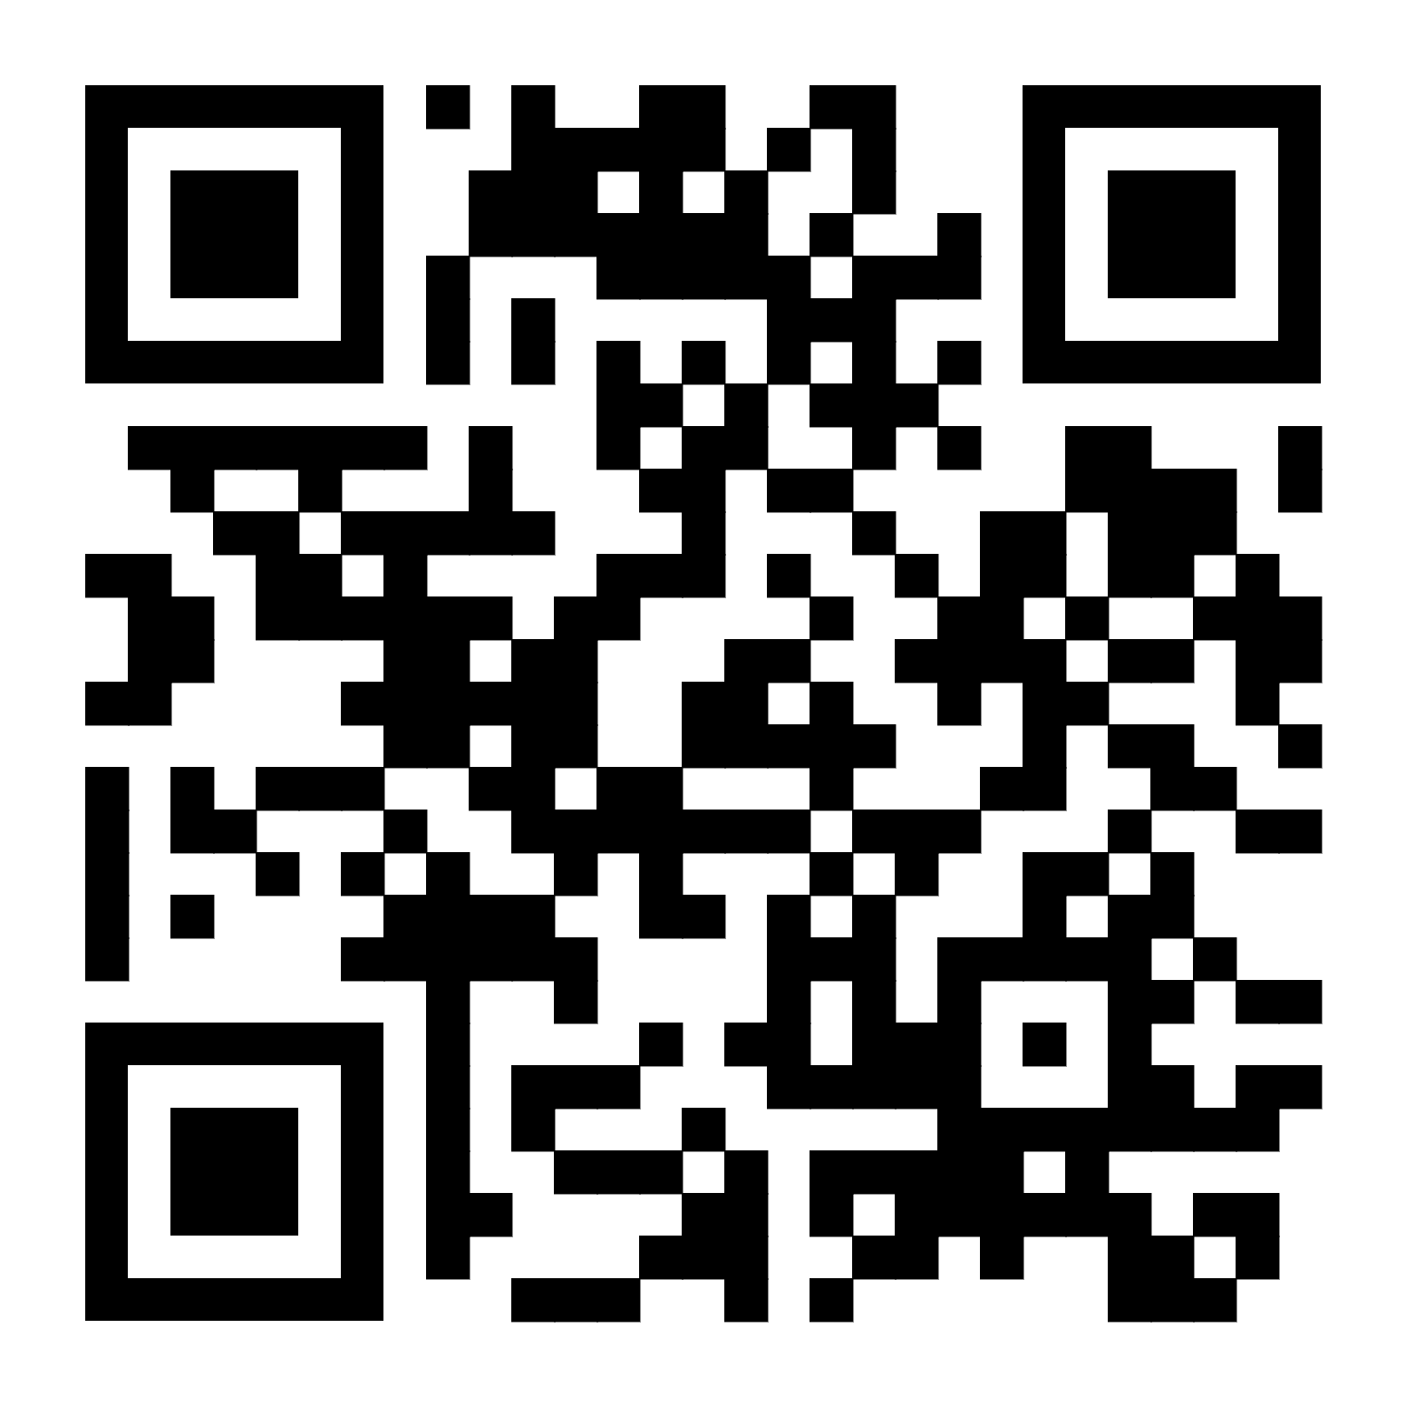
Paper Link
Notes:
Finally, I want to thank all the coauthors and reviewers of this paper.
For more details, please check our paper! Thank you!

Slide 33
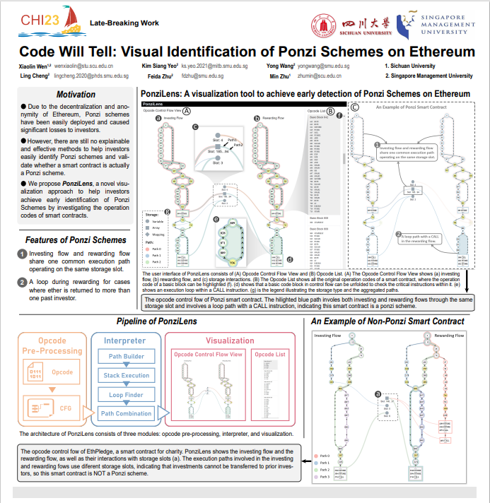
LBW-B044
Code Will Tell: Visual Identification of
Ponzi Schemes on Ethereum
Xiaolin Wen
wenxiaolin@stu.scu.edu.cn
Yong Wang
yongwang@smu.edu.sg
Notes:
We also have a poster in this conference, if you are interested in this work, please feel free to contact us. Thank you!

Slide 34
Design Requirements
R1 Analyze wash trading in the scope of NFT collection;
R2 Recognize suspicious transactions and addresses from the overview;
R3 Reveal wash trading features at multiple levels;
R4 Display the detailed transaction patterns of wash trading;
R5 Enable the evaluation of wash trading influence.

Slide 35
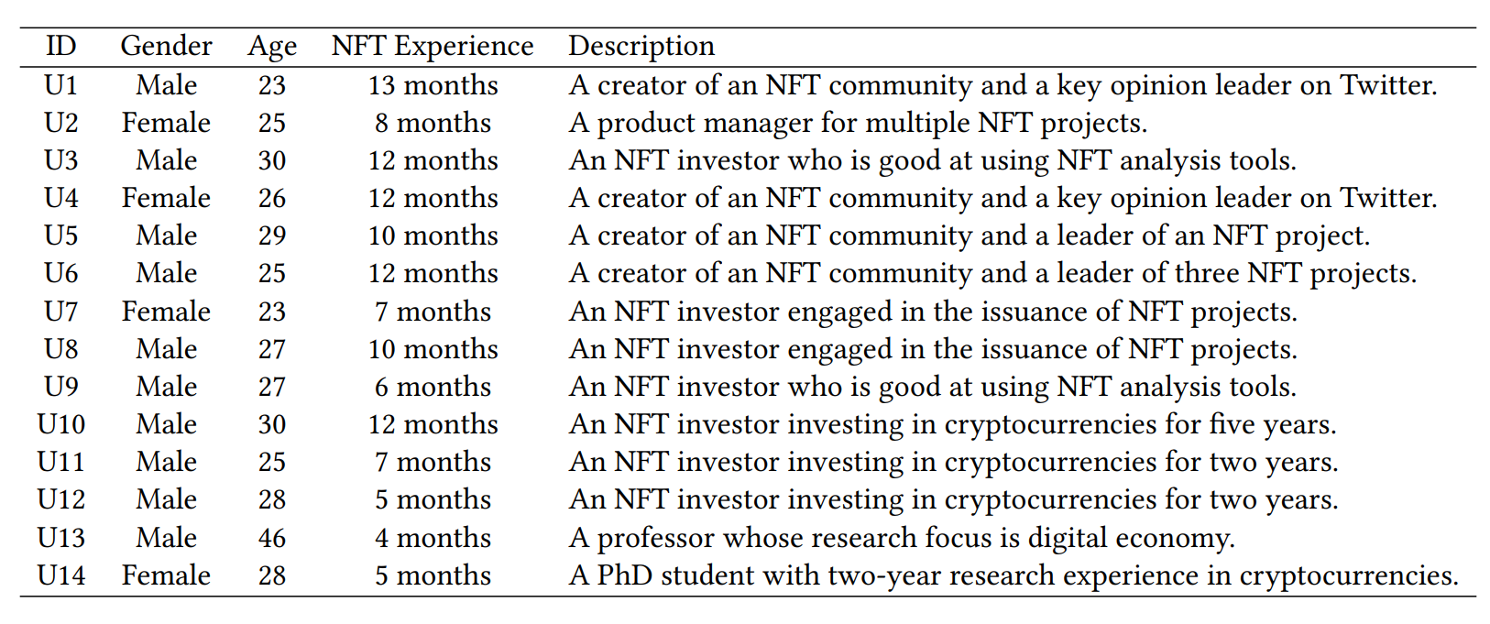
Participants

Slide 36
Implications
Lessons learned:
Group of addresses > Individual addresses.
Different addresses have different tasks.
Not all wash trading are “harmful”.
Design considerations for novices users:
Straightforward visual design (market risk -> height of flows);
Overview first, Details on demand;

Slide 37
Generalization
Workflow => Other frauds in cryptocurrency markets:
e.g. money laundering
NFTDisk => Traditional financial market:
e.g. stocks and bonds
NFTDisk => Other abnormal online activities involving different participants:
e.g. Political Astroturfing

Slide 38
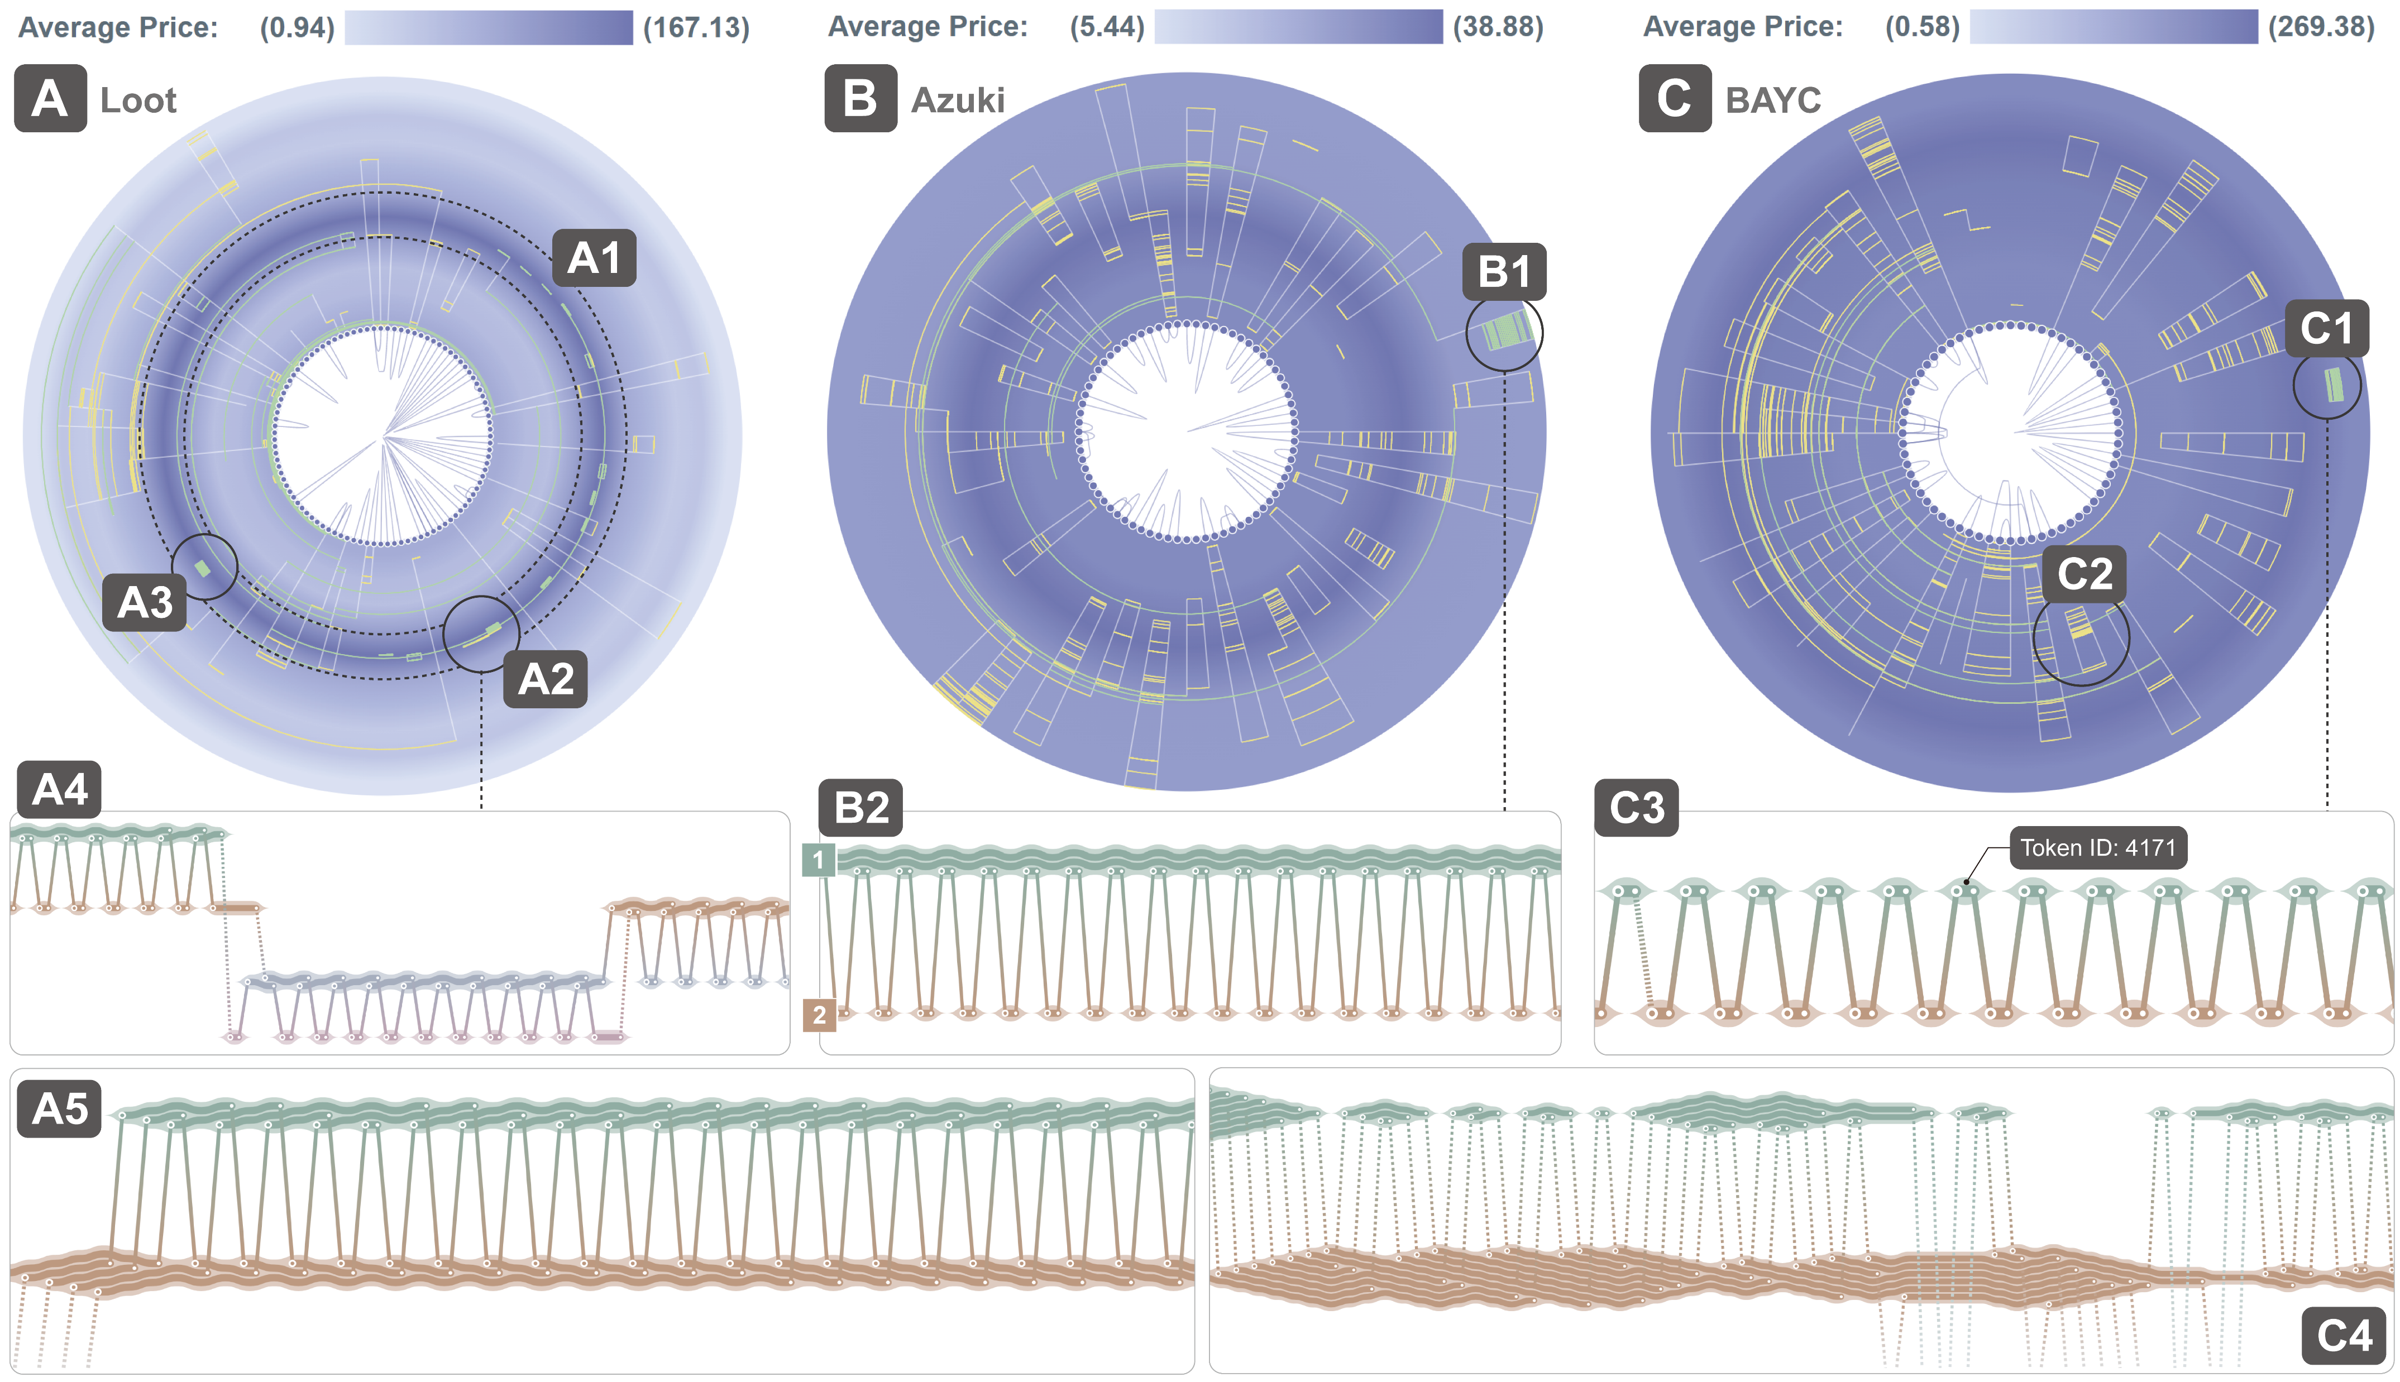
Case 2
Wash Trading Enhanced by Trading Rewards but Discouraged by Royalties
Notes:
Overall, Wash trading is rampant in NFT markets, and we proposed an amazing visualization tools to protect investors from wash trading and save their money.

Slide 39
Address Reordering
Amount of transactions => distance matrix of addresses
Hierarchy clustering => clustering tree => optimal leaf ordering algorithm
Notes:
Overall, Wash trading is rampant in NFT markets, and we proposed an amazing visualization tools to protect investors from wash trading and save their money.

Slide 40
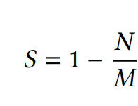
Suspicious Score
where 𝑀 is the number of transactions between the two addresses, and 𝑁 is the number of unique NFTs involved in these transactions. The higher the suspicious score, the more likely the address pair is to collude. If each transaction from a pair of addresses includes a different NFT, then their suspicious score is zero.
Notes:
Overall, Wash trading is rampant in NFT markets, and we proposed an amazing visualization tools to protect investors from wash trading and save their money.

