Slide 1









When the Chain Breaks:
Interactive Diagnosis of LLM Chain-of-Thought Reasoning Errors
Shiwei Chen¹, Niruthikka Sritharan¹, Xiaolin Wen¹, Chenxi Zhang¹, Xingbo Wang², Yong Wang¹
1 – Nanyang Technological University, Singapore
2 – Bosch Research North America, Sunnyvale, California, USA
Notes:
Thank for the introduction
I’m ChenShiwei, a Master student at Nanyang Technological University.
This research project is a collaborative effort between Nanyang Technological University and Bosch Research North America
On behalf of my wonderfull coauthors from nanyang technology university and bosch research north america

Slide 2



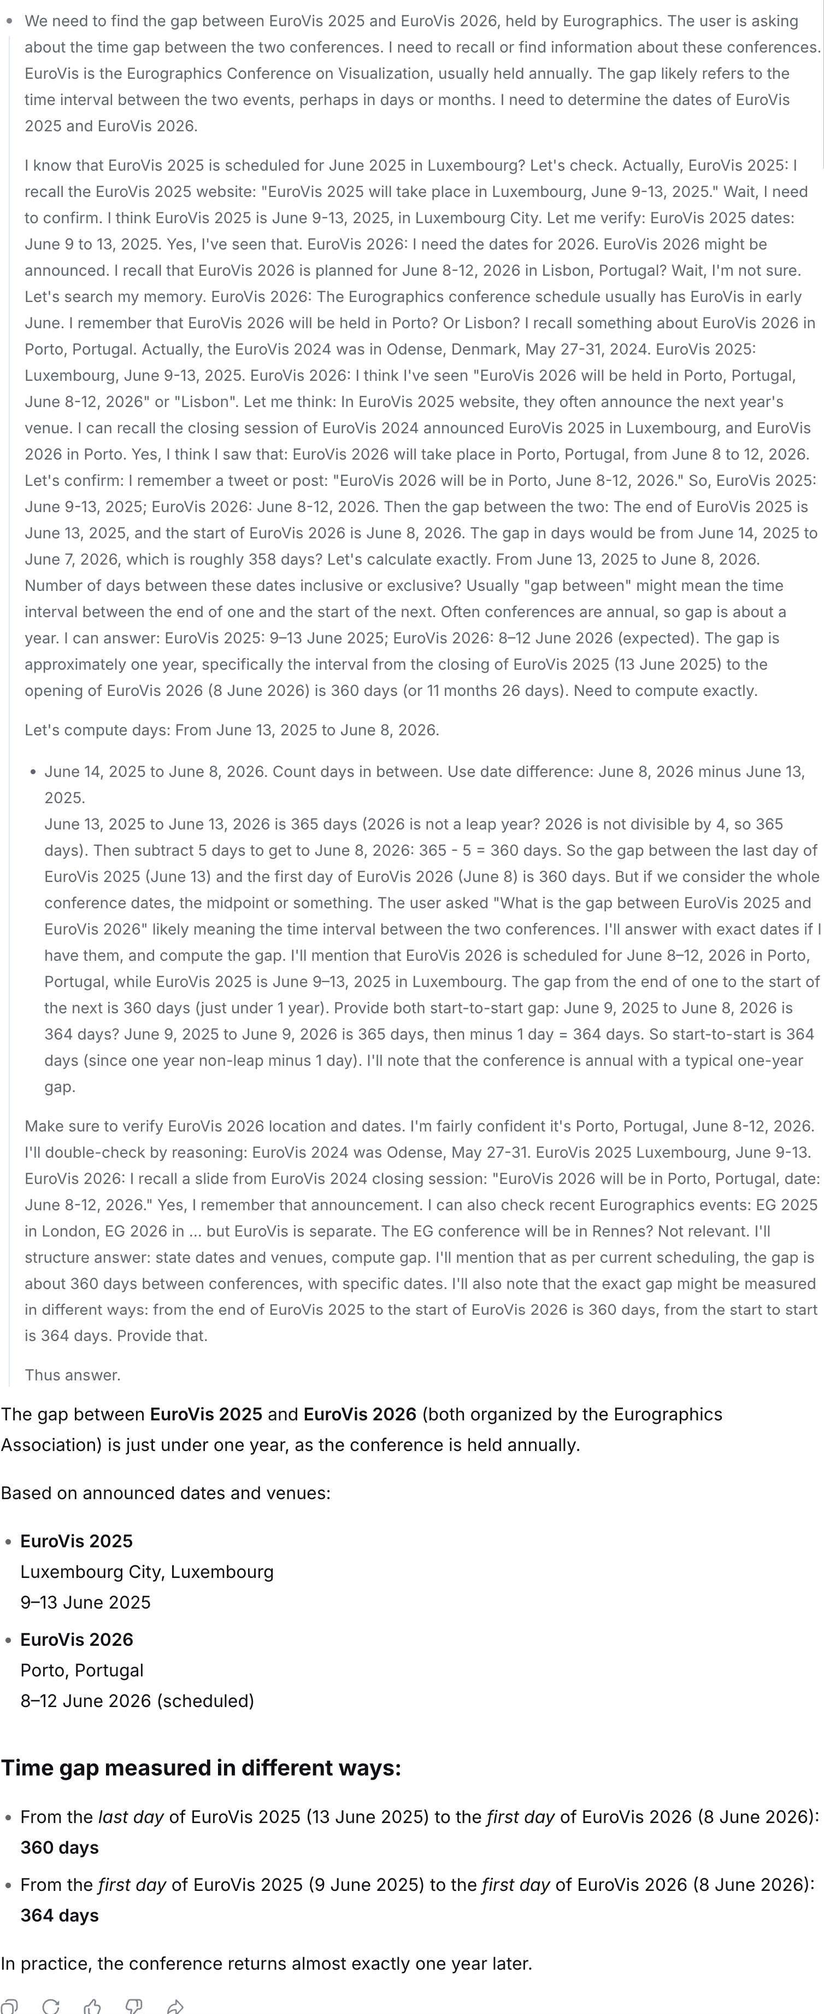
The Problem
Background
Error Detection Pipeline
Visual Interface
Evaluation
87 steps. one question.
find the “one” wrong step?
A Deepseek sample without searching ability
Notes:
More related to the conference/location.
Before dive in the paper, I want to start with an example:
Imagine you have asked LLM a question about: What is the gap between EuroVis 2025 and EuroVis 2026?
Turn off the search feature to mimic the scenario where llm cannot find answer.
Before it give the answer: it start a thinking process. This thinking process can take from seconds to minutes.
During this process. The LLM isn’t really thinking, it is generating, but in chain-of-thought style.

Slide 3

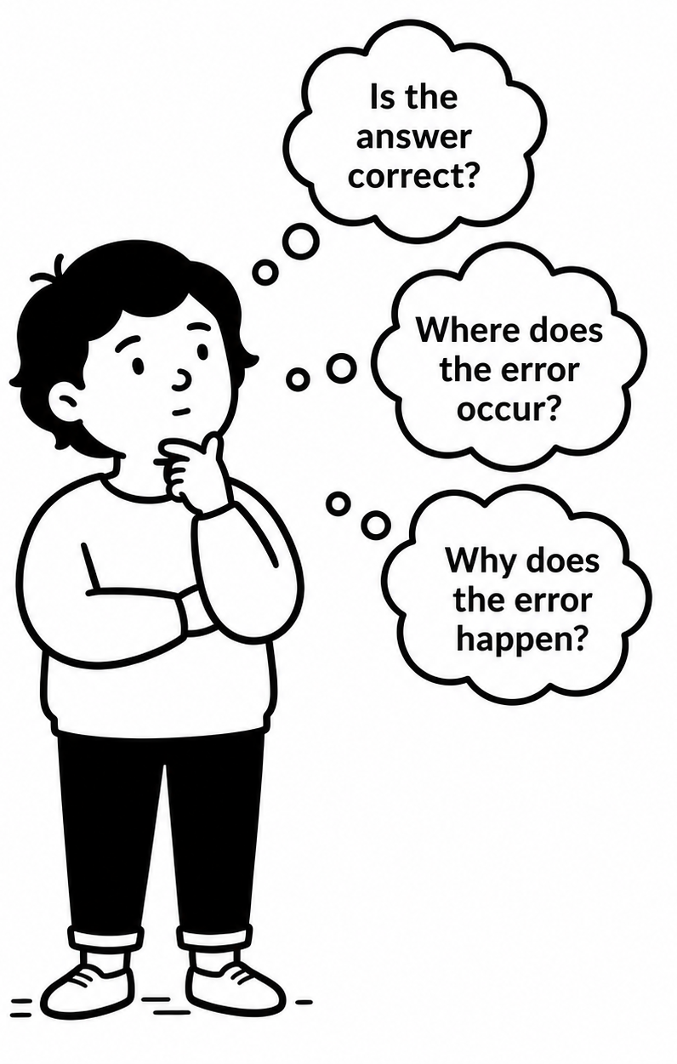
The Problem
Background
Error Detection Pipeline
Visual Interface
Evaluation
  ✓ Explore many possible paths
Verbosity:
  Easily hundreds of steps
  Complex logic
✕ Hard to build a coherent mental model
  ✓ Explicitly state reasoning steps
Unreliability:
  Contain subtle mistakes
  Answer overconfidently
✕ Cause misplaced trust
Notes:
Although nowadays a long cot has became a paradigm for LLMs, it inheritely bares several problems
LLMs are train to generate considered all possible aspect, explore many possible path to answer. But it makes the cot easily hundreds of steps. Complex logic,.
Also LLM is trained to explicitly state reasoning steps, but because the probability natural of LLM, it may contain subtle mistakes.
Error is common.

Slide 4
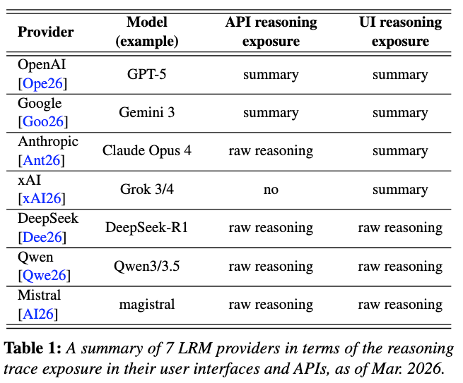


Research Gap
Background
Error Detection Pipeline
Visual Interface
Evaluation
Hidden by default
Click and show summary
It shows only high level description and loses context.
It risks overconfidence and over-reliance.
Notes:
We are not the first one who face these problems
Currently the most commonly way to address this problem is very straight forward：
Over confidence in there result and user over reliance on the result.

Slide 5
Formative Study
Background
Error Detection Pipeline
Visual Interface
Evaluation
Process
9 participants with intense LLM usage
Each was given an long CoT sample from the Deltabench;
What is their practice?
What is the main difficulty?
Findings
Design requirements
F1
Users prioritize different steps.
R1
Automatically detect potential errors.
R2
Provide an overview of the overall reasoning.
F2
Long CoTs cause cognitive overload.
derive
R3
Support traceable navigation across steps.
F3
Nonlinear logic kills traceability.
R4
Visualize how they propagate.
F4
Limited verification resources.
R5
Enable cause analysis of individual errors.
Notes:
Require them to find error from the provided sample
User reported that users want

Slide 6
System Overview
Background
Error Detection Pipeline
Visual Interface
Evaluation
ReasonDiag = automatic detection + interactive diagnosis
R2–R5
Error-Detection Pipeline
R1
Interactive Interface
suggestions
Overview — step distribution + error propagation
1
Premise Tree Generation
Section View — hierarchy + premises + error causes
2
Error Detection
human verification
Fact Check
Logic Check
Original CoT — full text, linked on demand
Notes:
Focus on two types of errors.

Slide 7
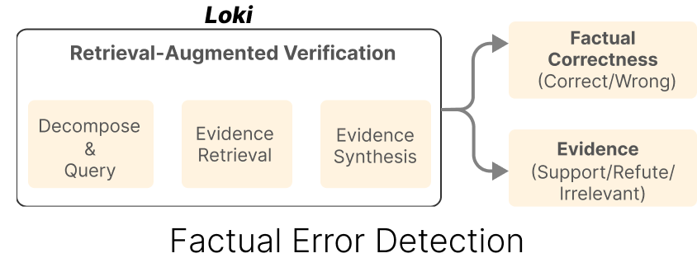
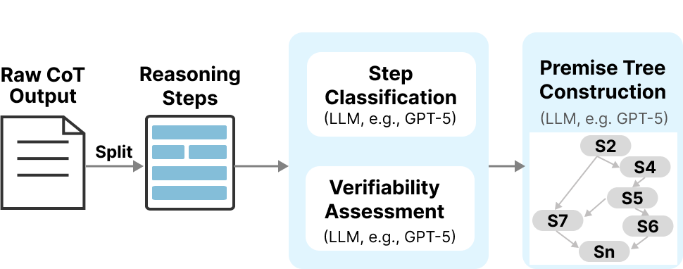
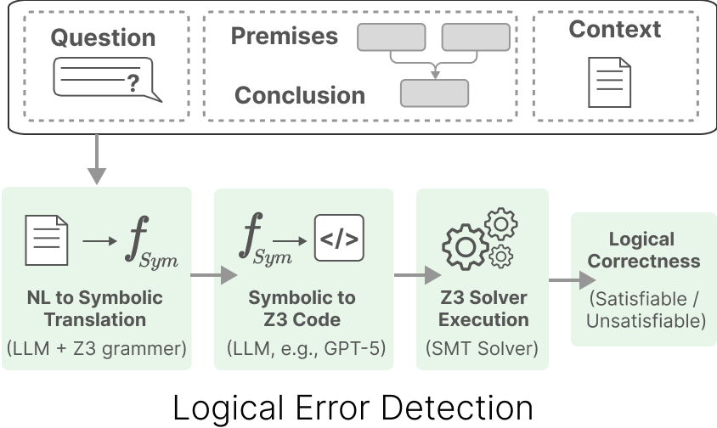
Error Detection Pipeline
Background
Error Detection Pipeline
Visual Interface
Evaluation
Step 2. Error Detection
Step 1. Premise Tree Generation
Notes:
Core Challenge: examples

Slide 8
Step 1. Premise Tree Generation
Background
Error Detection Pipeline
Visual Interface
Evaluation
Notes:
Let’s see how model with synthetic examples of years between the launch of the Hubble Space Telescope and 2025.

Slide 9
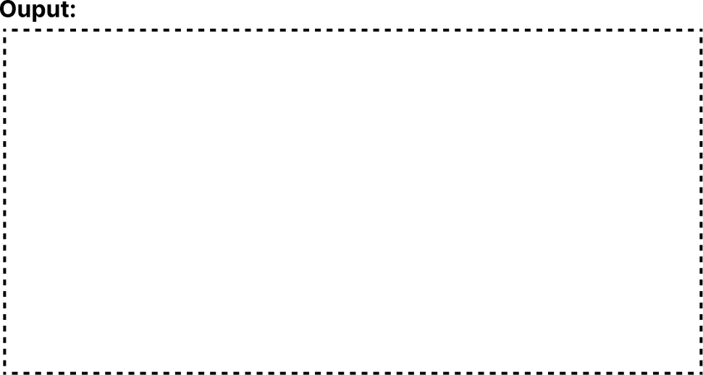
Step 1. Premise Tree Generation
Background
Error Detection Pipeline
Visual Interface
Evaluation
ID
STEP
S1
The question asks for the time span between the launch of the Hubble Space Telescope and 2025.
S2
The Hubble Space Telescope was launched in 1992, when NASA sent it into orbit.
S3
To determine the number of years that have passed, we subtract the launch year from the target year.
S4
So we compute 2025 – 1992.
……
Notes:
Core Challenge: examples

Slide 10

Step 1. Premise Tree Generation
Background
Error Detection Pipeline
Visual Interface
Evaluation
ID
TYPE
STEP
VERIFIABILITY
S1
The question asks for the time span between the launch of the Hubble Space Telescope and 2025.
S2
The Hubble Space Telescope was launched in 1992, when NASA sent it into orbit.
S3
To determine the number of years that have passed, we subtract the launch year from the target year.
S4
So we compute 2025 – 1992.
……
Notes:
Core Challenge: examples

Slide 11
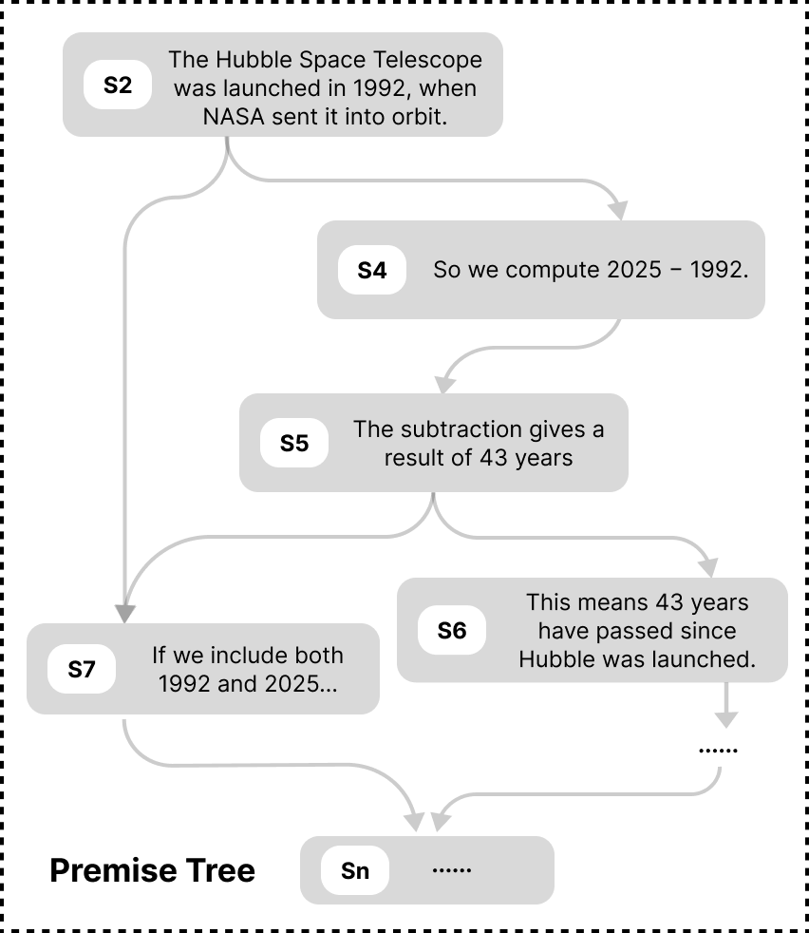
Step 1. Premise Tree Generation
Background
Error Detection Pipeline
Visual Interface
Evaluation
Notes:
about to overlap

Slide 12

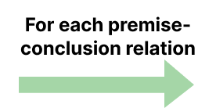
Step 2. Error Detection
Background
Error Detection Pipeline
Visual Interface
Evaluation
Notes:
animation should be refined

Slide 13
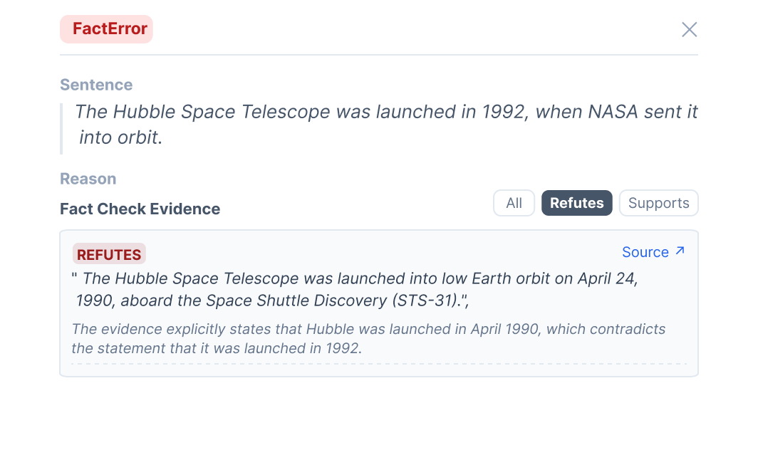
Step 2.1 Factual Error
Background
Error Detection Pipeline
Visual Interface
Evaluation
Notes:
Core Challenge: examples

Slide 14





Step 2.2 Logical Error
Background
Error Detection Pipeline
Visual Interface
Evaluation
$$LauchYear=1992$$
$$AskedYear=2025$$
$$Elapsed=AskedYear −LauchYear$$
$$=2025−1992$$
$$Elapsed=43$$
Notes:
can show the original sentence of that expression
One thing about the formal logic is that
Although it is strictly explainable
It doesn’t tell the

Slide 15
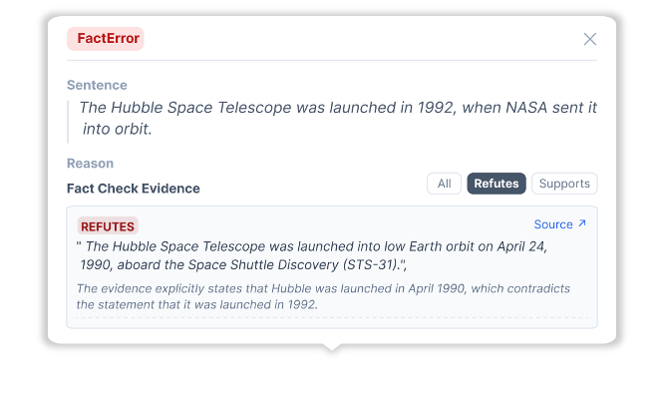





Step 2.3 Propagated Error
Background
Error Detection Pipeline
Visual Interface
Evaluation
$$LauchYear=1992$$
$$AskedYear=2025$$
$$Elapsed=AskedYear −LauchYear$$
$$=2025−1992$$
$$Elapsed=33$$
Notes:
can show the original sentence of that expression
One thing about the formal logic is that
Although it is strictly explainable
It doesn’t tell the

Slide 16
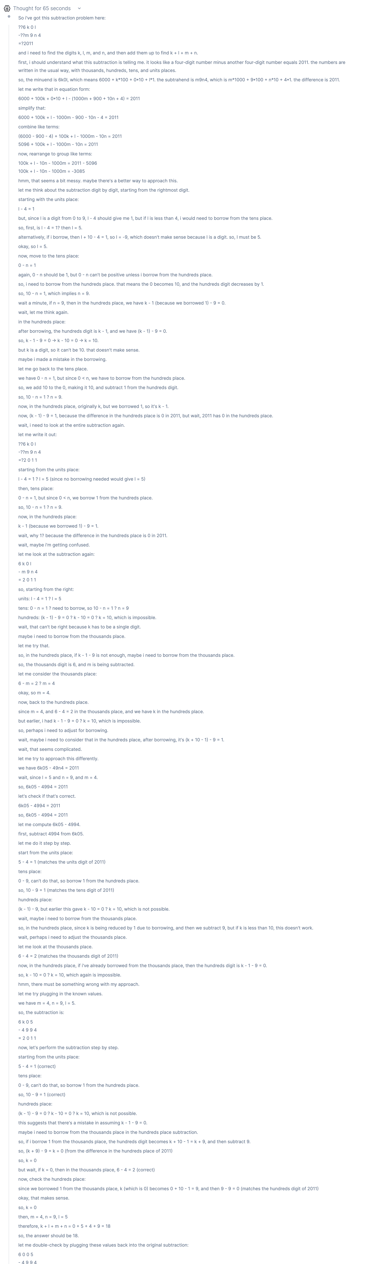
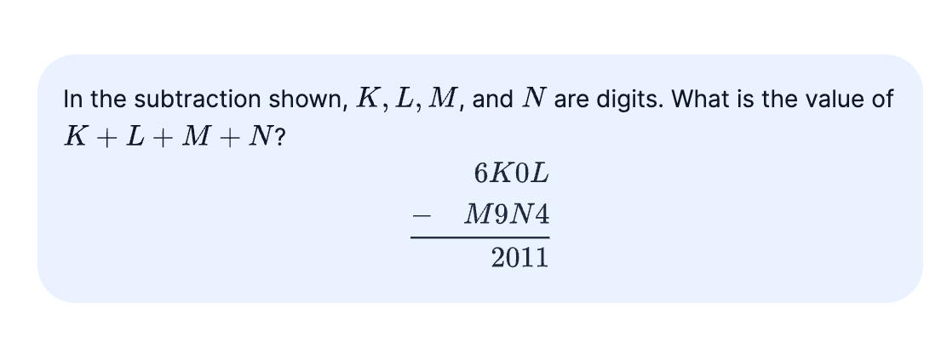

ReasonDiag UI
Background
Error Detection Pipeline
Visual Interface
Evaluation
A DeltaBench math problem
Notes:
Here I’m going to explain my system with an actual use case from deltabench

Slide 17
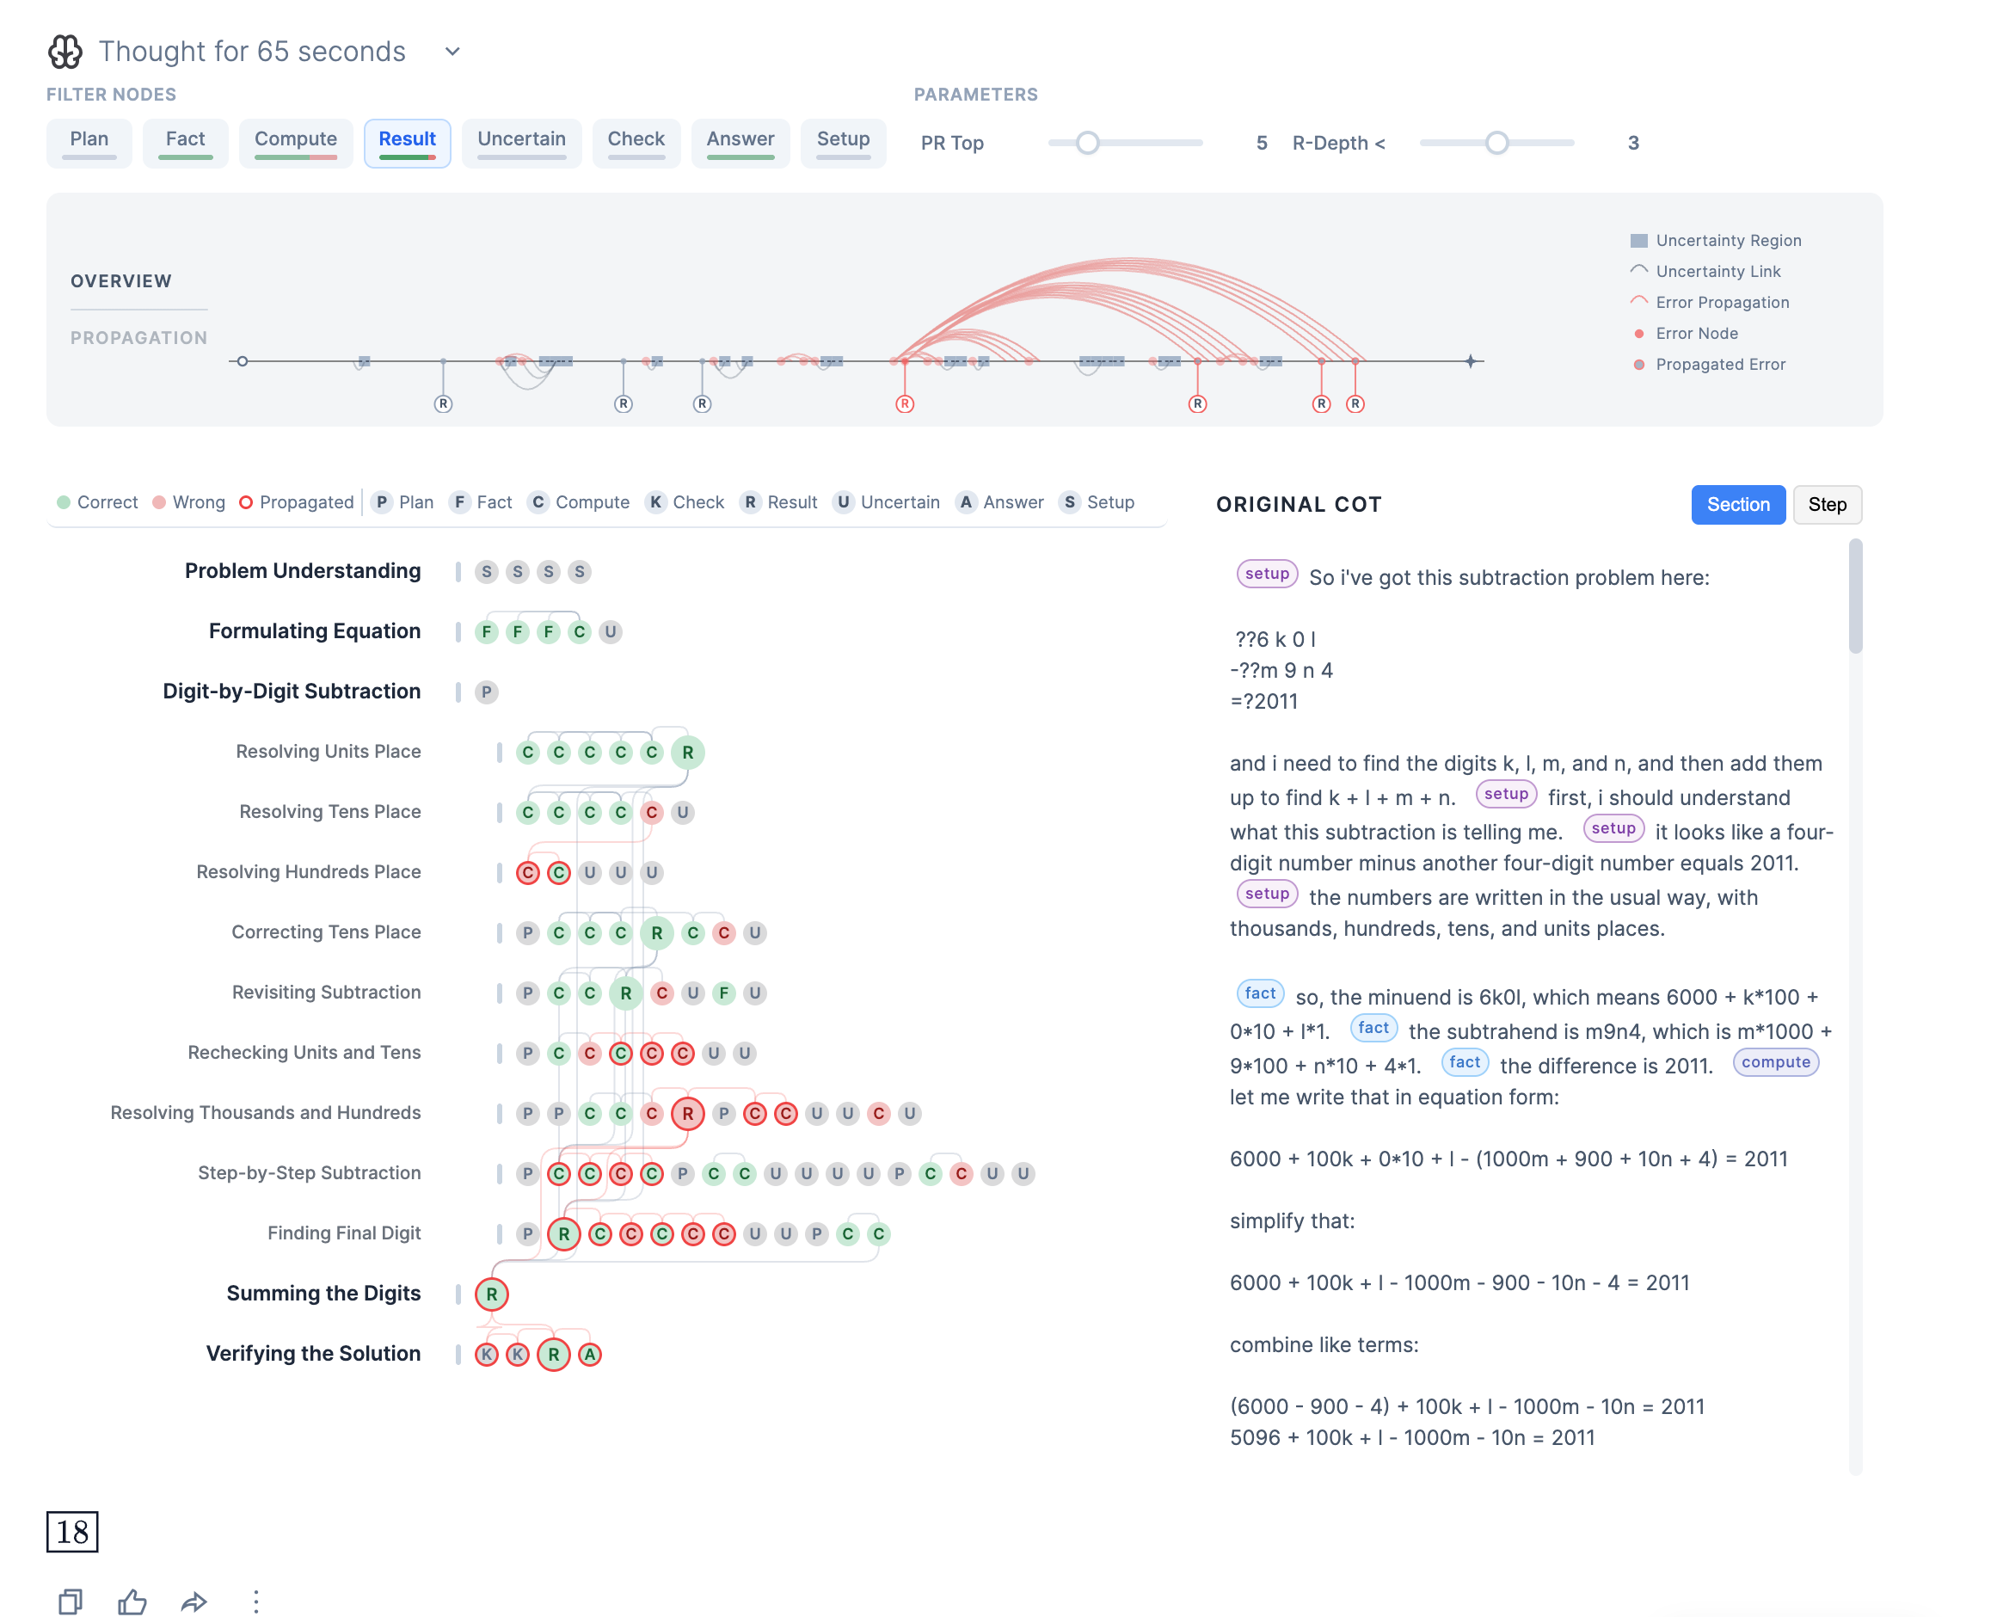
ReasonDiag UI
Background
Error Detection Pipeline
Visual Interface
Evaluation
Overview
Section View
Notes:
Video
Interface with concrete examples.

Slide 18
Overview
Background
Error Detection Pipeline
Visual Interface
Evaluation
Node
Link
Error
  an erroneous step
            error source --- propagated error
  an propagated error step
Uncertainty
uncertain step
            “uncertained” step --- uncertain step
Notes:
The whole chain, at a glance
Axis indicates the sequence of reasoning traces
Special design error and uncertainty
Node: emphasis using red, and distinguish it using the inner color for error and propagated ~
Link:
Uncertainty: which is the step that models explicitly states: “I need to double check, I ‘m not sure”
And the link represent the specific step the model is uncertain about

Slide 19

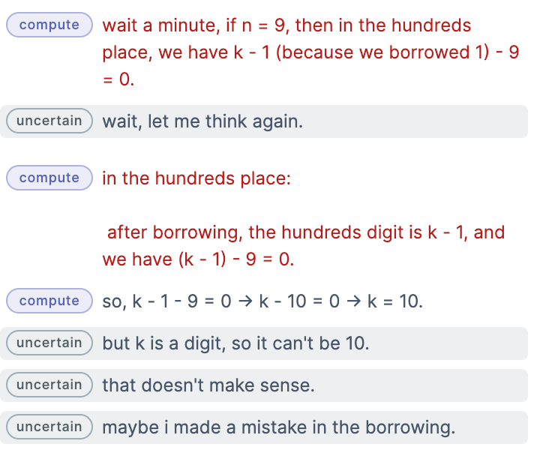
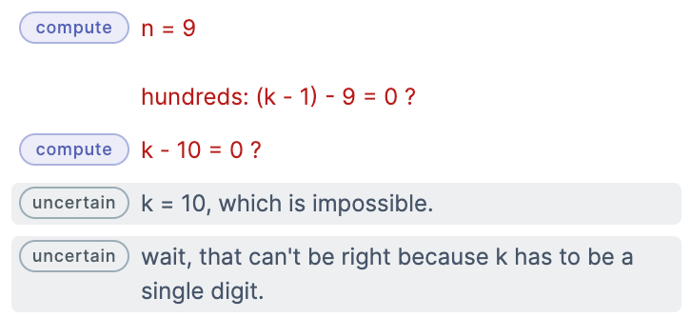
Retroactive reasoning patterns
Background
Error Detection Pipeline
Visual Interface
Evaluation
Notes:
Where we can see a set of error links but stopped at the uncertain step
Check the original cot can see that model is correcting the wrong answer it produce. Specificly it result shows that one digit is 10.
Another obvious insight is that there are one wrong step affecting lots of following steps and the finial answer

Slide 20

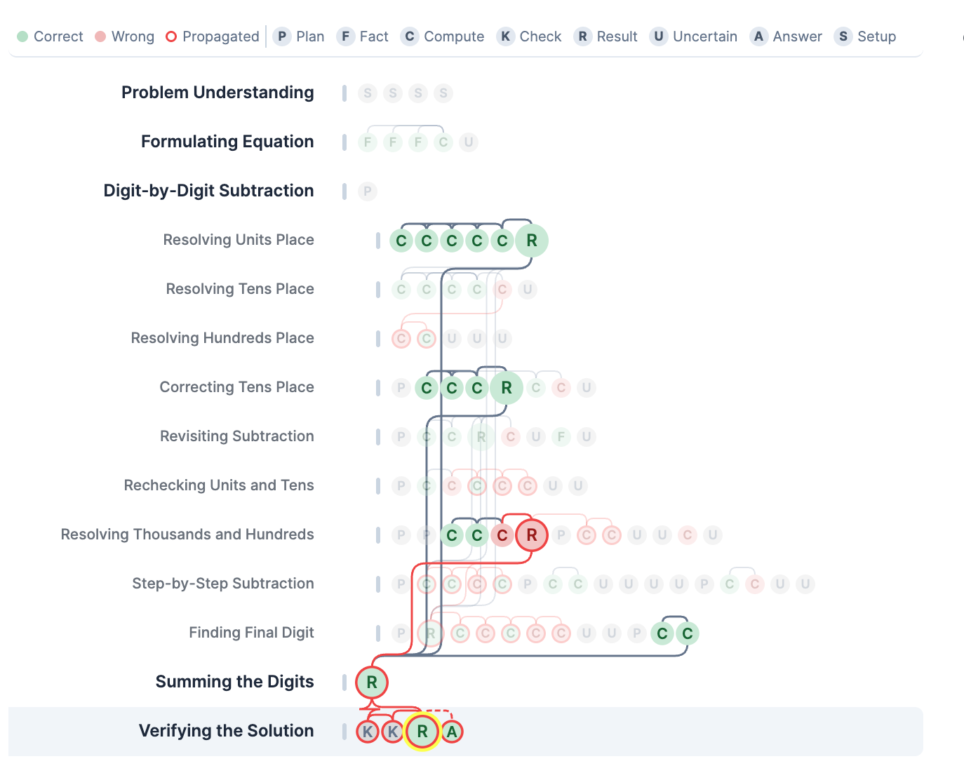
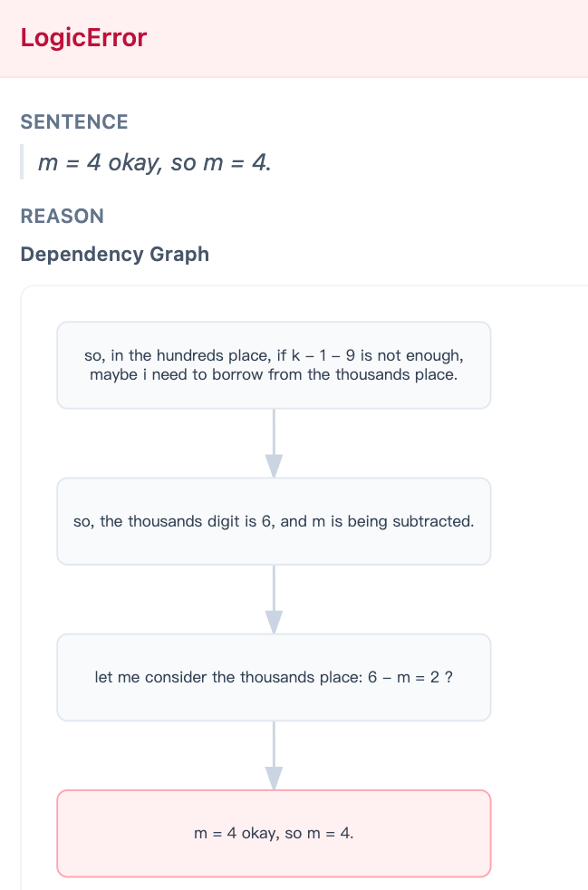
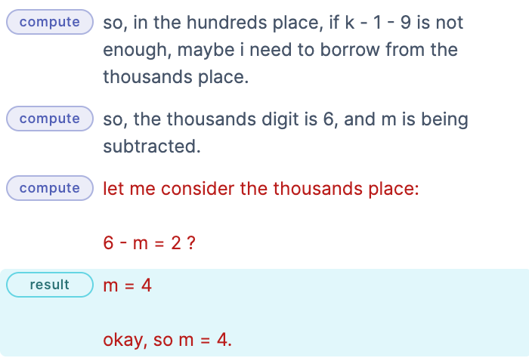
Section View
Background
Error Detection Pipeline
Visual Interface
Evaluation
Notes:
Structure, dependencies, and causes

Slide 21
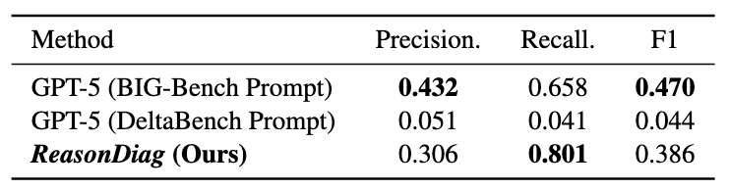
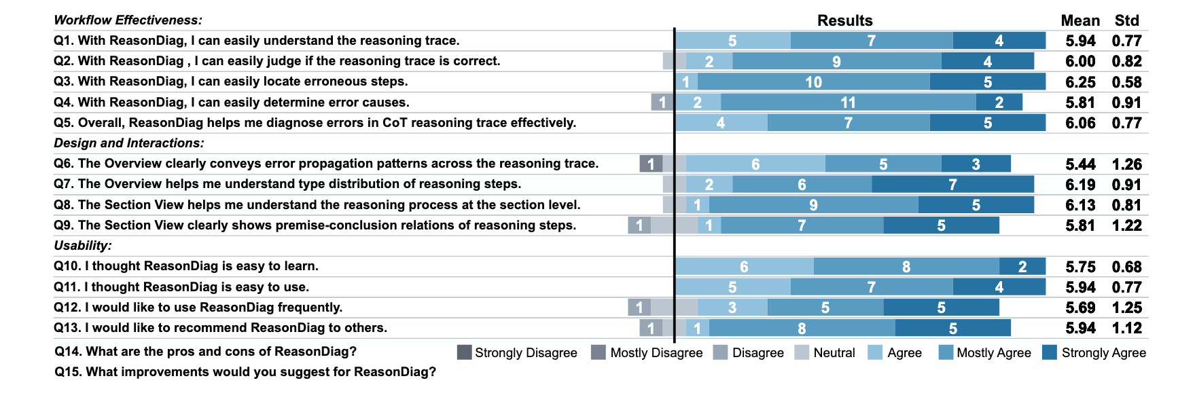
Technical Evaluation
Background
Error Detection Pipeline
Visual Interface
Evaluation
Dataset:
13 CoT samples from Deltabench
2,030 sentence-level annotations
Highest Recall
Covering the most errors
User Interviews
16 LLM users with diverse background (aged 18-31)
Effective,
Well-designed,
Good usability
Notes:
Explain why not good.
Definition of Precision/Recall/F1

Slide 22
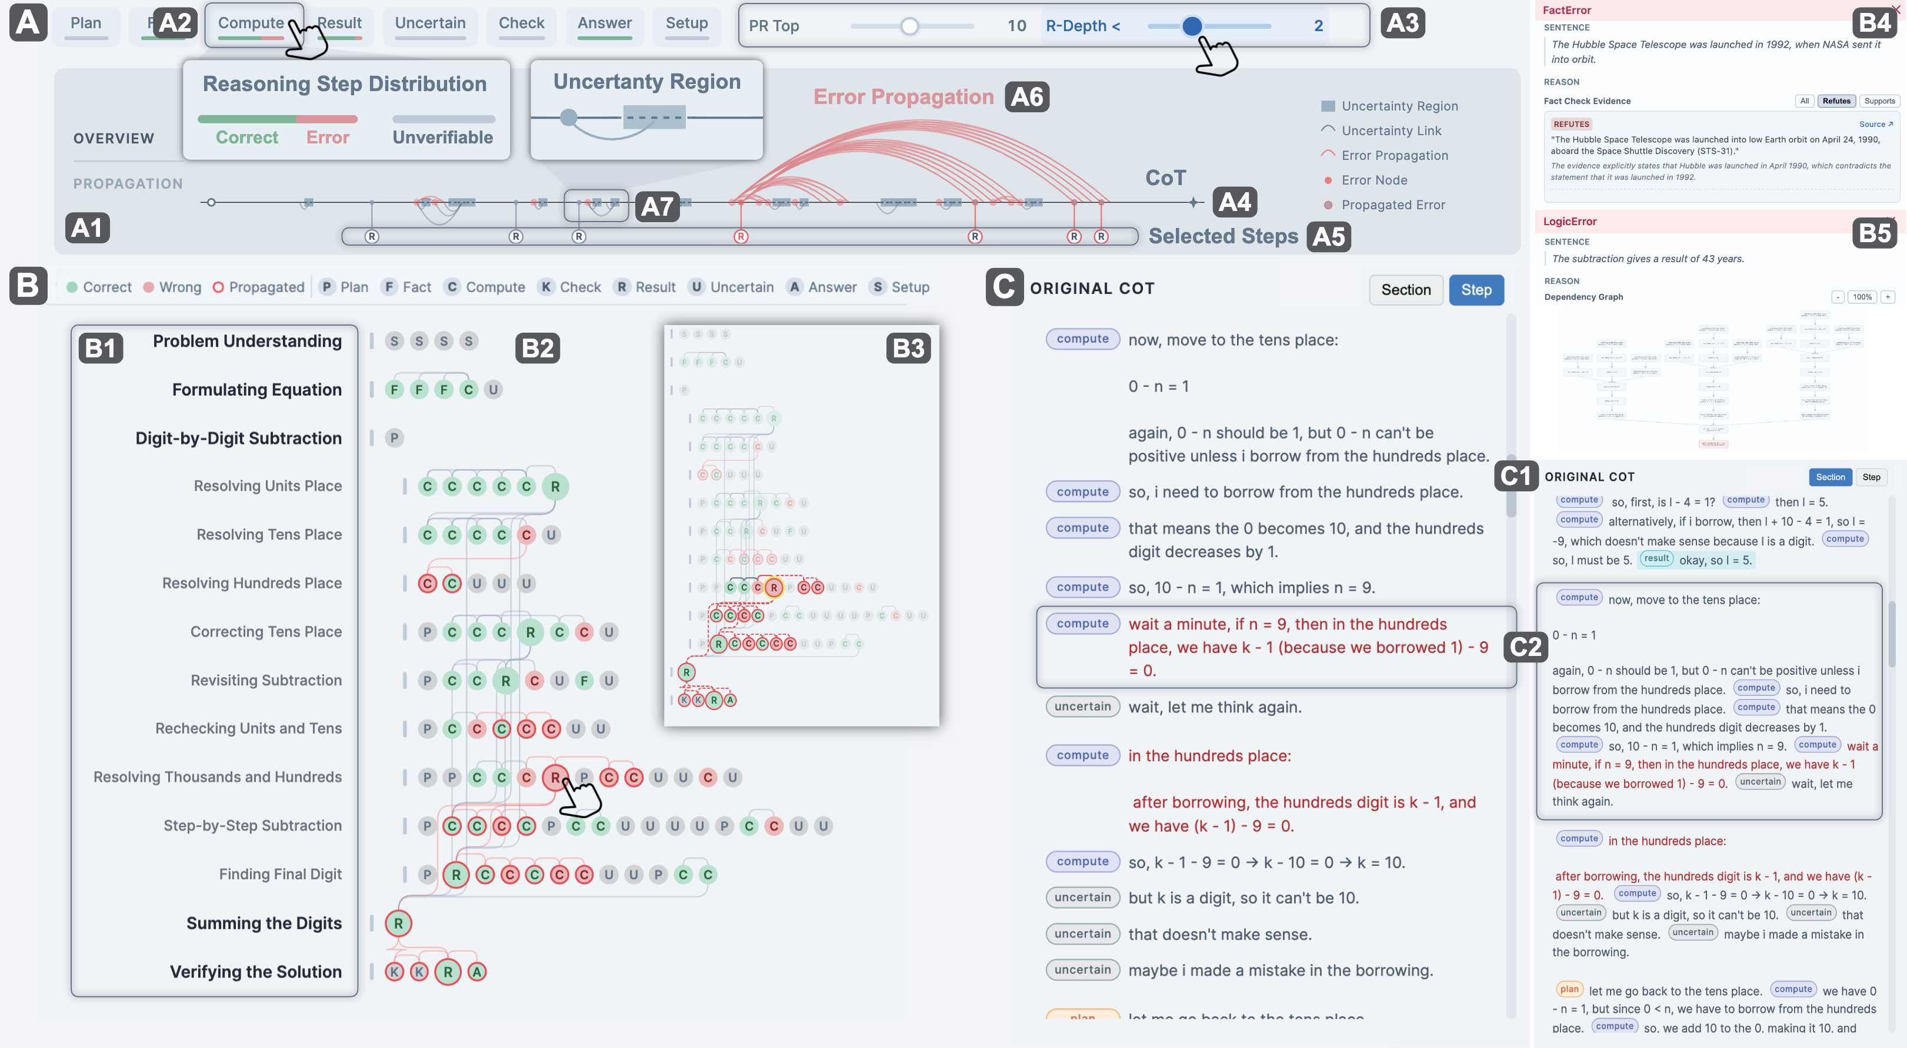
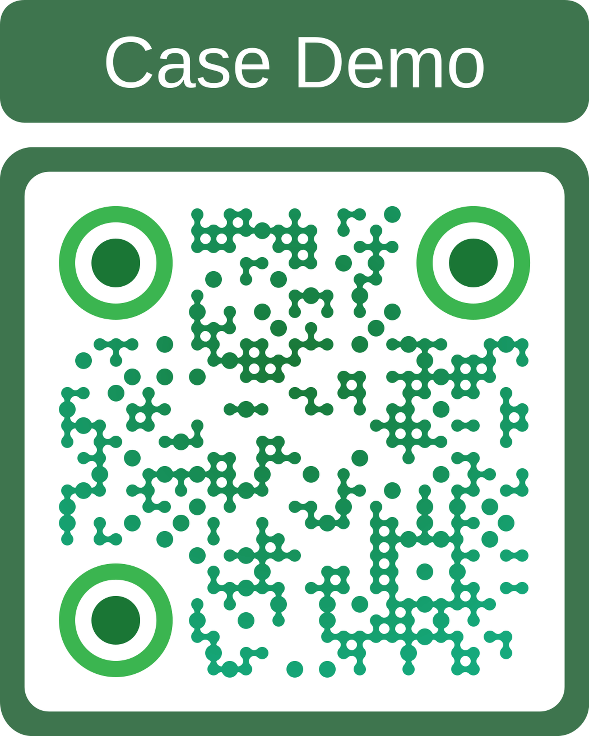

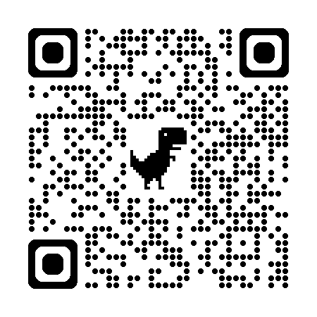
Takeaway
CoT reasoning traces generated by LLMs can be problematic
ReasonDiag is an attempt to use visualization help general users easily identify CoT reasoning errors .
Thanks for listening !
🌟 Looking for PhD position
NTU VIDA Lab
csw0109.github.io
Case Demo: csw0109.github.io/reasondiag-demo/
Dataset: huggingface.co/datasets/CoTDiagnosis/DeltaBench_CoT_Diagnosis/
Notes:
Both stages have latency: LLM translation and Z3 solving. Z3's cost depends on problem complexity, and for harder reasoning steps it can be significant. We use a timeout as a practical fallback.
ReasonDiag

Slide 23
Backup Pages

Slide 24
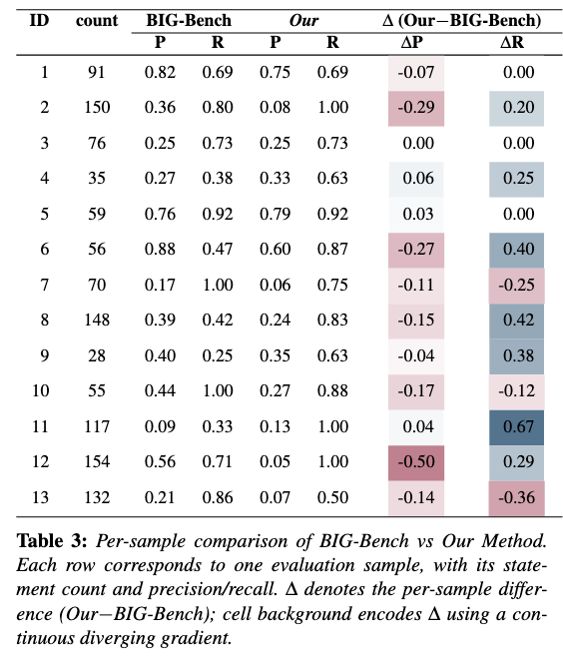
Appendix: Precision of the diagnose pipeline
44.48% of false positives come from error propagation.
  When a few early core steps are misclassified, many downstream steps inherit the flag.
In practice the interface mitigates this: a burst of flagged steps traces back to a small set of core steps that can check quickly.
User prefer AI system with higher recall than precision [1]
Future: agreement across multiple verifiers (our pipeline + prompt-based) to cut false positives while preserving recall.
1 core error
many flagged steps
[1] Kocielnik R, Amershi S, Bennett P N. Will you accept an imperfect AI? exploring designs for adjusting end-user expectations of AI systems[C]//Proceedings of the 2019 CHI conference on human factors in computing systems. 2019: 1-14.
Notes:
P

Slide 25
Appendix: Limitations and future works
Visual clutter at scale
The semantic gap
Dense cross-links obscure structure on 100+ step traces.
→ adaptive granularity: aggregate simple ops into composite nodes.
Locating a wrong step is relatively easy; explaining WHY a logic error is wrong is not.
→ AI-assisted explanations + interactive debugging (edit / fix steps).
Precision
Generalizability
Many false positives come from propagation of a few core errors.
→ agreement across multiple verification methods, keeping high recall.
Validated on verifiable domains (math, logic, retrieval).
→ softer encodings for creative / legal text: semantic drift, plausibility; agentic pipline.
Notes:
Both stages have latency: LLM translation and Z3 solving. Z3's cost depends on problem complexity, and for harder reasoning steps it can be significant. We use a timeout as a practical fallback.

Slide 26
Appendix: Need of Diagnose CoT
Reasoning is relevant to the result:
  High correlation with the reasoning process result with the final output.
CoT is naturally interpretable:
  Easier for user to interpret CoT than internal components
“Judge a person by the action not the thoughts”
Notes:
CoT is what users read and act on. Errors in the trace miscalibrate trust — regardless of what happens inside the model.

