Slide 1
KG4Vis: A Knowledge Graph-Based Approach for Visualization Recommendation
Haotian Li^{1,2}
Yong Wang²
Songheng Zhang²
Yangqiu Song¹
Huamin Qu¹
Notes:
Hello everyone, this is Haotian Li. Today I am going to present KG4Vis: A Knowledge Graph-Based Approach for Visualization Recommendation. This paper is a joint study by researchers from the Hong Kong University of Science and Technology and Singapore Management University.

Slide 2
Introduction
Motivation
Overview
Method
Evaluation
Discussion
Notes:
This is today's agenda and we will first introduce our motivation and the overview of the proposed method.

Slide 3
Motivation
The barrier of creating effective visualizations is high.
Notes:
Visualization is widely applied in various domains nowadays. However, existing tools for building visualizations require users to be familiar with their data and visualization design rules. Some packages like d3 and vega-lite even need programming skills. These requirements result in a high barrier of creating effective visualizations.

Slide 4
Visualization Recommendation
K. Z. Hu, M. A. Bakker, S. Li, T. Kraska, and C. A. Hidalgo. Vizml: A machine learning approach to visualization recommendation. CHI, 2019.
Notes:
To make creating visualizations easier, researchers have proposed a series of visualization recommendation tools to recommend visualizations for an input dataset.
Existing visualization recommendation approaches can mainly be categorized into two classes, rule-based and machine learning-based approaches.
Rule-based methods rely on empirical studies on visualizations and need enormous human effort to compile a comprehensive list of rules.
Thus, data-driven ML-based methods are proposed to address the limitation of rule-based methods. However, the black-box nature of ML-based methods makes models hard to be monitored and the recommendation results are not explainable to normal users.

Slide 5
Research Question
Can we achieve visualization recommendation that requires no manual specifications of rules and guarantees good explainability?
Notes:
Thus, there is a new research question: Can we achieve visualization recommendation that requires no manual specifications of rules and guarantees good explainability?

Slide 6
KG4Vis
Our knowledge graph (KG)-based visualization recommendation approach is data-driven and explainable.
Notes:
In this paper, to address the research question, we propose KG4Vis, a data-driven and explainable approach for visualization recommendation based on knowledge graph.
Knowledge graph provides an intuitive and explicit way to model the relationship between data and visualizations.
In our approach, we first describe each data-visualization pair with a set of data features and several visual design choices.
Then the features, design choices and data columns are linked to form a knowledge graph.
Based on the knowledge graph, the embeddings of entities and relations are learned.
These embeddings are further used for generating visual design rules and inferring how a new dataset can be visualized.

Slide 7
Introduction
Method
Feature Extraction
KG Construction
Embedding Learning
Inference
Evaluation
Discussion
Notes:
In the next few slides, we will briefly introduce the method of KG4Vis

Slide 8
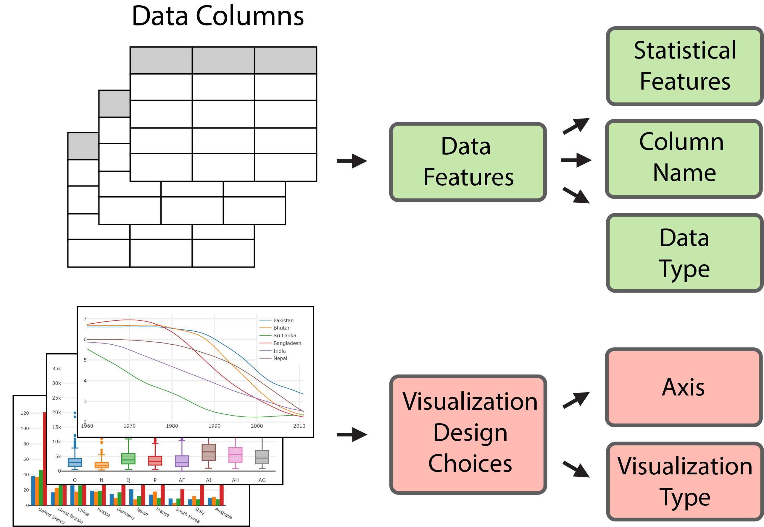
Feature Extraction
K. Z. Hu, M. A. Bakker, S. Li, T. Kraska, and C. A. Hidalgo. Vizml: A machine learning approach to visualization recommendation. CHI, 2019.
Notes:
In the first step, we extract the data features and visualization design choices from data-setvisualization pairs.
We follow VizML to extract a comprehensive list of features. They are designed to reflect the characteristics of a data column, such as the data types and the statistical features of values.
And the features include both continuous and categorical features. For example, the standard deviation of values in a data column and if outliers exist in the column.
The visual design choices in our paper are mainly about the arrangement of axes and the visualization types such as line charts or scatter plots.

Slide 9
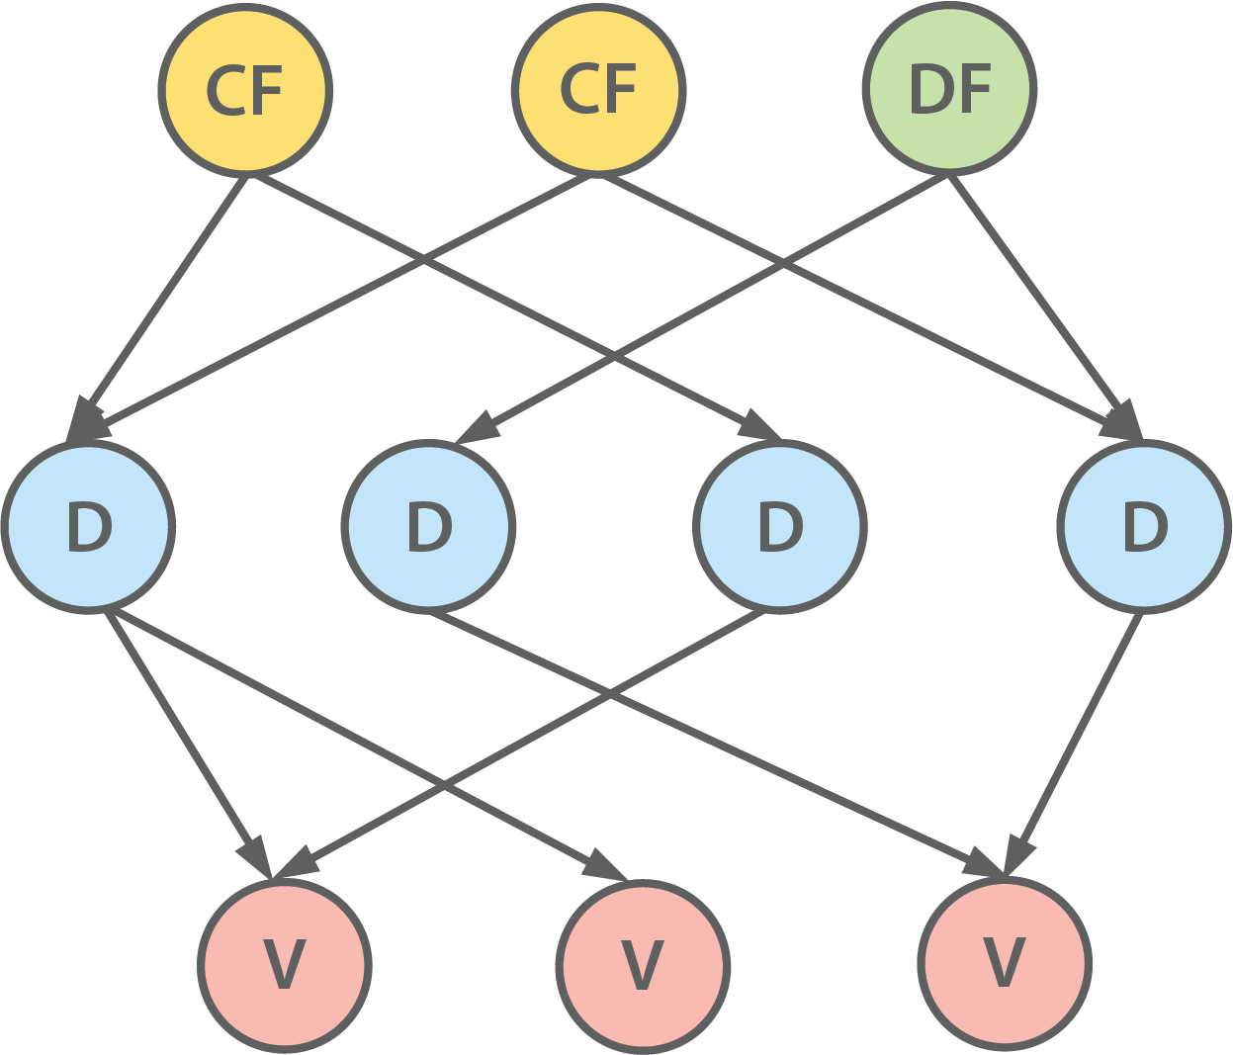
KG Construction
Entities:
Discretized continuous features
Use each interval after discretization as an entity
We employ a discretization algorithm based on minimum description length principle (MDLP)
Categorical features
Data columns
Visual designs
Relations:
Defined based on entity types
U. M. Fayyad and K. B. Irani. Multi-interval discretization of continuous valued attributes for classification learning. IJCAI, 1993.
Notes:
After extracting features, we construct the knowledge graph to model the complex mappings from these features to visualizations.
The first step is to define entities and relations.
Each categorical feature, visual design or data column is easy to be represented as an entity in the knowledge graph.
However, one critical issue is how we can transform a continuous data feature to entities.
To handle this issue, we propose to discretize a continuous feature to several intervals first and use each interval as an entity.
Here we apply an algorithm based on minimum description length principle to discretize the features since it can automatically decide the number of intervals and consider the distribution of visualization types.
The relations is then defined accordingly to connect entities.

Slide 10
A Example KG
Notes:
Here is an example shows how partial KG is constructed for a dataset-visualization pair.
Features and visual designs of the dataset-visualization pair in the first block are extracted as the second block shows.
Then they are treated as entities and connected with corresponding relations as the third block shows.

Slide 11
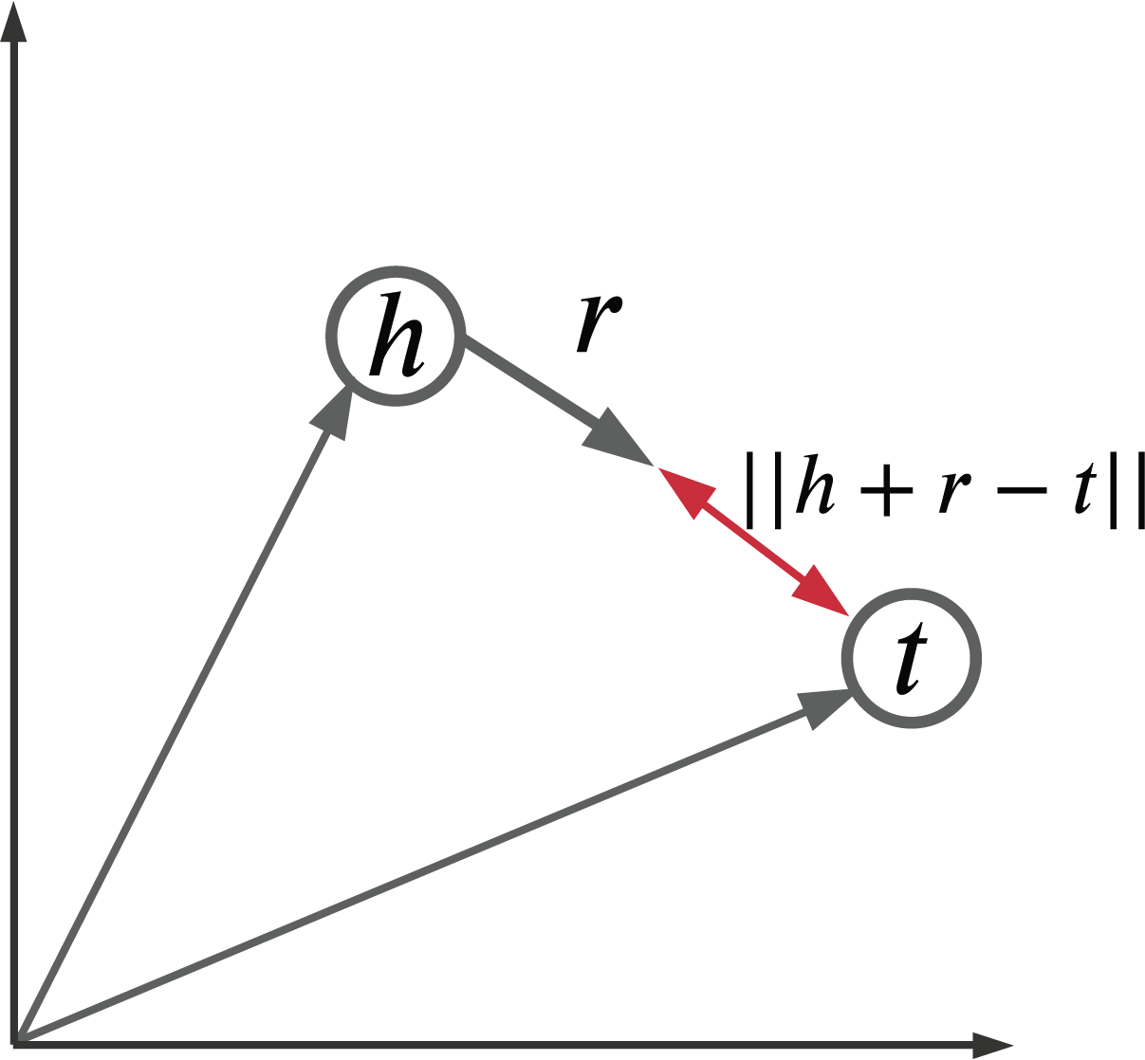
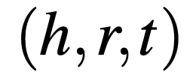
Embedding Learning
Triplet (denotes a edge in KG):
or
TransE assumption:
TransE scoring function (measures the possibility of a triplet):
A. Bordes, N. Usunier, A. Garcia-Duran, J. Weston, and O. Yakhnenko. Translating embeddings for modeling multi-relational data. NeurIPS, 2013.
Z. Sun, Z. Deng, J. Nie, and J. Tang. Rotate: Knowledge graph embedding by relational rotation in complex space. ICLR, 2019.
Notes:
In the next step, we use TransE, a widely used knowledge graph embedding model, to generate the embeddings of entities and relations. The reason why embeddings are used is that they are easy to be manipulated and thus facilitates our following inference.
In a Knowledge Graph, each edge can be represented as a triplet including a head entity, a relation and a tail entity.
The basic idea of TransE is simple. The relation between a head entity and a tail entity can be approximately represented by a translation between them.
Thus the possibility of a triplet’s existence is defined as the negative distance between the translated head entity and the tail entity.
In our paper, we utilize an improved TransE model with self-adversarial negative sampling, which is proposed to enhance the performance of embedding learning.

Slide 12
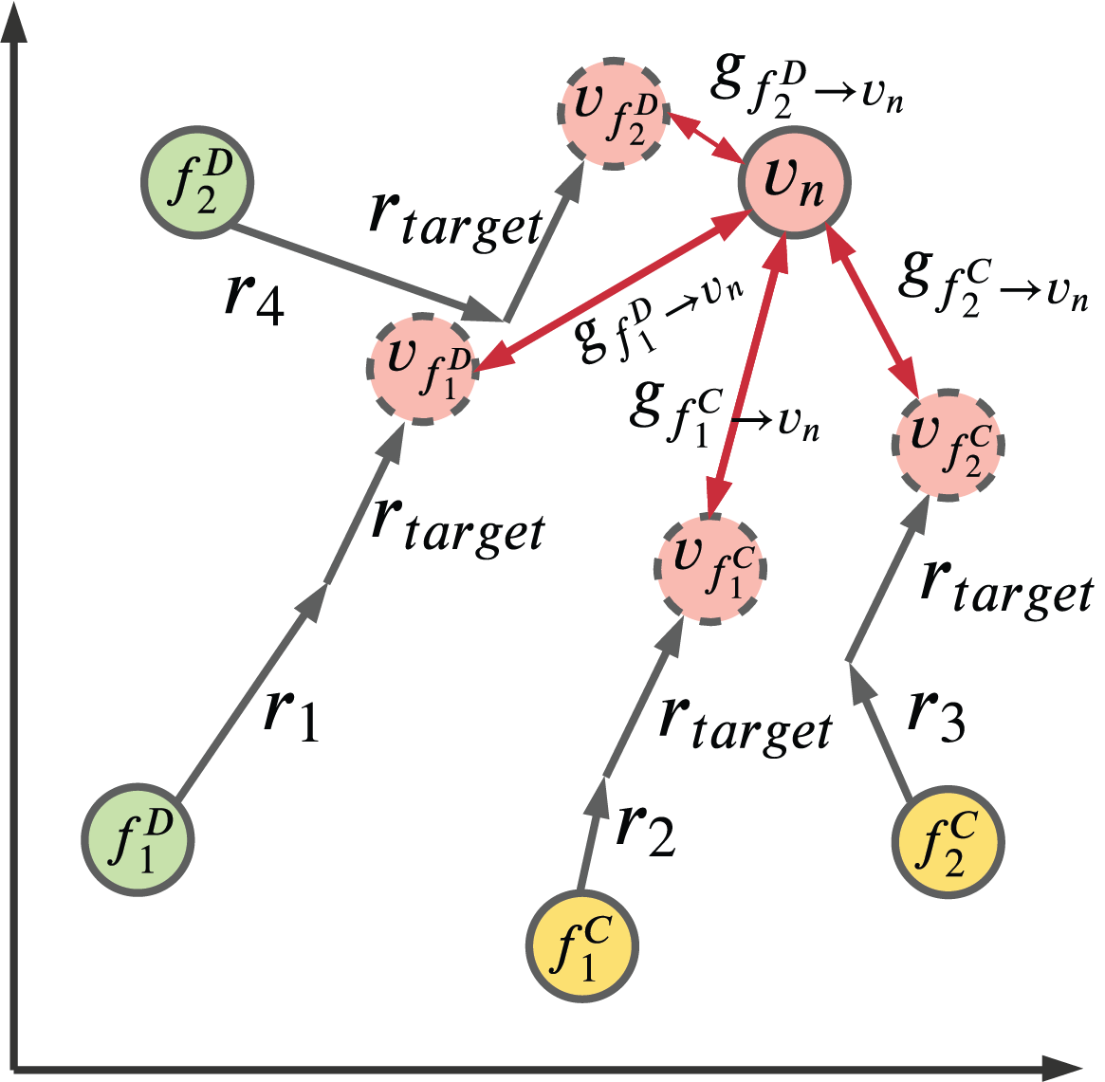
Inference
Rule structure:
or
Inference steps:
1. Compute rule score (possibility of the rule):
2. Aggregate all suitable rules' scores of a data column:
3. Recommend the design with the highest score
Notes:
In the previous step, we get the embedding of each entity or relation. These embeddings are used to generate rules and infer the visual designs of a new dataset.
Here a rule indicates how a data column is visually encoded given a certain feature.
To learn the possibility of each rule, we need to conduct two translations on the embedding of the feature entity as the figure shows.
Let's take f_1^c as an example.
The first translation is to approximate the embedding of an imaginary data column which is only connected by f_1^c.
The second translation is to infer how the imaginary data column will be visually represented.
The distance between the embedding after two translations and a visual design choice v_n shows the possibility of the rule.
Then, we aggregate all rules used by the data column to compute the scores of all design choices and recommend the one with the highest score.

Slide 13
Introduction
Method
Evaluation
Quantitative Evaluation
User Study
Case Study
Discussion
Notes:
To extensively evaluate KG4Vis, we conducted quantitative comparisons, a user study and case studies.
The evaluations are based on more than 80,000 dataset-visualization pairs from VizML corpus.

Slide 14
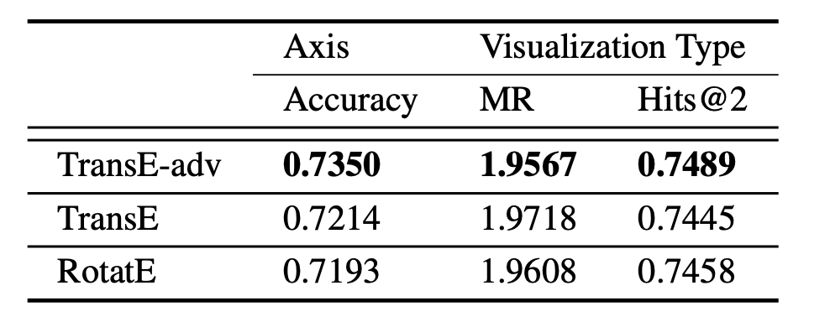
Quantitative Evaluation
Methods in comparison:
TransE-adv (used in KG4Vis): TransE with self-adversarial negative sampling
TransE: original TransE
RotatE:
Metrics:
MR: mean rank of the correct design choices
Hits@2: proportion of correct design choices ranked in the top two recommendations
TransE-adv outperforms others.
A. Bordes, N. Usunier, A. Garcia-Duran, J. Weston, and O. Yakhnenko. Translating embeddings for modeling multi-relational data. NeurIPS, 2013.
Z. Sun, Z. Deng, J. Nie, and J. Tang. Rotate: Knowledge graph embedding by relational rotation in complex space. ICLR, 2019.
Notes:
We first conducted quantitative comparisons to verify the effectiveness of TransE with self-adversarial negative sampling.
It is compared with both naïve TransE and RotatE,
RotatE is one of the latest knowledge graph embedding models. It models the relation between a head entity and a tail entity as rotation in the complex space.
In the comparison, we evaluated three approaches using the accuracy of predicted axis, the mean rank of the correct visualization type and the correction rate of top 2 recommendations.
The results show that TransE with self-adversarial negative sampling achieves the best performance.

Slide 15
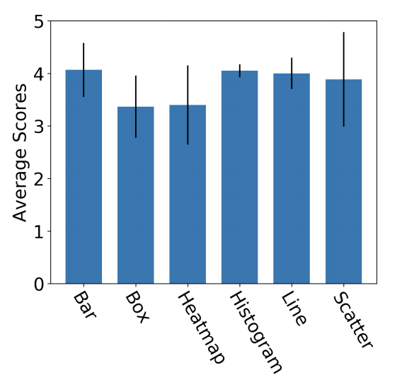
Expert Interview
Results:
Most of the rules are of high quality, but some features need to be further improved.
The recommended visualizations are correct. Users' analytical tasks should be further taken into consideration.
Average scores of recommended visualizations
Notes:
To verify the recommendation results and the correctness of generated rules, we invited 12 visualization researchers to join the expert interview. Overall speaking, the recommended visualizations met the expectation of these experts and they verified that the most of the rules make sense to them.
However, the results also show some limitations of our method. For example, the quality of rules is highly related to features and the corpus. Also, some recommended visualizations are not optimal due to the lack of consideration on users' analytical tasks.

Slide 16
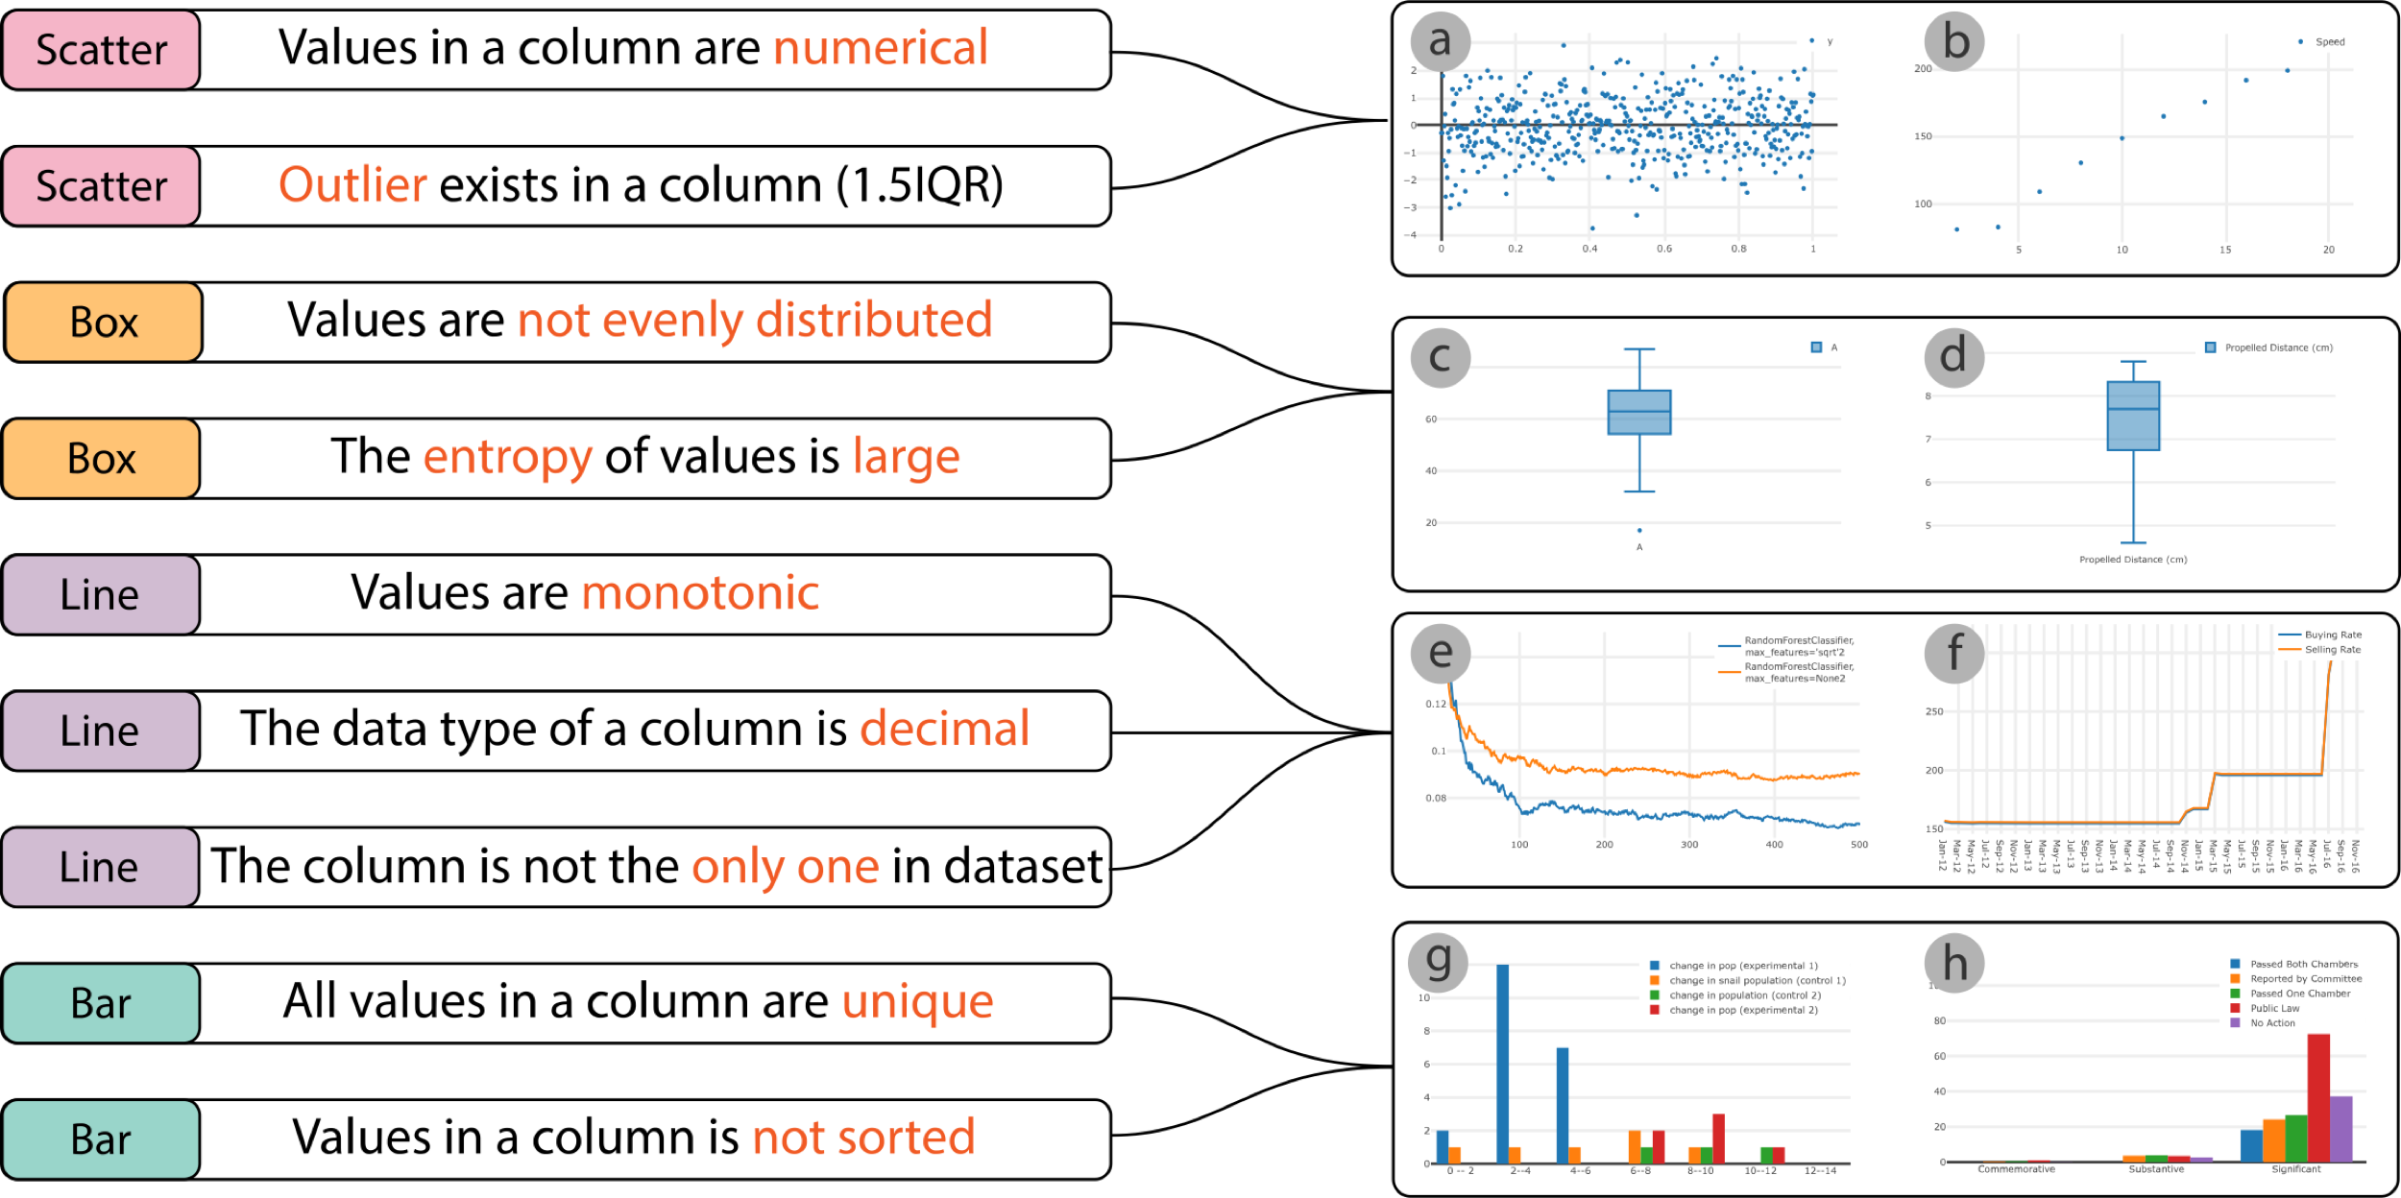
Case Study
Our methods can learn commonly used explicit and implicit visual design rules.
Notes:
In this slide, we present some highly rated rules and visualizations identified in our expert interviews. These rules match widely used visual design rules well.
For example, numerical values are usually visually encoded by scatter plots and monotonic values like temporal data are commonly represented by line charts.
Furthermore, we notice some rules that have been seldom mentioned but also reasonable such as box plots are used when values are not evenly distributed.
We often use box plots to discover and present the data distribution. In most cases, we care more about the distribution of data when it is not evenly distributed. Thus, we may plot the unevenly distributed data using box plots for observation.
This case can demonstrate that our method may help identify some implicit rules for effective visual designs.

Slide 17
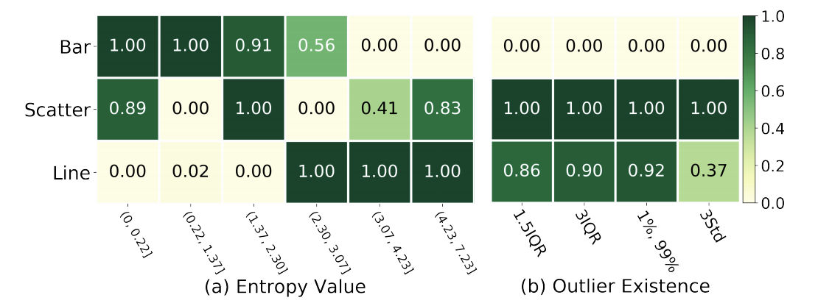
Comparison with Empirical Studies
Ours align well with empirical rules:
Bar charts are suitable for identifying clusters
Scatter plots should be used to find anomalies
B. Saket, A. Endert, and C. Demiralp. Task-based effectiveness of basic visualizations. TVCG, 2019.
Notes:
Finally, we further compared some rules with an empirical study on visual designs to check the consistency between generated rules and empirical rules.
In a previous study on effectiveness of visualizations, authors proposed several rules shown in the slide.
Othe right hand side, we present two heatmaps showing the normalized scores of rules about entropy values and outlier existence. A higher score means the rule is with higher possibility to be correct.
Compared the scores of generated rules and empirical rules, we can find that they align well. For example, bar charts are usually suggested when the entropy is small, which indicates that clusters exist in the data column. Also, we notice that when there are outliers in the data column, the scatter plot is always the most preferred visualization type.
The results of this comparison further verify the effectiveness of KG4Vis.

Slide 18
Introduction
Method
Evaluation
Discussion
Lessons
Pros and Cons
Future Work
Notes:
During developing and evaluating KG4Vis, we learned several important lessons and conclude some pros and cons of our approach. We would like to discuss them to facilitate the following studies.

Slide 19
Lessons
Knowledge graph for visualizations
Entity construction: discretize continuous features
Embedding learning: facilitate inference and rule generation
Explainability of rules
Straightforward features in conditions
Number of conditions
Notes:
In our paper, we propose to use a knowledge graph to delineate the relationship of data and visualizations. During the construction of Knowledge graph, we identify two important steps, the construction of entities and the method of embedding learning.
The major issue we met in defining entities is how to deal with continuous features. If we use each concrete value of the feature as an entity, there will be too many entities and the graph will be sparse. Thus we decide to discretize the features. There are many different algorithms to discretize continuous values such as uniform and Kmeans discretization. To avoid the manual specification of interval numbers, we apply an algorithm based on the minimum description length principle. In future studies, more advanced discretization algorithms may also be applied in this step
The second one is the algorithm for embedding learning. We extract the embeddings of entities and relations to facilitate the manipulation of them in rule generation and inference. TransE is selected as our embedding algorithm since it is intuitive and efficiency. In future, more complex algorithms can also be tested, for example, graph neural networks.
Also, according to our observation in development and expert interviews, we found the generated rules should follow some criteria to make them easily understood by users, such as straightforward features and less conditions in rules.

Slide 20
Pros and Cons
Compared with rule-based methods
Have better extendability and require less human effort
Rely on the quality of corpus
Compared with ML-based methods
Improve the explainability
Have potential performance drop
Notes:
We also conclude some pros and cons of our approach compared to other two classes of methods. Compared with the rule-based methods, KG4Vis is also explainable, but has better extendability, since it can derive rules automatically from an existing corpus. Meanwhile, the corresponding limitation of KG4Vis is that the quality and coverage of the rules depend on the corpus.
Compared with ML-based methods, it is also data-driven and with higher explainability. However, compared to other ML models, the performance can be further improved. A possible reason of slightly worse performance is that it cannot consider non-linear mapping from data to visualizations as well as neural networks.

Slide 21
Future Work
Introduce more visual designs such as color usage
Consider analytical tasks and cross-column data features
Extend to more visualization types including infographics
Notes:
Finally, we would like to propose some potential future work along this direction.
The first one is to consider more visual designs such as color usage and layout.
Another one is to take users' analytical tasks and cross-column features into account to improve the recommendation performance
Some other visualization types such as infographics can also be explored

Slide 22
Take-home Message
Knowledge graph provides an intuitive way to model the relationship between data and visualizations.
Representing entities and relations with embeddings facilitates the further inference and the rule generation.
Many factors affects the explainability of visualization rules, such as the complexity of features and the number of conditions.
Notes:
At the end of this talk, here are some take home messages:
First, Knowledge graph provides an intuitive way to model the relationship between data and visualizations. More scenarios of KG for visualizations can be explored.
Second, Representing entities and relations with embeddings facilitates the further inference and the rule generation.
And the last one is that many factors can affect the explainability of visual design rules, such as the complexity of features and the number of conditions.

Slide 23
KG4Vis: A Knowledge Graph-Based Approach for Visualization Recommendation
https://kg4vis.github.io/
Notes:
Thanks for listening and I am happy to answer questions from the audience.

