Slide 1
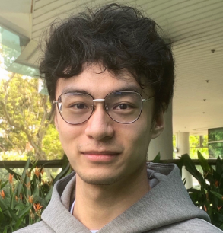
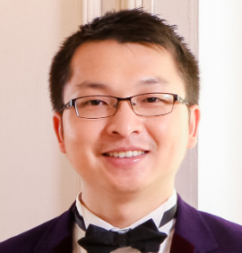
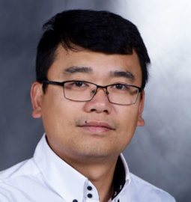
VACSEN: A Visualization Approach for Noise Awareness in Quantum Computing
Shaolun
RUAN
Yong
WANG
Weiwen
JIANG
Ying
MAO
Qiang
GUAN
Notes:
Hello everyone, thank you for attending this presentation.
My name is Shaolun RUAN, and I’m a PhD student from Singapore Management University.
In this video, I will present our work “VACSEN: A Visualization Approach for Noise Awareness in Quantum Computing”.
This work is in collaboration with my advisor Prof. Yong Wang, and Prof. Weiwen Jiang, Ying Mao, and Qiang Guan.

Slide 2
VACSEN: A Visualization Approach for Noise
Awareness in Quantum Computing
Background
Motivation
Approach
Evaluation
Conclusion
Notes:
The agenda of this presentation is as follows.

Slide 3
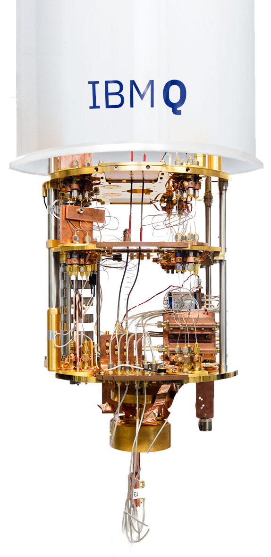
background
Quantum computers have shown a considerable speedup over classical computers [1]
[1] Arute F, Arya K, Babbush R, et al. Quantum supremacy using a programmable superconducting processor[J]. Nature, 2019, 574(7779): 505-510.
Background
Notes:
In recent years, quantum computers have shown a considerable speedup over classical computers. For example, Google demonstrated Quantum Supremacy using a 53-qubit quantum computer, where it spent 200 seconds to complete a random sampling task that would cost 10,000 years on the current classical computer. Thus, quantum computing research has attracted considerable public attention and has been rapidly growing in the past few years.

Slide 4
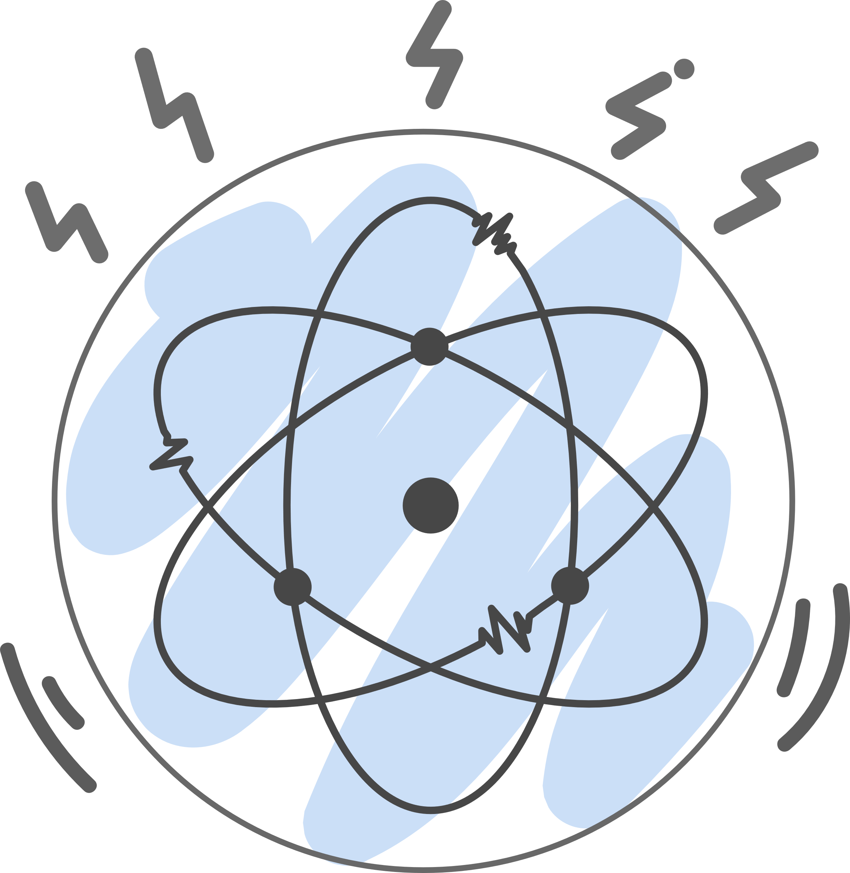
Background
Noisy Intermediate-Scale Quantum
The noise issues are severe and inevitable in today’s quantum computers [2,3]
Noisy
[2] Bharti K, Cervera-Lierta A, Kyaw T H, et al. Noisy intermediate-scale quantum (NISQ) algorithms[J]. arXiv preprint arXiv:2101.08448, 2021.
[3] Preskill J. Quantum computing in the NISQ era and beyond[J]. Quantum, 2018, 2: 79.
Background
Notes:
Despite the promising speedup over the classical counterparts, the high noise level in quantum devices is one of the key challenges to achieving the real quantum advantages in today’s quantum computers, which are well-known as Noisy Intermediate-Scale Quantum (NISQ) computers.

Slide 5
Motivation
Noise in quantum computing
Noise from fundamental components in a quantum computer
Qubits
Quantum gates
Noise from various compiled circuits
Not deterministic topology
A large number of compiled circuits
Motivation
Notes:
The reasons may be categorized as follows: first, the noise originates from quantum computer’s fundamental components, i.e., qubits and quantum gates, whose noise implicitly affects the accuracy of the results. Second, a quantum algorithm can be compiled to various compiled circuits with significantly different noise on the same quantum computer. For a large-scale quantum algorithm, the compiled circuits can be several hundred.

Slide 6
Motivation
Noisy quantum circuit execution
No tool to reflect the hidden noise
The common practice to obtain less-noisy execution results is still a trial-and-error process with a long queuing time of up to hours.
Motivation
Notes:
Although quantum computing users significantly suffer from the noisy execution for given quantum circuits. However, no uniform tool revealing the noise exists to assist the domain users. Meanwhile, due to the rapid increase of quantum computing users, we face the increasing queuing time for accessing cloud quantum computers without noise awareness. Thus, the evaluation and mitigation of noise before execution is important to avoid the waste of queuing time for unsatisfied results. Currently, the common practice to obtain less-noisy execution results is still a trial-and-error process.

Slide 7
Approach
Design Requirements
Quantum computer selection
Facilitate the temporal analysis of various noise.
Make users aware of the latest noise.
Compiled circuit selection
Provide an overview of all compiled circuits.
Enable a detailed comparison of the usages of qubits and gates.
Support a real-time compilation and fidelity validation.
User Interaction
Provide flexible user interactions and intuitive visual designs
Approach
Notes:
To bridge the research gap, we work closely with five quantum computing experts. Through a well-designed pilot study and iterative meetings for over four months, we summarize five design requirements, which are grouped into three categories: quantum computer selection, compiled circuit selection, and user interaction. Quantum computer selection supports the users to pick the appropriate quantum computer to execute the quantum circuits from a set of devices on the cloud quantum computing platform, which includes facilitating the temporal analysis of qubit and gate noise and making users aware of the latest quantum computing noise. For compiled circuit selection, VACSEN allows users to select optimal compiled circuits regarding the various noises and usage times of qubits and quantum gates, which includes providing an overview of all compiled circuits, enabling a detailed comparison of the usages of implemented qubits and gates, and supporting a real-time compilation and fidelity validation of quantum algorithms. Besides, experts also request flexible user interactions and intuitive visual designs.

Slide 8
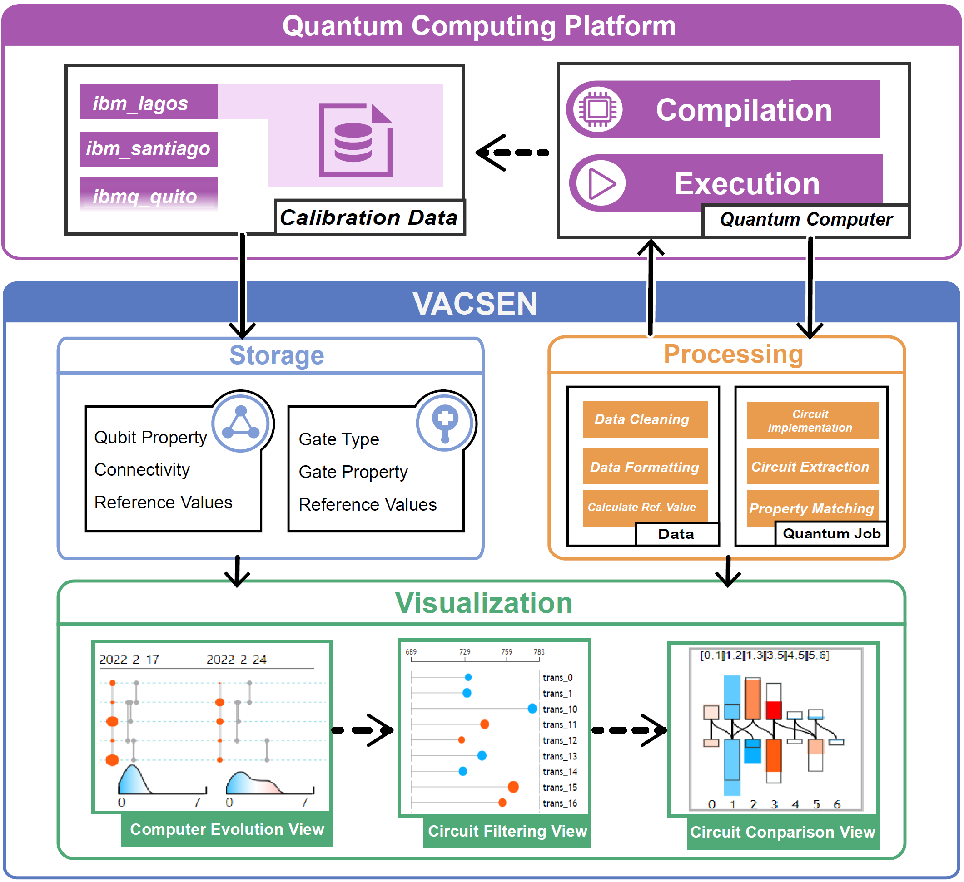
Approach
Visualization system
VACSEN consists three modules: storage module, processing module, and visualization module. The system is connected to an external cloud quantum computing platform.
Approach
Notes:
According to the design requirements, we propose a visualization system for noise awareness during quantum circuit execution. The architecture of online visualization system is shown on the right. VACSEN consists of three modules, i.e., storage module, data processing module, and visualization module. Through interacting with the system, users can access the online demo via the URL link. The quantum noise of the execution results can be mitigated for quantum users through the interaction with the visualization system, which is intuitive and easy-to-understand for both novice and experts in quantum computing.

Slide 9
Approach
Circuit-like design
Challenge: It is challenging to temporally visualize the complex noise factors as well as the qubit topological connections along a timeline.
We propose a circuit-like design to portray the quantum computer noise in each time stamp.
Approach
Notes:
First, Computer Evolution View assists users in visualizing the time-varying performance of quantum computers. We propose a circuit-like design to portray the quantum computer noise in each time stamp. As shown in the Figure, the colored circles represent the performance of qubits regarding T1 time, T2 time, and readout error. Meanwhile, the quantum gate topology is encoded by the line segments in grey. The horizontal coordinate of each line segment indicates its gate error rate, while the vertical position of two endpoints denotes the two qubits that the quantum gate operates on. Furthermore, we utilize a colored dense distribution glyph called Kernel Density Estimation to indicate the overall noise level of quantum gates.

Slide 10
Approach
Coupled bar chart design
Challenge: It is difficult to visually summarize a large number of the compiled circuits regarding the various noises and enable users to select the most appropriate one shortly.
We proposed coupled bar chart to support the in-depth comparison of multiple compiled circuits.
Approach
Notes:
Circuit Comparison View supports the in-depth comparison of multiple compiled circuits based on a novel design coupled bar chart. The upper group of bars indicates the quantum gates, and the lower group of bars indicates the qubits in a quantum computer. The color and height of each bar represent the performance and usage times of qubits and gates, while the back rectangle denotes the average usage times among all qubits and gates in a certain quantum computer.

Slide 11
Evaluation
Case study
Quantum circuits:
Two-qubit circuit
Shor’s algorithm
Participants:
Two domain experts from universities
Tasks:
Perform quantum circuit execution with noise awareness provided by VACSEN
Evaluation
Notes:
We first evaluate VACSEN via two case studies on both small-scale and large-scale quantum circuits, i.e., a two-qubit circuit and Shor’s algorithm, respectively. We invite two domain experts from Case Western Reserve University and Fordham University, both working on quantum machine learning, to perform the quantum circuit execution based on our online visualization system. The result shows that our visualization approach can effectively make them aware of the various noise in each step and further improve the fidelity compared to the random selection process. I will show an example case to illustrate the usage scenario (…)

Slide 12
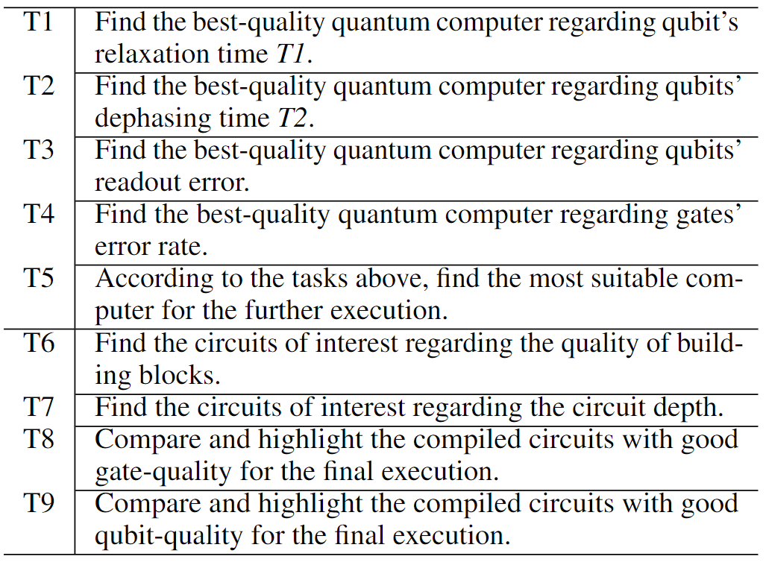
Evaluation
User interview
Participants:
12 domain experts
Tasks:
Methods
Rating for VACSEN
Feedback
Evaluation
Notes:
We further evaluate our approach via a well-designed user interview. We invited 12 participants from six different educational institutions and a national research laboratory, i.e., Pacific Northwest National Laboratory, to join our in-depth user interviews. Specifically, the participants were asked to accomplish the pre-defined tasks of selecting an appropriate quantum computer and an optimal compiled circuit for execution. Finally, we also invited every participant to rate the VACSEN system based on a 7-point Likert scale.

Slide 13
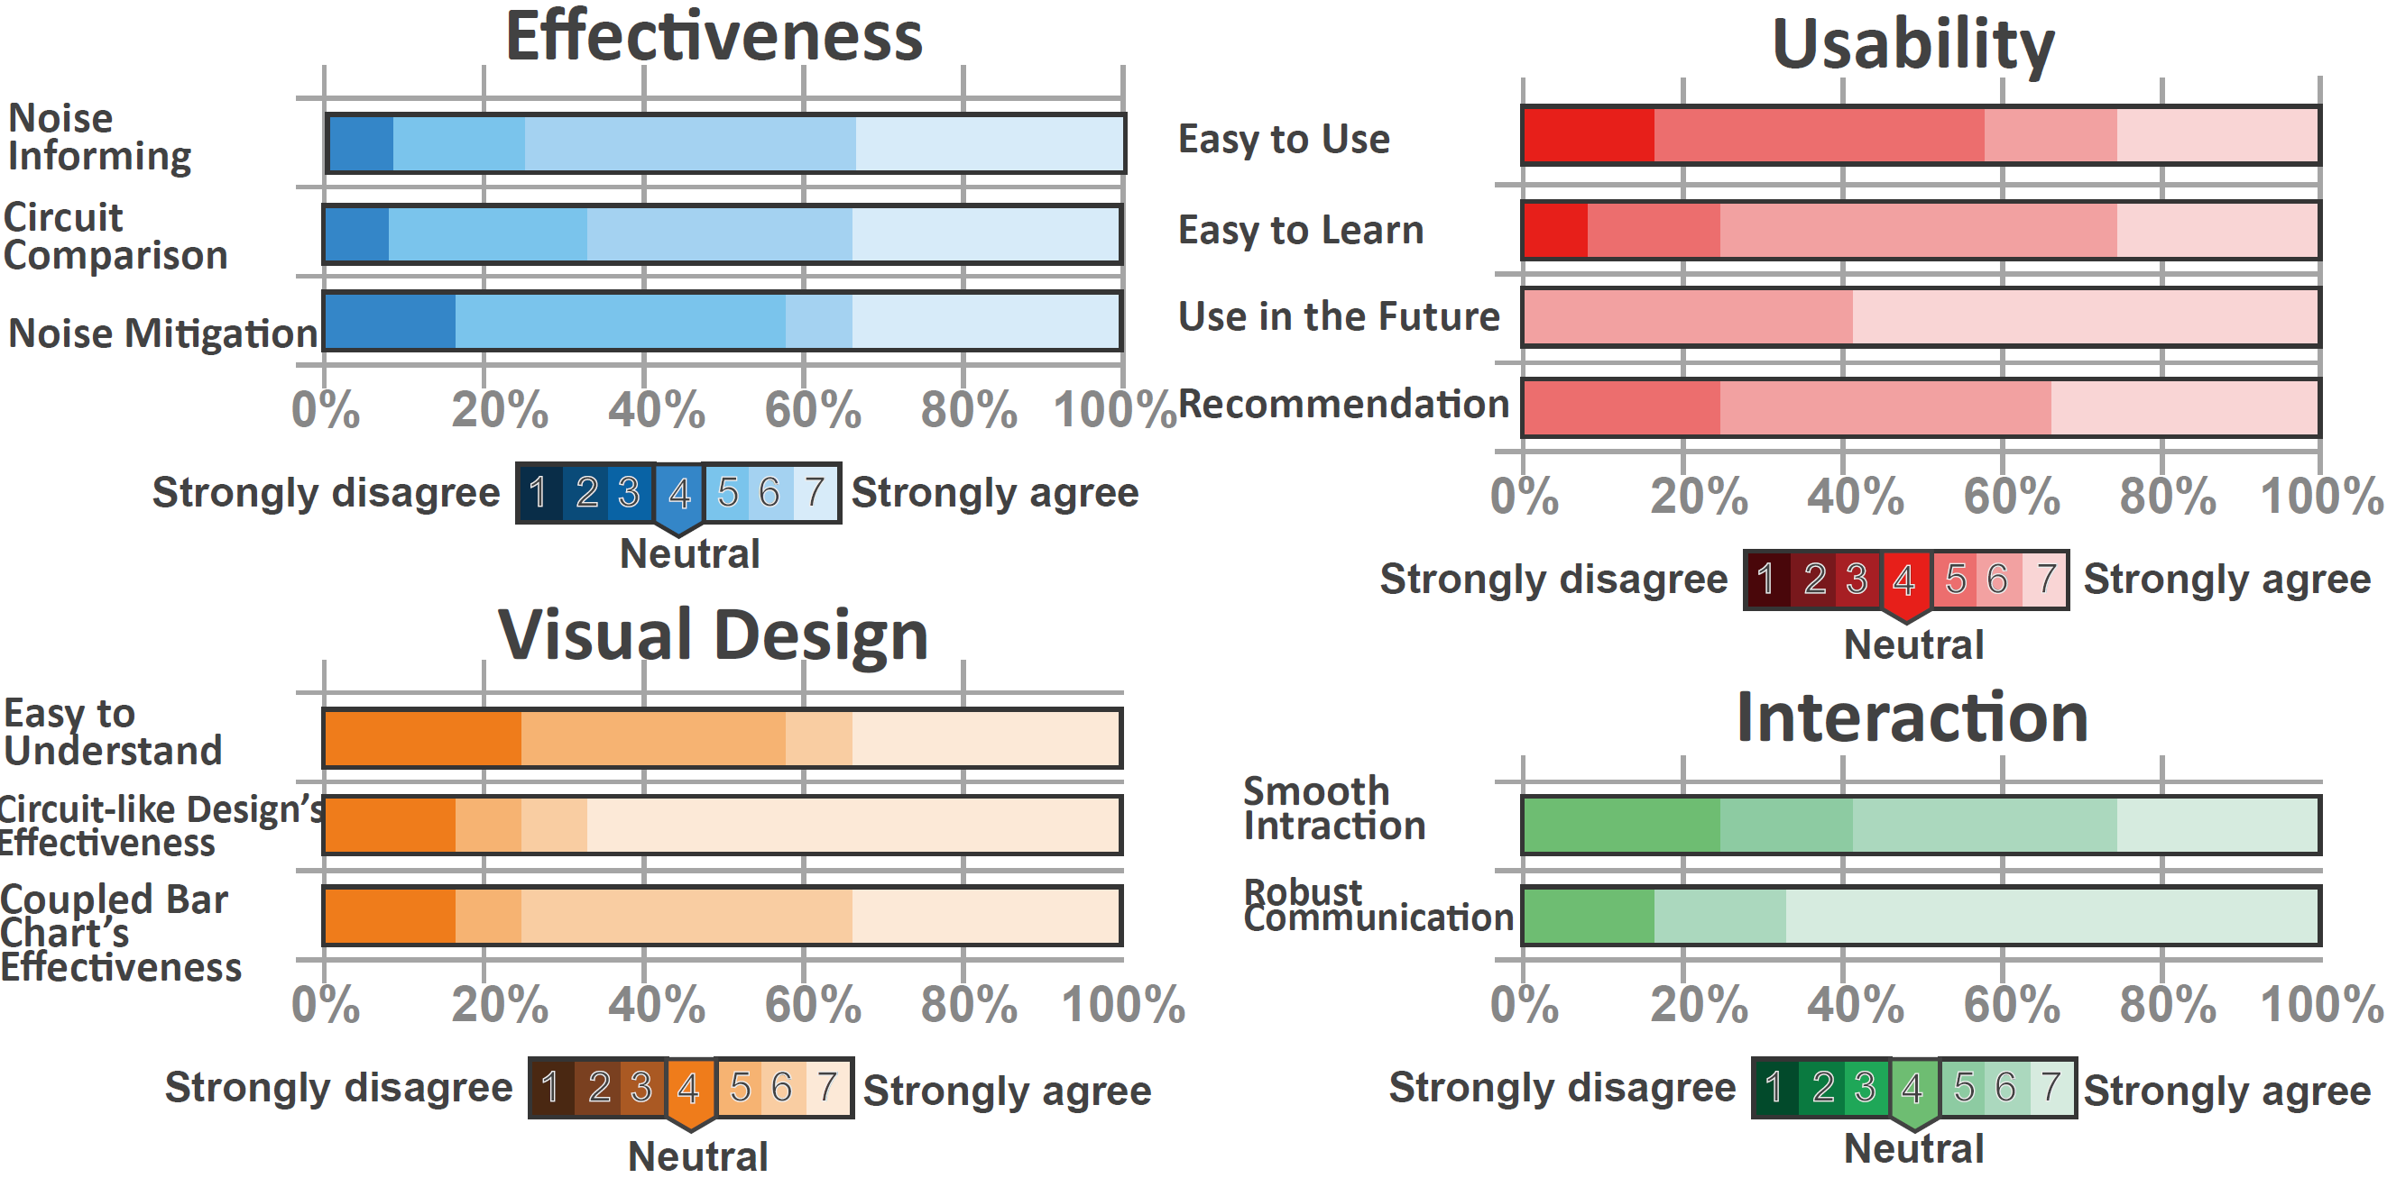
Evaluation
Results for the user interview
Likert-scale rating:
Feedback:
“I believe VACSEN will be helpful for our current research topic of quantum network routing. We can utilize VACSEN to host our different routing algorithm and get more accurate results as it can reflect various noises in real-time.”
Evaluation
Notes:
The summarization of the results is shown here.

Slide 14
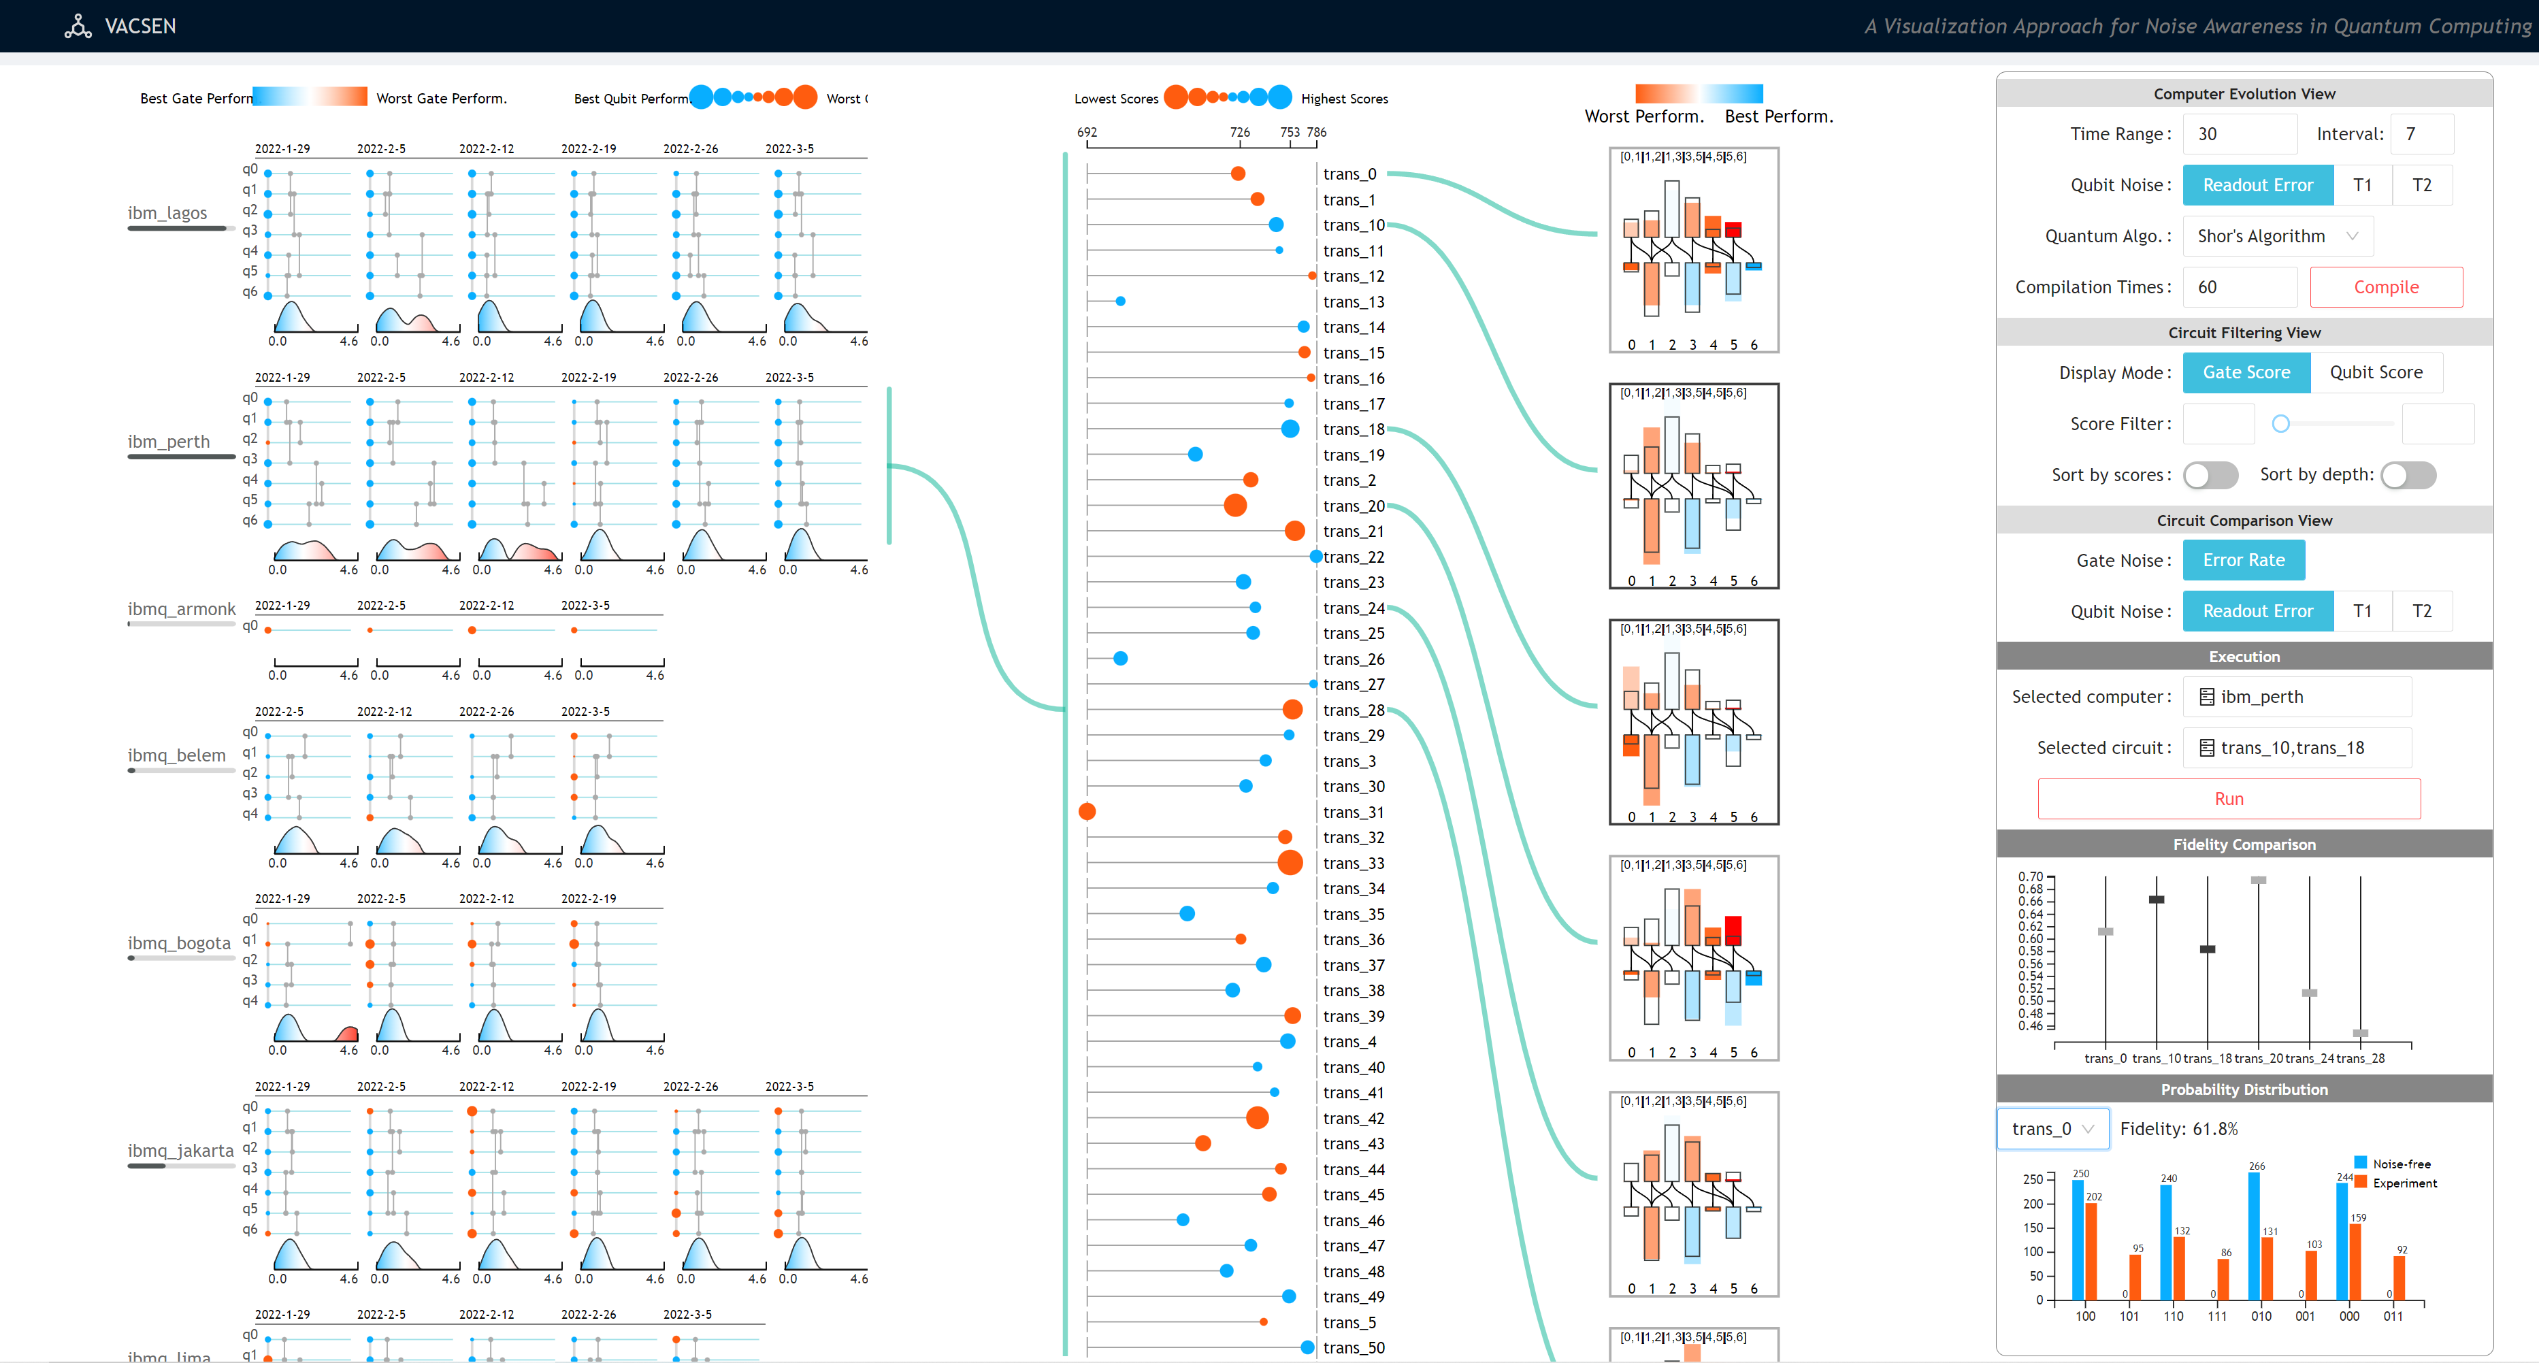
Conclusion
Conclusion
Notes:
In conclusion, we present VACSEN, ->

Slide 15
Conclusion
VACSEN supports a real-time noise awareness of quantum computers and compiled circuits, leading to a better circuit execution with higher fidelity
Conclusion
Notes:
-> an interactive visual analytics approach to support real-time noise awareness in quantum computing. To inform the visual design, we identified six design requirements for visually analyzing a quantum computing-specific problem. We proposed two novel quantum computing-specific designs, i.e., the circuit-like design and coupled bar chart, to facilitate the temporal analysis of noise in quantum computers and in-depth comparison of compiled circuits. We conducted case studies and in-depth user interviews with 12 target users to demonstrate the effectiveness of VACSEN. The results show that VACSEN can effectively make the users aware of various noises and further improve the reliability of the execution result of a given quantum circuit.

Slide 16
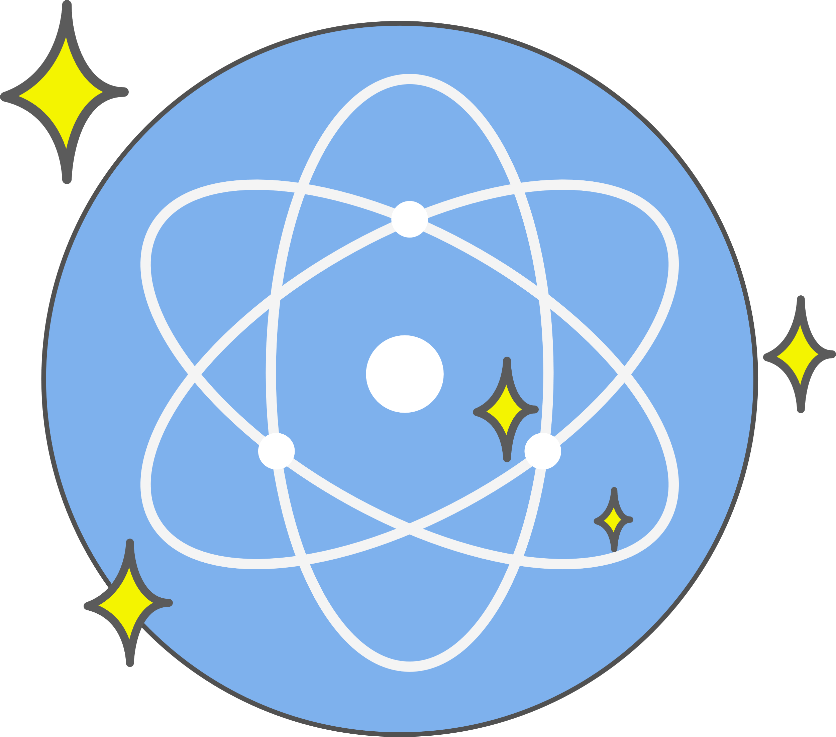
Conclusion
VACSEN
Inform users of the quantum noise
Noisy
Reliable
Conclusion
Notes:
-> an interactive visual analytics approach to support real-time noise awareness in quantum computing. To inform the visual design, we identified six design requirements for visually analyzing a quantum computing-specific problem. We proposed two novel quantum computing-specific designs, i.e., the circuit-like design and coupled bar chart, to facilitate the temporal analysis of noise in quantum computers and in-depth comparison of compiled circuits. We conducted case studies and in-depth user interviews with 12 target users to demonstrate the effectiveness of VACSEN. The results show that VACSEN can effectively make the users aware of various noises and further improve the reliability of the execution result of a given quantum circuit.

Slide 17
Thank you for your attention!
Q&A
VACSEN: A Visualization Approach for Noise Awareness in Quantum Computing
Shaolun
RUAN
Yong
WANG
Weiwen
JIANG
Ying
MAO
Qiang
GUAN
Online demo: https://vacsen.github.io/
Contact me: slruan.2021@phdcs.smu.edu.sg
My homepage: https://shaolun-ruan.com/
Notes:
That’s all for the presentation of our paper.
If you have any questions and suggestions, please feel free to contact me via the email.
My personal homepage and QR code are shown below.
Thank you for your attention!
I’m open to any questions!

